Slide 1
STRUCTURE OF SKELETAL MUSCLE
بسم الله الرحمن الرحيم
Dr.Mohammed Sharique Ahmed Quadri
Assistant Professor, Physiology

Slide 2
Objectives
By the end of this lecture, you should be able to:
Draw and label a skeletal muscle at all anatomical levels, from the whole muscle to the molecular components of the sarcomere. At the sarcomere level, include at least two different stages of myofilament overlap.
Diagram the structure of the thick and thin myofilaments and label the constituent proteins.
Describe the functional importance of the subunits.

Slide 3
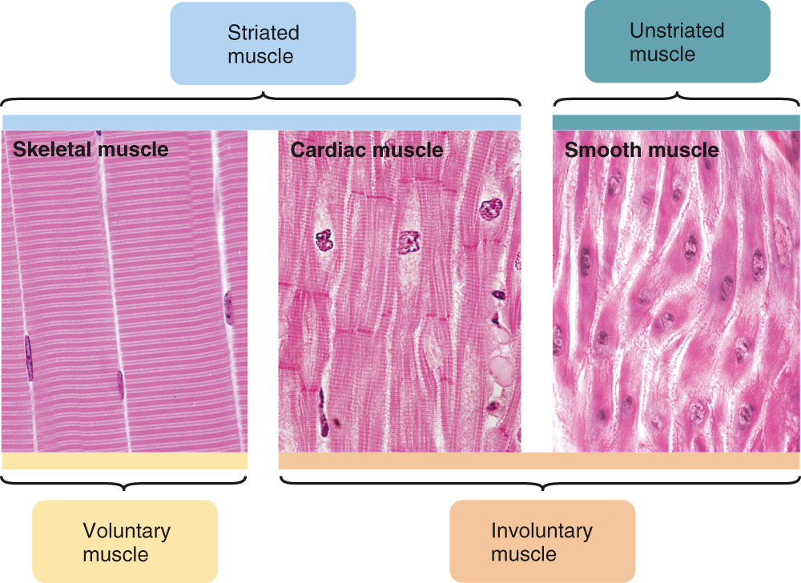
Categorization of Muscle

Slide 4
Structure of Skeletal Muscle
Skeletal muscle consists a number of muscle fibers lying parallel to one another and held together by connective tissue
Single skeletal muscle cell is known as a muscle fiber
  Multinucleated
  Large, elongated, and cylindrically shaped
  Fibers usually extend entire length of muscle

Slide 5
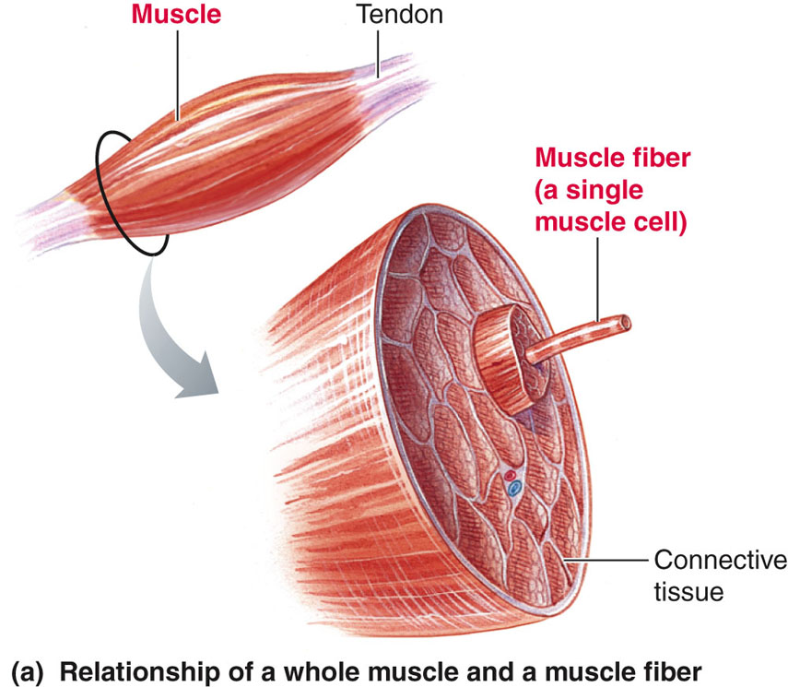

Slide 6
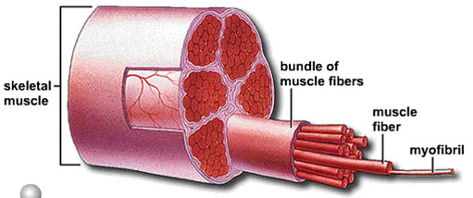
Structure of skeletal muscle

Slide 7
Structure of Skeletal Muscle
Myofibrils
  Contractile elements of muscle fiber
  Regular arrangement of thick and thin filaments
    Thick filaments – myosin (protein)
    Thin filaments – actin (protein)

Slide 8
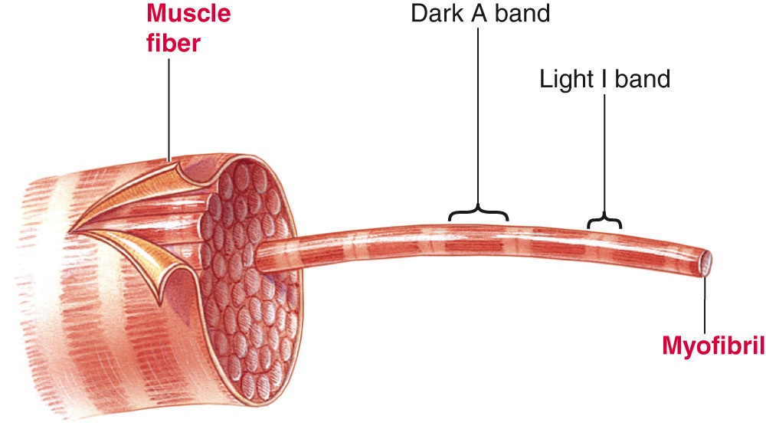
  Viewed microscopically myofibril displays alternating dark (the A bands) and light bands (the I bands) giving appearance of striations

Slide 9
Structure of Skeletal Muscle
Sarcomere
  Functional unit of skeletal muscle
  Found between 2 Z lines (connects thin filaments of two adjoining sarcomeres)
  Regions of sarcomere
    A band
      Made up of thick filaments along with portions of thin filaments that overlap on both ends of thick filaments
    H zone
      Lighter area within middle of A band where thin filaments do not reach
    M line
      Extends vertically down middle of A band within center of H zone
    I band
      Consists of remaining portion of thin filaments that do not project into A band

Slide 10
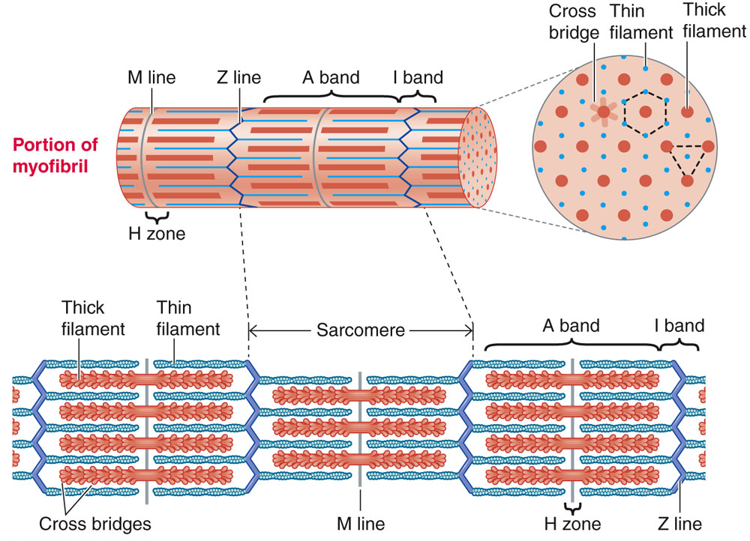
Cytoskeleton components of myofibril

Slide 11
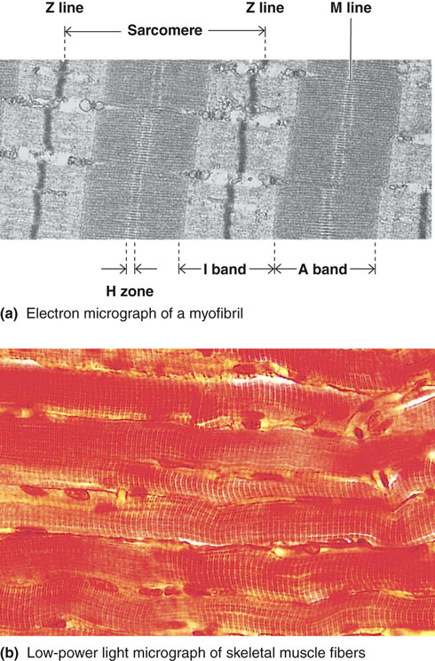

Slide 12
Myosin
Component of thick filament
Protein molecule consisting of two identical subunits shaped somewhat like a golf club
  Tail ends are intertwined around each other
  Globular heads project out at one end
Tails oriented toward center of filament and globular heads protrude outward at regular intervals
  Heads form cross bridges between thick and thin filaments
    Cross bridge has 2 important sites critical to contractile process
      An actin-binding site
      A myosin ATPase (ATP-splitting) site

Slide 13
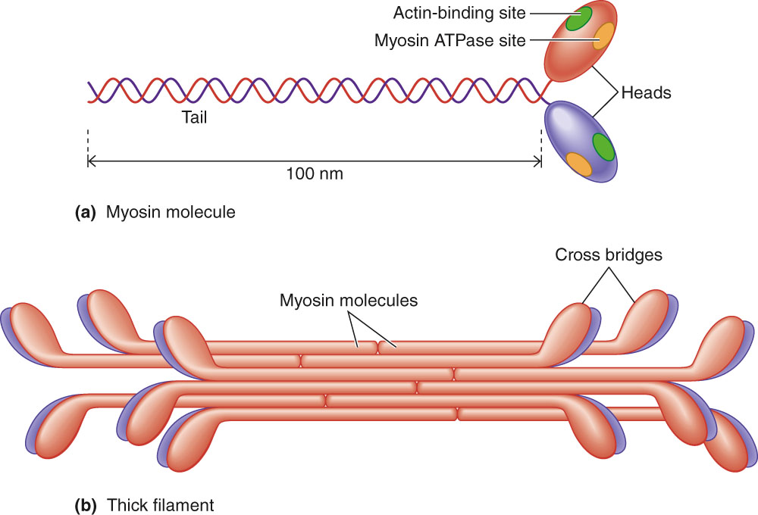
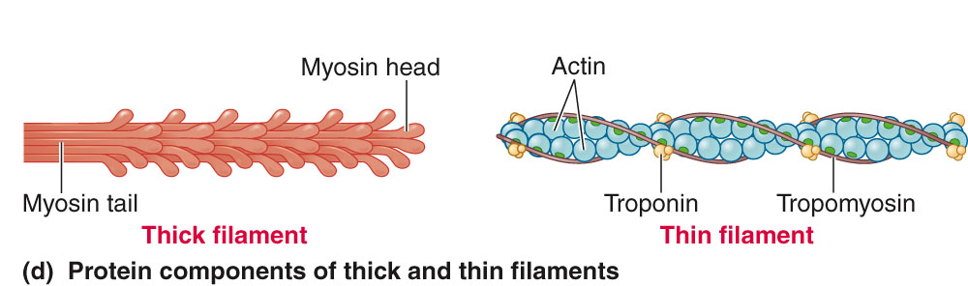
Structure and Arrangement of Myosin Molecules Within Thick Filament

Slide 14
Actin
Primary structural component of thin filaments
Spherical in shape
Thin filament also has 2 other proteins
  Tropomyosin
  Troponin
Each actin molecule has special binding site for attachment with myosin cross bridge
  Binding results in contraction of muscle fiber

Slide 15
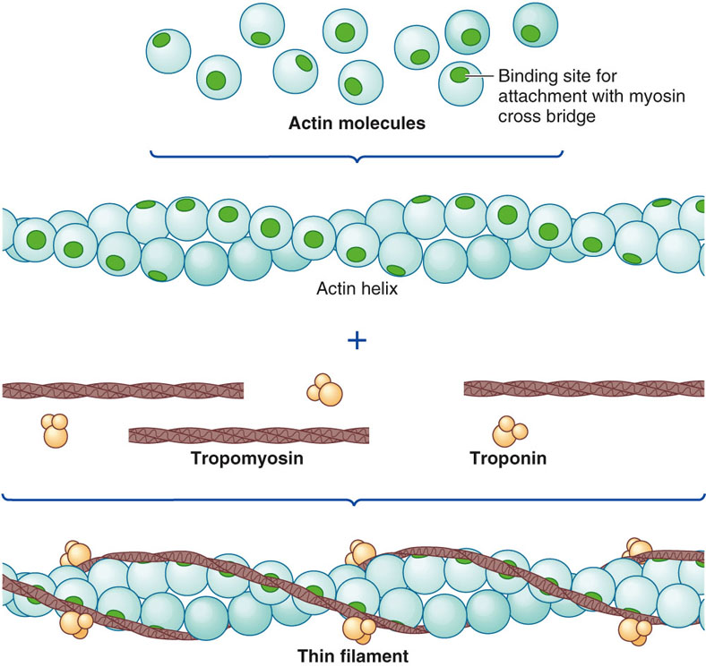
Composition of a Thin Filament

Slide 16
Actin and myosin are often called contractile
Proteins.
  Neither actually contracts.
Actin and myosin are not unique to muscle cells, but are more abundant and more highly organized in muscle cells.

Slide 17
Tropomyosin and Troponin
Often called regulatory proteins
Tropomyosin
  Thread-like molecules that lie end to end alongside groove of actin spiral
  In this position, covers actin sites for binding with myosin , blocking interaction that leads to muscle contraction
Troponin
  Made of 3 polypeptide units
    One binds to tropomyosin
    One binds to actin
    One can bind with Ca²⁺

Slide 18
Tropomyosin and Troponin
Troponin
  When not bound to Ca²⁺
    Troponin stabilizes tropomyosin in blocking position over actin’s cross-bridge binding sites
  When Ca²⁺ binds to troponin
    Tropomyosin moves away from blocking position
  With tropomyosin out of way, actin and myosin bind, interact at cross-bridges
    Muscle contraction results

Slide 19
Cross-bridge interaction between actin and myosin brings about muscle contraction by means of the sliding filament mechanism.

Slide 20
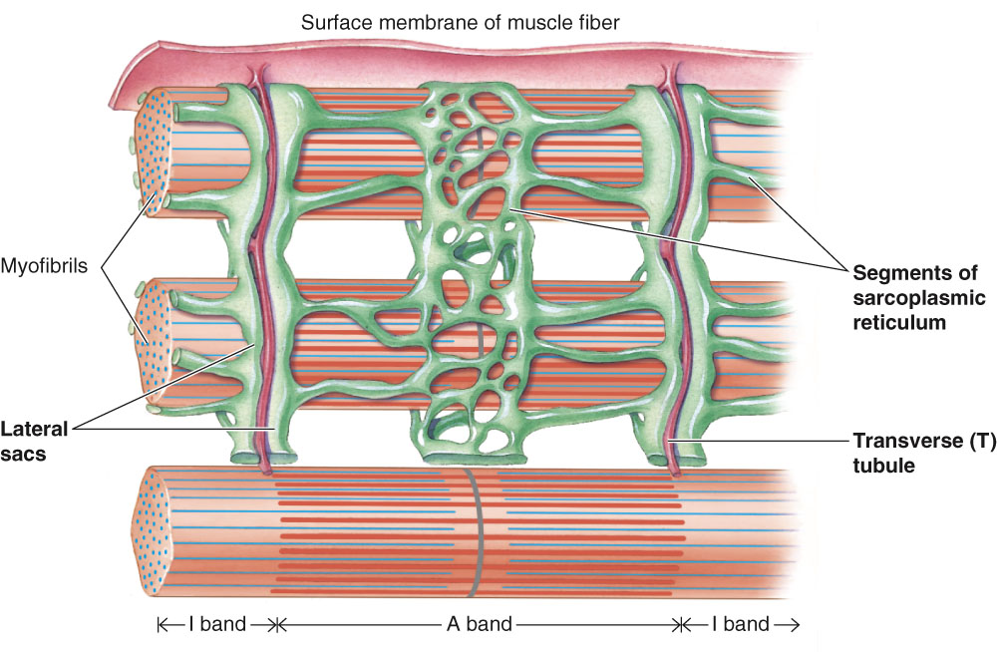
T Tubules and Sarcoplasmic Reticulum

Slide 21
Sarcoplasmic Reticulum
Modified endoplasmic reticulum
Consists of fine network of interconnected compartments that surround each myofibril
Not continuous but encircles myofibril throughout its length
Segments are wrapped around each A band and each I band
  Ends of segments expand to form saclike regions – lateral sacs (terminal cisternae)

Slide 22
Transverse Tubules
T tubules
Run perpendicularly from surface of muscle cell membrane into central portions of the muscle fiber
Since membrane is continuous with surface membrane – action potential on surface membrane also spreads down into T-tubule
Spread of action potential down a T tubule triggers release of Ca²⁺ from sarcoplasmic reticulum into cytosol

Slide 23
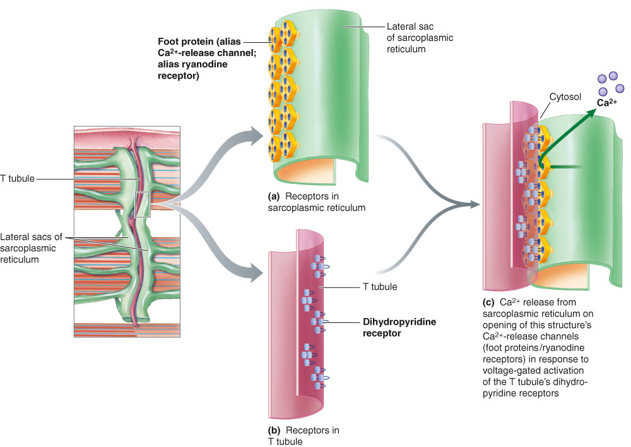
Relationship Between T Tubule and Adjacent Lateral Sacs of Sarcoplasmic Reticulum

Slide 24
References
Human physiology by Lauralee Sherwood, 7th edition
Text book physiology by Guyton &Hall,12th edition
Text book of physiology by Linda .s contanzo,third edition

