Slide 1
SMOOTH MUSCLES
بسم الله الرحمن الرحيم
Dr.Mohammed Sharique Ahmed Quadri
Assistant Professor
Department Basic Medical Sciences
Division of Physiology
Faculty of Medicine
Almaarefa Colleges

Slide 2
Smooth Muscle
Found in walls of hollow organs and tubes
No striations
  Filaments do not form myofibrils
  Not arranged in sarcomere pattern found in skeletal muscle
Spindle-shaped cells with single nucleus
Cells usually arranged in sheets within muscle
Have dense bodies containing same protein found in Z lines

Slide 3
Smooth Muscle
Cell has 3 types of filaments
  Thick myosin filaments
    Longer than those in skeletal muscle
  Thin actin filaments
    Contain tropomyosin
    Calmodulin ( but no troponin)
  Filaments of intermediate size = Intermediate Filaments
    Do not directly participate in contraction
    Form part of cytoskeletal framework that supports cell shape

Slide 4
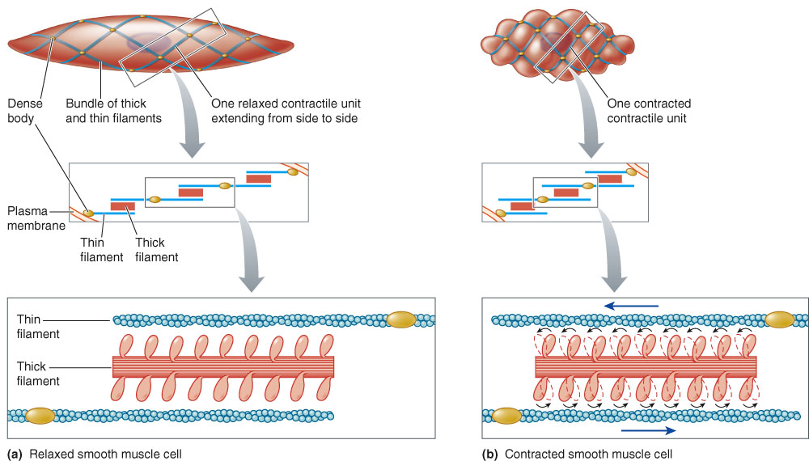
Schematic Representation of the Arrangement of Thick and Thin
Filaments in a Smooth Muscle Cell In Contracted and Relaxed States

Slide 5
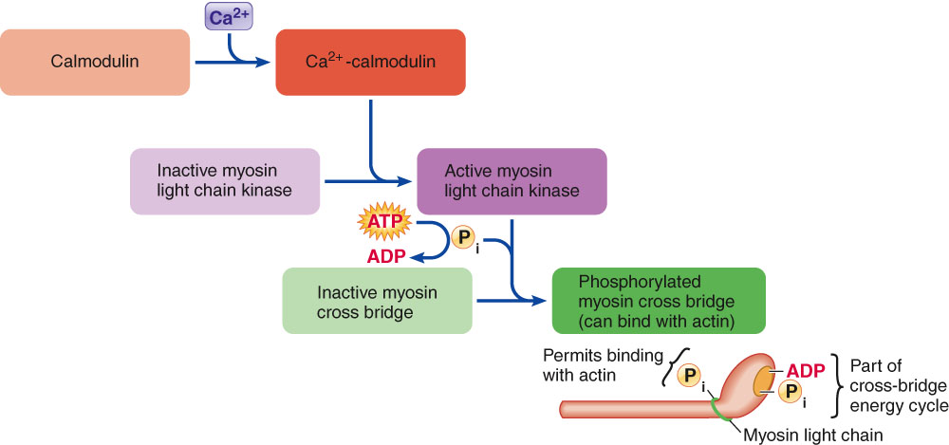
Calcium Activation of Myosin Cross Bridge in Smooth Muscle

Slide 6
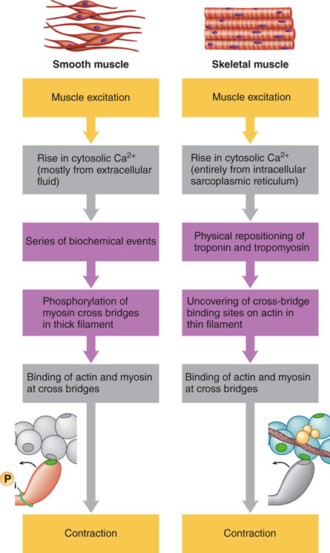
Comparison of Role of
Calcium In Bringing About
Contraction in Smooth
Muscle and Skeletal Muscle

Slide 7
Smooth Muscle
2 major types
  Multiunit smooth muscle
  Single-unit smooth muscle
  another way of classification
  Sub classification
  On the basis of timing of contraction & source for cytosolic Ca²⁺increase
  - Tonic
  - Phasic
  On the basis of generation of action potential
  - Myogenic
  - Neurogenic

Slide 8
Phasic Smooth muscle:
  Contracts in burst triggered by action potential
  Located in the walls of hollow organs like GIT
  Source of cytosolic Calcium
    ECF
    voltage gated dihydropyridine receptors in plasma membrane functions as calcium channels
    Sarcoplasmic reticulum ( sparse )
    ECF calcium entering in the cell trigger release of calcium from sarcoplasmic reticulum

Slide 9
Tonic smooth muscle :
  Maintain state of partial contraction constantly
  Voltage gated Ca²⁺ channels are open all the time because of low resting membrane potential( -55 to -40 )
  Example : smooth muscle in walls of arterioles.
  Source of cytosolic Calcium
    Binding of chemical messenger (norepinephrine or various hormones ) to G-Protein couples receptors on surface membrane.
    Activation of IP3/Ca²⁺ second messenger pathway
    IP3 recptors ( Ca²⁺ channels ) on membrane of sarcoplasmic reticulum

Slide 10
Multiunit Smooth Muscle
Neurogenic
Consists of discrete units that function independently of one another
Units must be separately stimulated by nerves to contract( autonomic nerves)
All multi unit smooth muscles are phasic
Found
  In walls of large blood vessels
  In small airways to lungs
  In ciliary muscle of eye that adjusts lens for near or far vision
  In iris of eye
  At base of hair follicles

Slide 11
Single-unit Smooth Muscle
Self-excitable (does not require nervous stimulation for contraction)
Also called visceral smooth muscle
Fibers become excited and contract as single unit
Cells electrically linked by gap junctions
Can also be described as a functional syncytium
Contraction is slow and energy-efficient
  Well suited for forming walls of distensible, hollow organs

Slide 12
Single-unit Smooth Muscle
Found in
  Digestive tract
  Reproductive tract
  Uterus
  Bladder
  Ureter
  Bile duct
  Small blood vessels

Slide 13
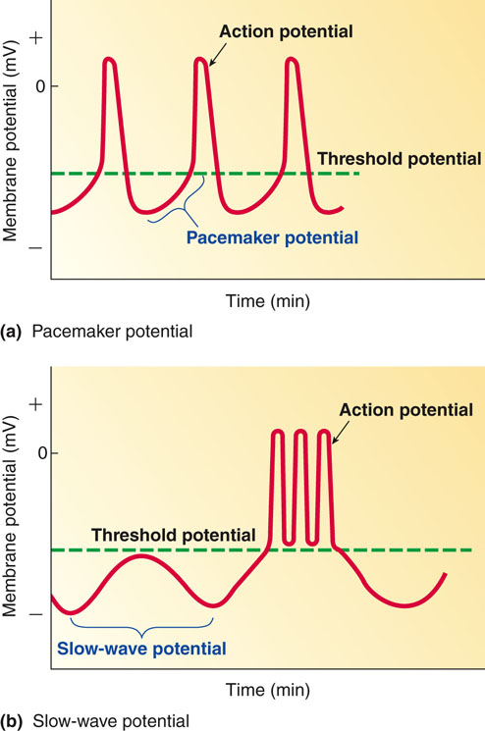
A.P IN SMOOTH MUSCLES
SPIYKE POTENTIAL or
SLOW WAVE POTENTIAL
PACEMAKER POTENIAL

Slide 14
PROPERTIES OF SMOOTH MUSCLE CONTRACTION
SLOW CYCLING OF MYOSIN CROSS BRIGDES
LESS ENERGY REQUIRES TO SUSTAIN THE CONTRACTION
SLOWNESS OF ONSET OF CONTRACTION AND RELAXATION
LENGTH TENSION RELATION SHIP
STRESS RELAXATION PROCESS
LATCH MECHANISM

Slide 15
Length tension relation ship
smooth muscle can still develop considerable tension even when stretch up to 2.5 times because
  Resting length is much shorter than the optimal length ( lo)
  thin filament can still overlap much longer thick filament even after considerable stretch

Slide 16
STRESS RELAXATION
smooth muscle when stretch , initially increase tension much like the rubber band , but slowly tension comes back to resting level due to readjustment of cross bridges

Slide 17
References
Human physiology by Lauralee Sherwood, 7th edition
Text book physiology by Guyton &Hall,12th edition
Text book of physiology by Linda .s contanzo,third edition

