Slide 1
Skeletal Muscle Mechanics
بسم الله الرحمن الرحيم
Dr.Mohammed Sharique Ahmed Quadri
Assistant Professor
Department Basic Medical Sciences
Division of Physiology
Faculty of Medicine
Almaarefa Colleges

Slide 2
Skeletal Muscle Mechanics
Muscle consists of groups of muscle fibers bundled together and attached to bones
Connective tissue covering muscle divides muscle internally into bundles
Connective tissue extends beyond ends of muscle to form tendons
  Tendons attach muscle to bone

Slide 3
Muscle Tension
Tension is produced within the sarcomere (contractile component),as a result of cross-bridge cycling resulting.in sarcomere shortening.
To move the bones, the tension generated by these contractile component must be transmitted to the bones via the connective tissue and tendons.
Connective tissue + tendons + titin = series elastic components

Slide 4
Relationship between contractile component & series elastic component
Muscle typically attached to at least 2 different bones across a joint
  Origin
    End of muscle attached to more stationary part of skeleton
  Insertion
    End of muscle attached to skeletal part that moves

Slide 5
Lever Systems
Skeletal muscles are attached to the bones across joints, forming lever system
Bones function as levers
Joints function as fulcrums
Skeletal muscles provide force to move bones

Slide 6
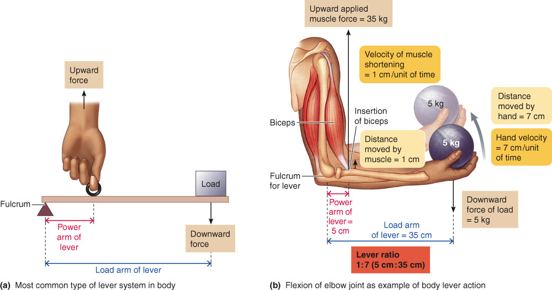
Lever Systems
Bones, muscles, and joints interact to form lever systems

Slide 7
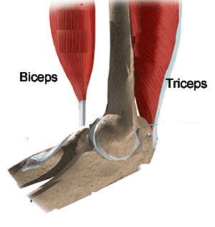
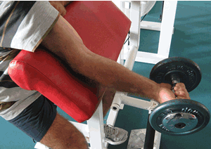
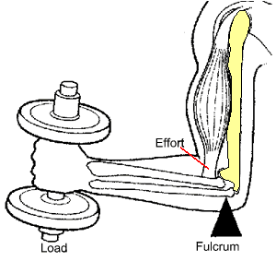

Slide 8
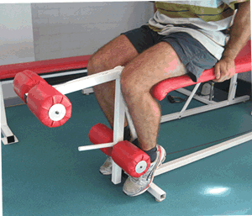

Slide 9
Advantages and disadvantages of lever system
Advantage : enables load to be moved to a distance much greater than shortening distance of the muscle.
Disadvantage: muscle much exert a considerable greater force than the actual load to be moved

Slide 10
Types of Contraction
Two primary types
  Isotonic
    Muscle tension remains constant as muscle changes length
    Two types
      Concentric contractions
        Muscle shortens
      Eccentric contractions
        Muscle lengthens
  Isometric
    Muscle is prevented from shortening
    Tension develops at constant muscle length

Slide 11
Muscle Contractions
Contractions of whole muscle can be of varying strength
Twitch
  Brief, weak contraction
  Produced from single action potential
  Too short and too weak to be useful
  Normally does not take place in body
  Many muscle fibers in a muscle function cooperatively to produce contraction of variable grades of strength stronger than twitch.

Slide 12
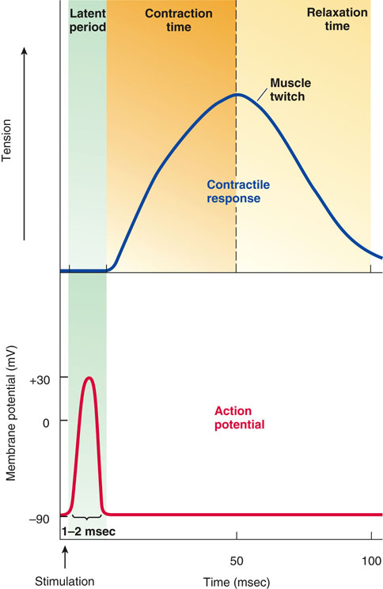
Muscle Twitch

Slide 13


We can vary the force exerted by same muscle

Slide 14
Muscle Contractions
Two primary factors which can be adjusted to accomplish gradation of whole-muscle tension
  Number of muscle fibers contracting within a muscle
  Tension developed by each contracting fiber

Slide 15
Motor Unit Recruitment
Greater the number of fibers contracting greater the total muscle tension
The number of muscle fibers contracting within a muscle depends on the extent of motor unit recruitment.
Muscle containing more muscle fibers can generate more tension

Slide 16
Motor Unit Recruitment
Motor unit
  One motor neuron and the muscle fibers it innervates
Number of muscle fibers varies among different motor units
Number of muscle fibers per motor unit and number of motor units per muscle vary widely
  Muscles that produce precise, delicate movements contain fewer fibers per motor unit e.g. external muscles of eye
  Muscles performing powerful, coarsely controlled movement have larger number of fibers per motor unit e.g. muscles of thigh

Slide 17
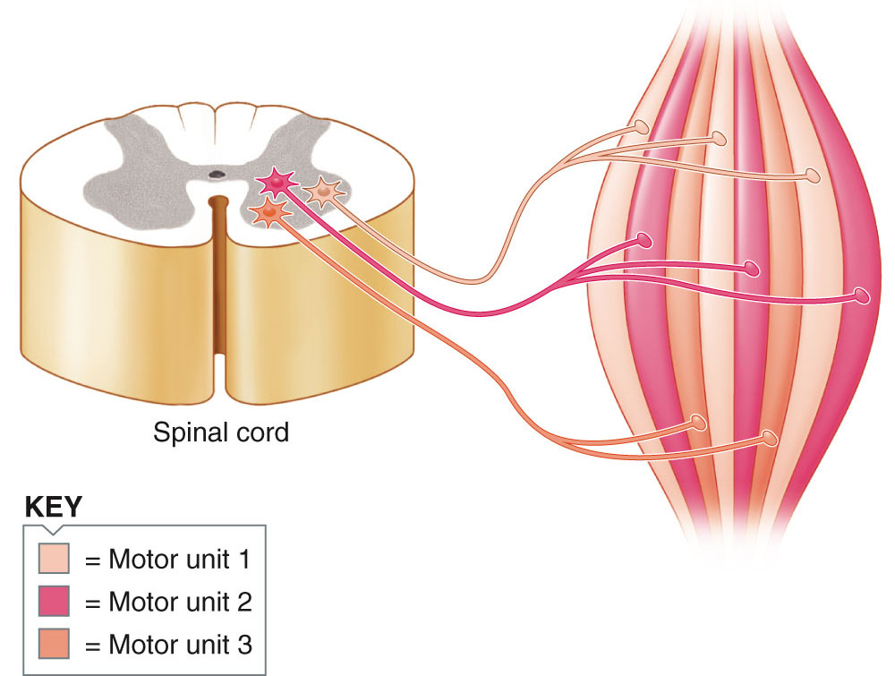
Motor Units in Skeletal Muscle
One motor neuron innervates number of muscle fibers but each muscle fiber is innervated by only one motor neuron

Slide 18
Motor Unit Recruitment
For weak contraction of whole muscle only few motor units are activates
For stronger contraction , more and more motor units are recruited (stimulated) to contract together , a phenomenon known as motor unit recruitment.
Strength of contraction with recruitment of each additional motor unit depends on size of that motor unit

Slide 19
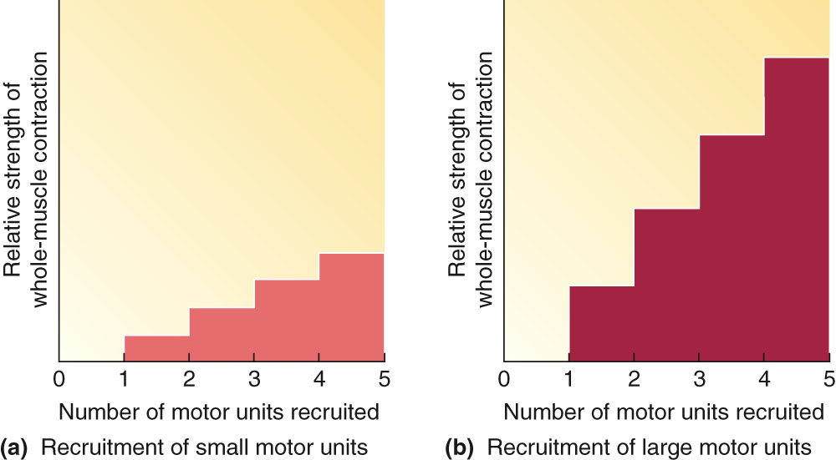
Motor Unit Recruitment

Slide 20
Motor Units in Skeletal Muscle
Asynchronous recruitment of motor units helps delay or prevent fatigue

Slide 21
Muscle Tension
Factors influencing extent to which tension can be developed
  Frequency of stimulation
  Length of fiber at onset of contraction
  Extent of fatigue
  Thickness of fiber

Slide 22
Twitch Summation and Tetanus
Single action potential in muscle fiber produces twitch. Which is very weak & brief.
Contraction of longer duration and greater tension can be produces by repeated stimulation of fiber.
Two twitches from two action potential add together , or sum, to produce greater tension in the fiber.

Slide 23
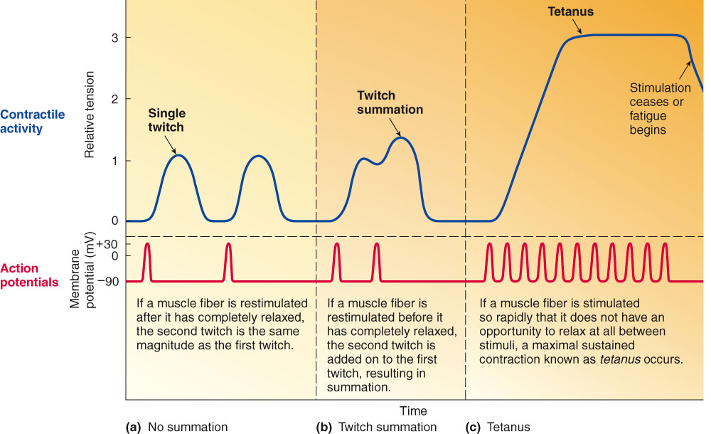
Summation and Tetanus

Slide 24
Twitch Summation
Twitch summation is possible because the duration of action potential is much shorter than duration of twitch(contraction)
Twitch summation Results from sustained elevation of cytosolic calcium, permitting greater cross bridge cycling.

Slide 25
Twitch Summation and Tetanus
Tetanus
  Occurs if muscle fiber is stimulated so rapidly that it does not have a chance to relax between stimuli, smooth sustained contraction of maximum strength occurs known as tetanus .
  Contraction is usually three to four times stronger than a single twitch

Slide 26
Optimal Length (l₀)
Length of muscle fiber before the onset of contraction at which maximum tension can be developed in subsequent contraction.
At this length there is maximum overlap between thin and thick filament
  Maximum number of cross bridges can interact ( binds) to actin molecules

Slide 27
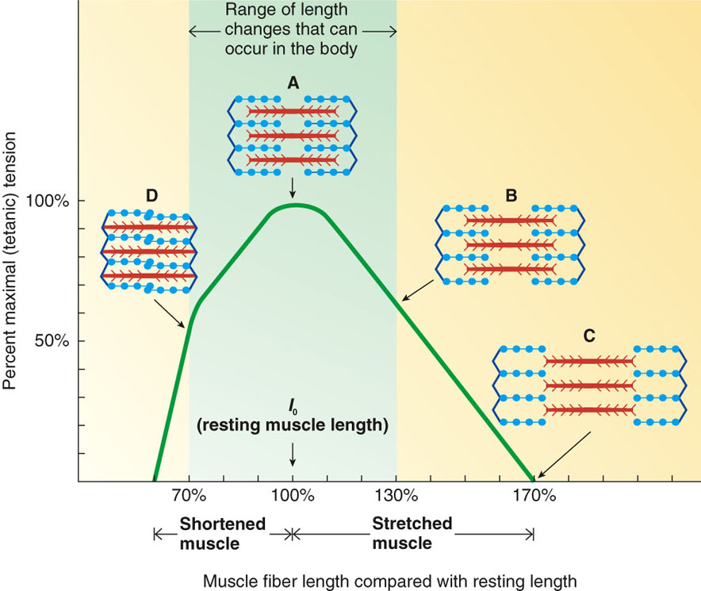
Optimal Length (l₀)

Slide 28
FATIGUE
Contractile activity in a muscle can not be maintained at given level indefinitely. And tension declines after some time.
Types of Fatigue
  Muscle fatigue
  Central fatigue

Slide 29
Muscle Fatigue
Exercising muscle can no longer respond to stimulation with same degree of contraction
Defense mechanism that protects muscle from reaching - (rigor mortis)
Underlying causes of muscle fatigue are unclear
    Local increase in ADP & inorganic phosphate
    Accumulation of lactate
    Accumulation of extracellular K⁺
    Depletion of glycogen energy reserve

Slide 30
Central Fatigue
Occurs when CNS no longer adequately activates motor neurons supplying working muscles
Often psychologically based
Mechanisms involved in central fatigue are poorly understood
  Neuromuscular fatigue: inability of motor neuron to synthesize acetylcholine- possible only experimentally

Slide 31
References
Human physiology by Lauralee Sherwood, 7th edition
Text book physiology by Guyton &Hall,12th edition
Text book of physiology by Linda .s contanzo,third edition

