Slide 1
Molecular Basis of Skeletal Muscle Contraction
بسم الله الرحمن الرحيم
Dr.Mohammed Sharique Ahmed Quadri
Assistant Professor
Department of Basic Medical Sciences
Division of Physiology
Faculty of Medicine
Almaarefa Colleges

Slide 2
Objectives
By the end of this lecture, you should be able to:
Understand the Molecular mechanism of skeletal muscle contraction including:
    Role of calcium ions in excitation contraction coupling
    Sliding Filament Theory of Contraction
    The role of T-tubule and sarcoplasmic reticulum
    Regulation of Calcium efflux and influx from the sarcoplasmic reticulum and into the sarcoplasm
    Molecular rearrangement of Actin and Myosin
    Myosin-ATPase cycle and Rigor Mortis phenomenon

Slide 3
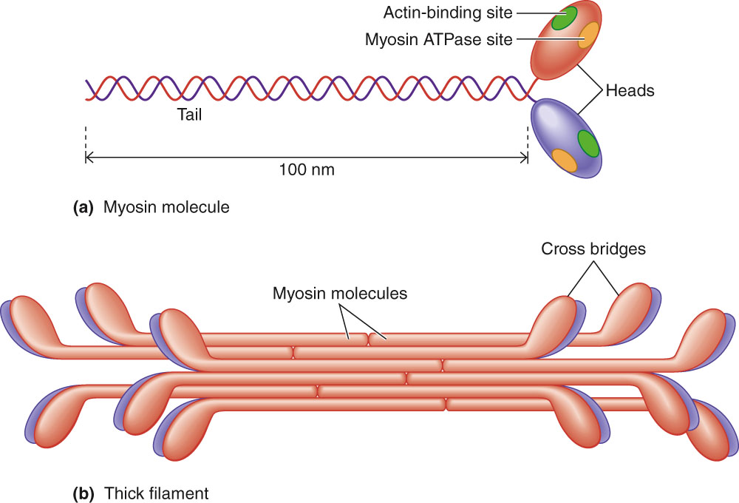
Structure and Arrangement of Myosin Molecules Within Thick Filament

Slide 4
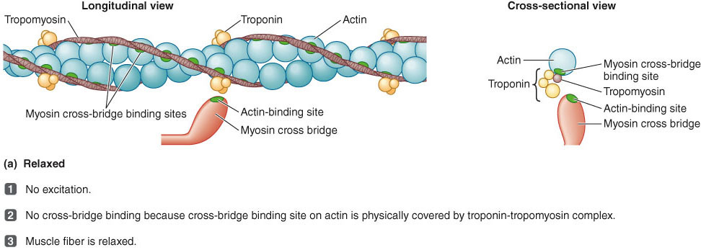
Role of Calcium in Cross-Bridge Formation
During relaxed state

Slide 5
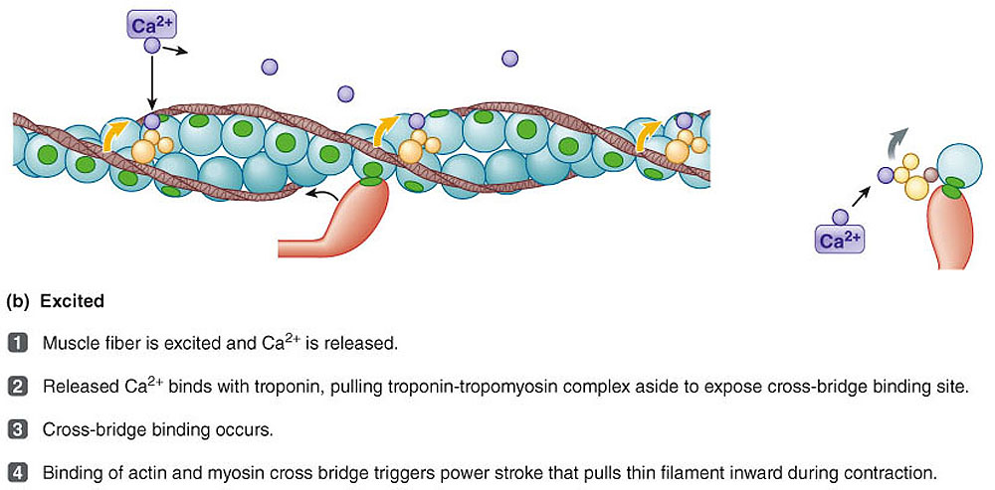
Role of Calcium in Cross-Bridge Formation
Excited

Slide 6
Sliding Filament Mechanism
Cross-bridge interaction between actin and myosin brings about muscle contraction by means of the sliding filament mechanism.

Slide 7
Sliding Filament Mechanism
Increase in Ca²⁺ starts filament sliding
Decrease in Ca²⁺ turns off sliding process
Thin filaments on each side of sarcomere slide inward over stationary thick filaments toward center of A band during contraction
As thin filaments slide inward, they pull Z lines closer together
Sarcomere shortens

Slide 8
Sliding Filament Mechanism
All sarcomeres throughout muscle fiber’s length shorten simultaneously
Contraction is accomplished by thin filaments from opposite sides of each sarcomere sliding closer together between thick filaments.

Slide 9
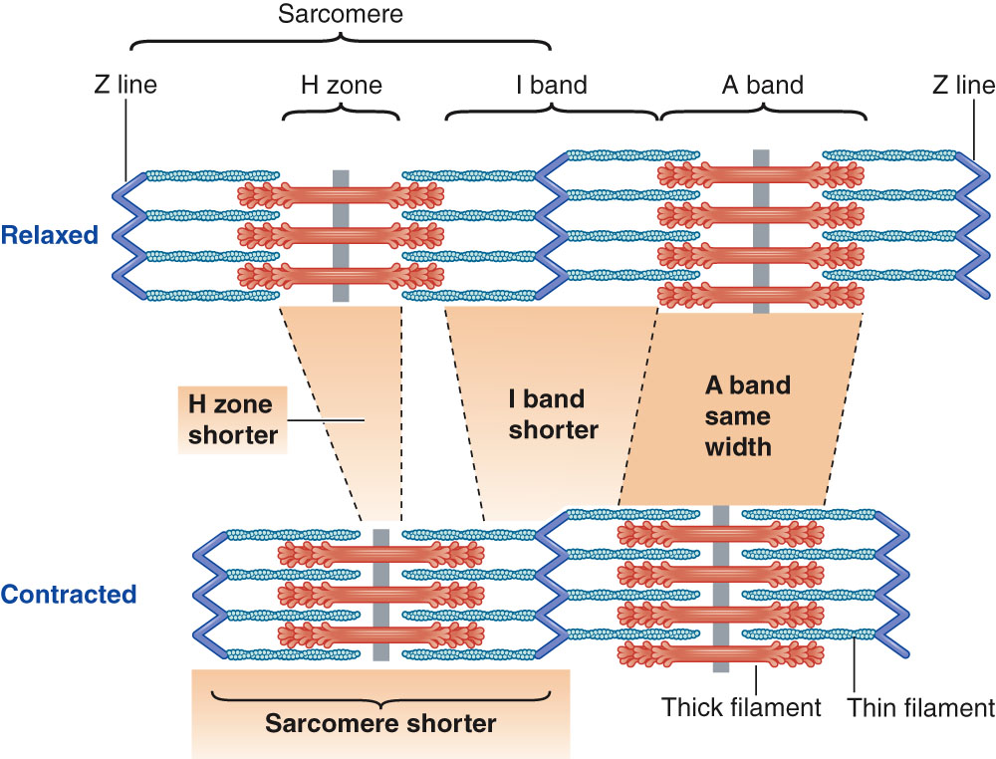
Changes in Banding Pattern During Shortening

Slide 10
Power Stroke
Activated cross bridge bends toward center of thick filament, “rowing” in thin filament to which it is attached
  Sarcoplasmic reticulum releases Ca²⁺
  Myosin heads bind to actin
  Hydrolysis of ATP transfers energy to myosin head and reorients it
  Myosin heads swivel toward center of sarcomere (power stroke)
  ATP binds to myosin head and detaches it from actin

Slide 11
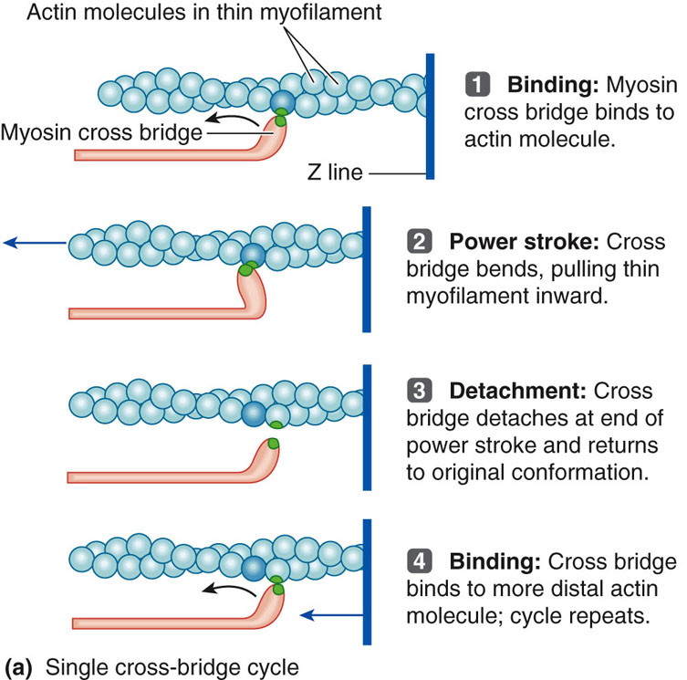

Slide 12
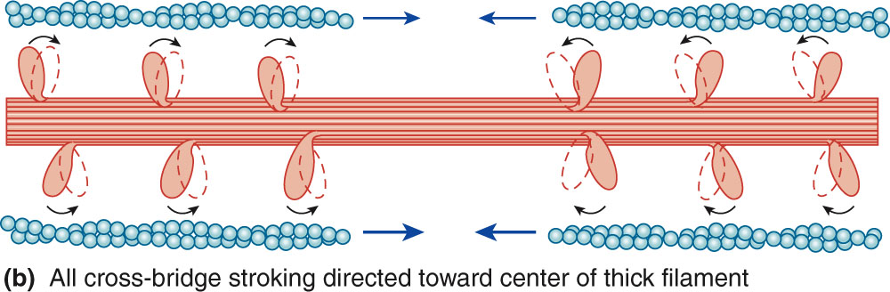

Slide 13
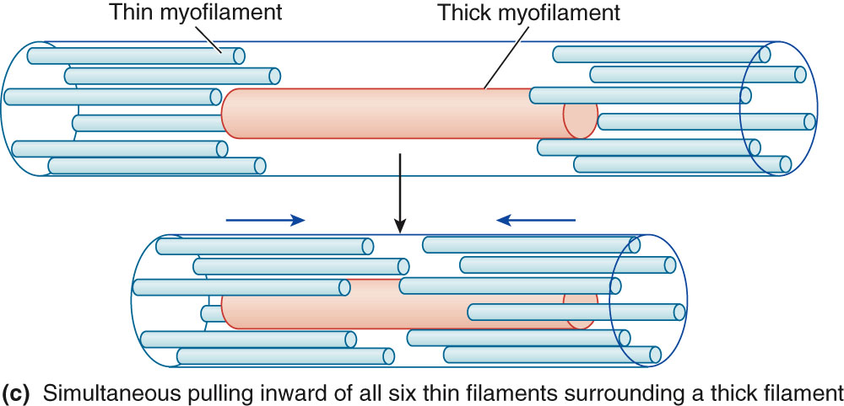

Slide 14
Relaxation
Depends on reuptake of Ca²⁺ into sarcoplasmic reticulum (SR)
Acetylcholinesterase breaks down ACh at neuromuscular junction
Muscle fiber action potential stops
When local action potential is no longer present, Ca²⁺ moves back into sarcoplasmic reticulum

Slide 15
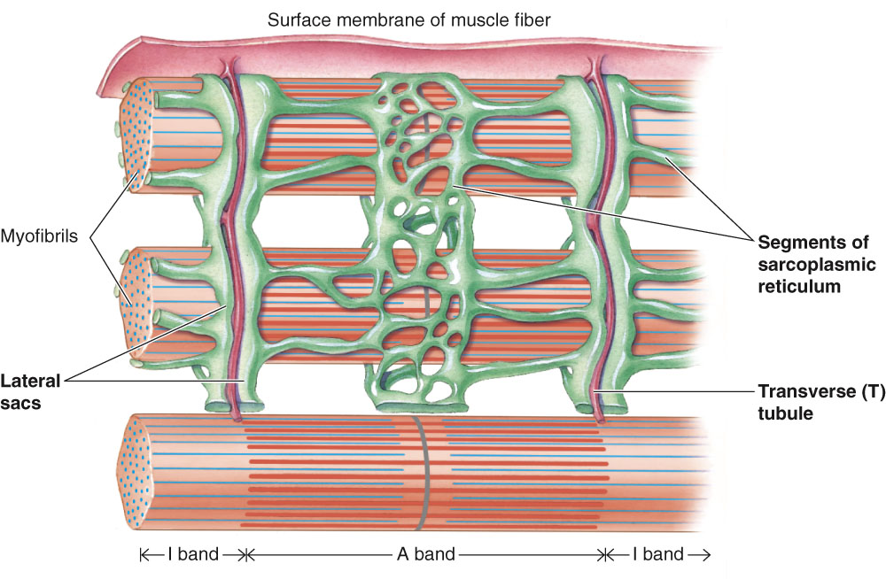
Excitation contraction coupling
T Tubules and Sarcoplasmic Reticulum

Slide 16
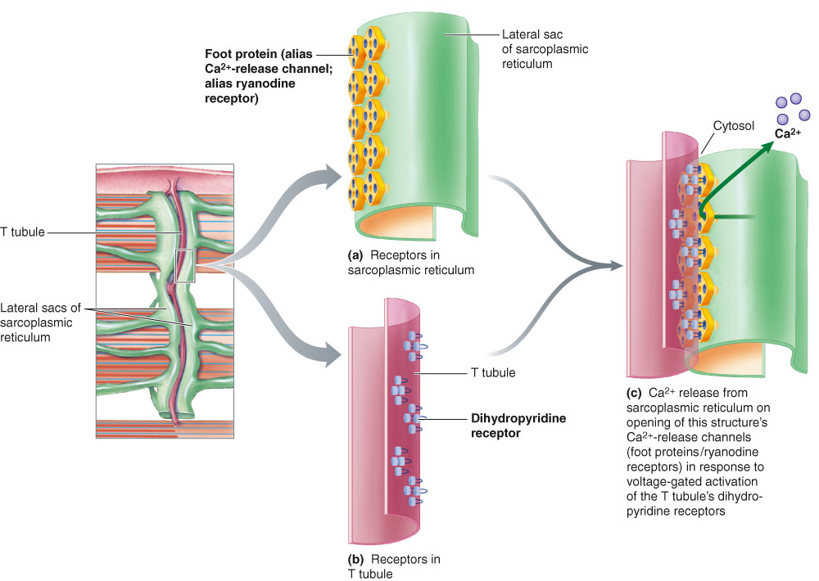
Relationship Between T Tubule and Adjacent Lateral Sacs of Sarcoplasmic Reticulum

Slide 17
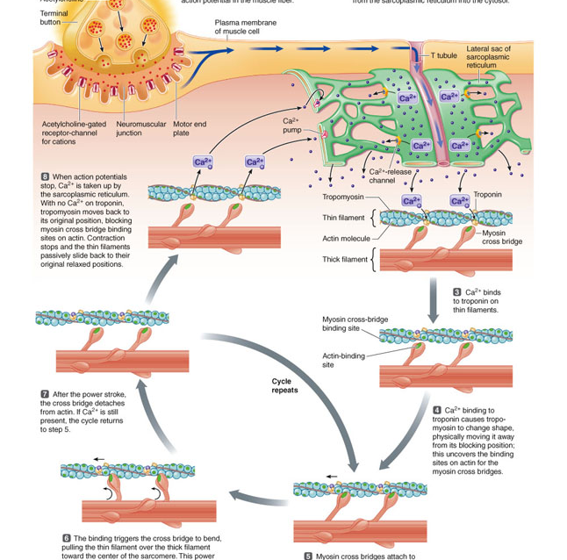
Calcium Release in Excitation-Contraction Coupling

Slide 18
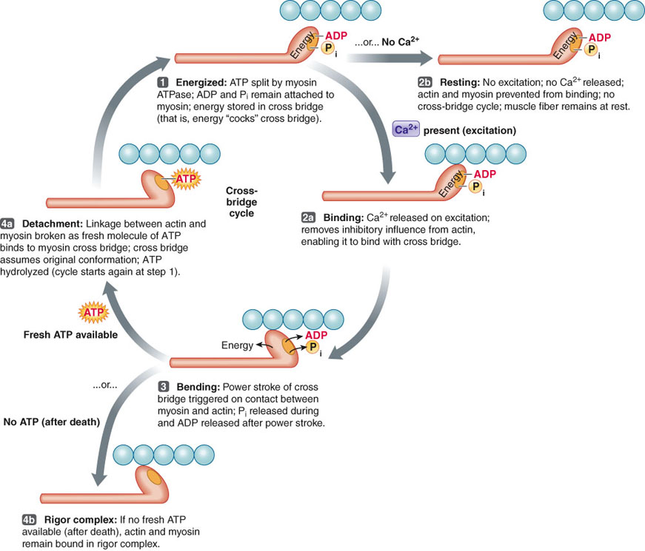
CROSS-BRIDGE CYCLE

Slide 19
Contraction-Relaxation Steps Requiring ATP
Splitting of ATP by myosin ATPase provides energy for power stroke of cross bridge
Binding of fresh molecule of ATP to myosin lets bridge detach from actin filament at end of power stroke so cycle can be repeated
Active transport of Ca²⁺ back into sarcoplasmic reticulum during relaxation depends on energy derived from breakdown of ATP

Slide 20
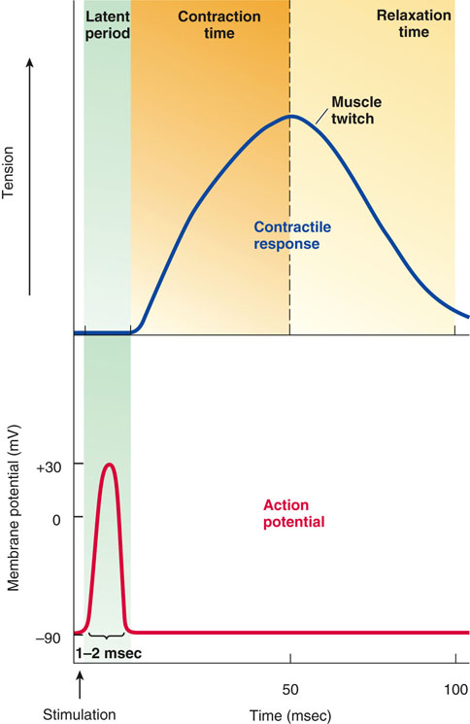

Slide 21
References
Human physiology by Lauralee Sherwood, 7th edition
Text book physiology by Guyton &Hall,12th edition
Text book of physiology by Linda .s contanzo,third edition

