Slide 1
Comparison of different types of muscles
بسم الله الرحمن الرحيم
Dr. Shaikh Mujeeb Ahmed
Assistant Professor
Department Basic Medical Sciences
Division of Physiology
Faculty of Medicine
Almaarefa Colleges

Slide 2
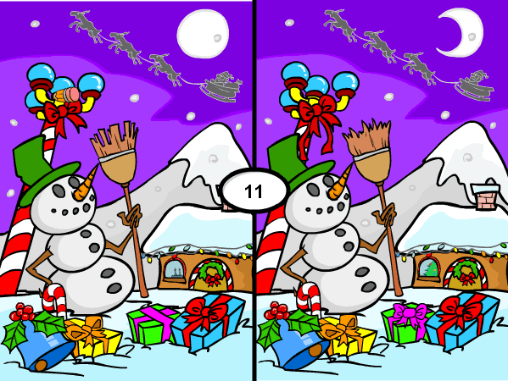
Spot the Difference

Slide 3
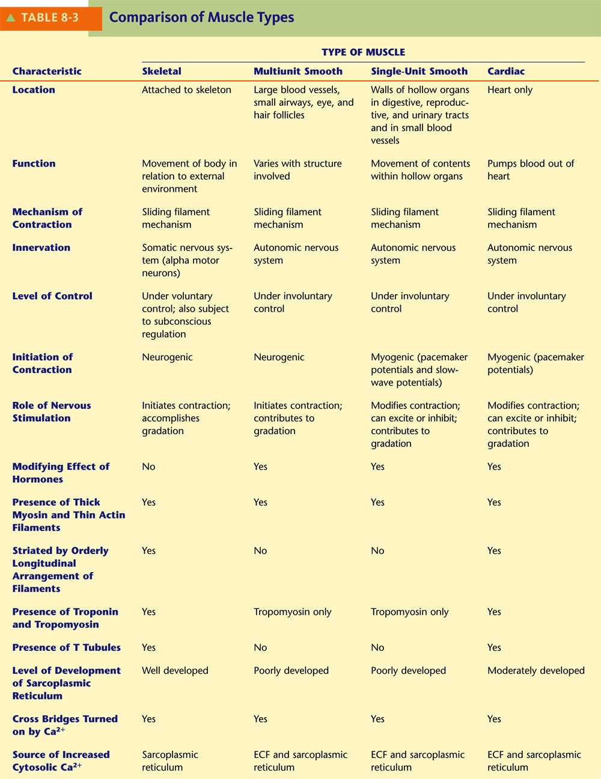

Slide 4
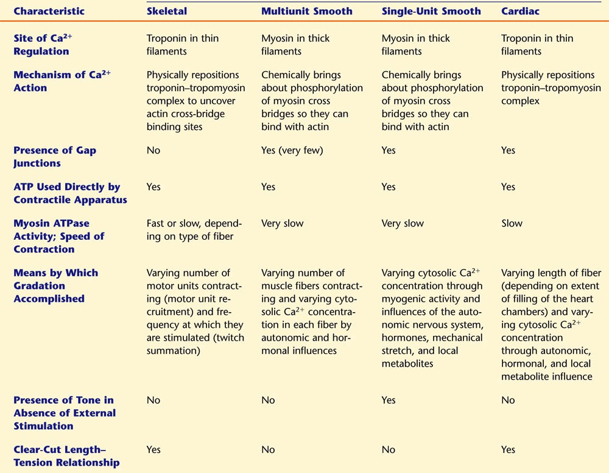

Slide 5
References
Human physiology by Lauralee Sherwood, 7th edition
Text book physiology by Guyton &Hall,12th edition
Text book of physiology by Linda .s contanzo,third edition

