Slide 1
CARDIAC MUSCLE
بسم الله الرحمن الرحيم
Dr.Mohammed Sharique Ahmed Quadri
Assistant Professor
Department Basic Medical Sciences
Division of Physiology
Faculty of Medicine
Almaarefa Colleges

Slide 2
CARDIAC MUSCLE
ATRIAL MUSCLE
VENTRICULAR MUSCLE
SPECIALISES EXCITATORY &CONDUCTIVE MUSCLE FIBERS

Slide 3
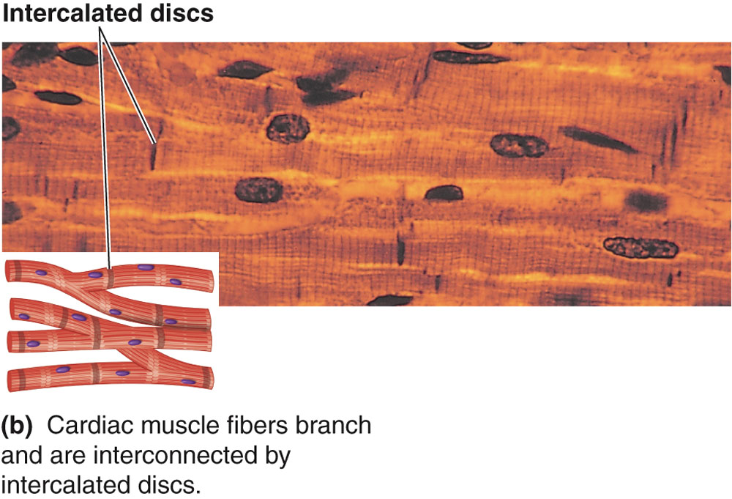

Slide 4
Cardiac Muscle Fibers
Interconnected by intercalated discs and form functional syncytia
Within intercalated discs – two kinds of membrane junctions
  Desmosomes
  Gap junctions

Slide 5
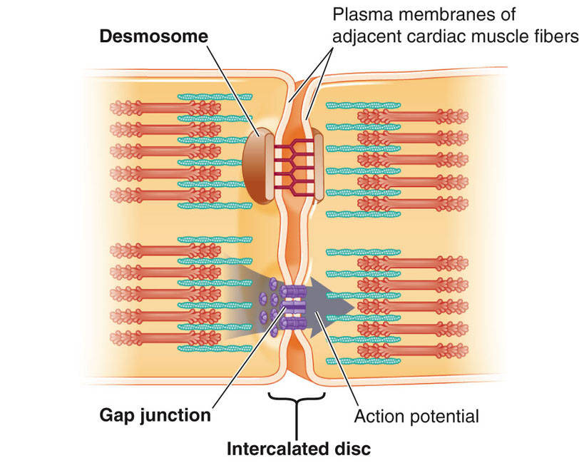

Slide 6
Electrical Activity of Heart
Heart beats rhythmically as result of action potentials it generates by itself (Autorhythmicity)
Two specialized types of cardiac muscle cells
  Contractile cells
    99% of cardiac muscle cells
    Do mechanical work of pumping
    Normally do not initiate own action potentials
  Autorhythmic cells
    Do not contract
    Specialized for initiating and conducting action potentials responsible for contraction of working cells

Slide 7
AUTORHYTHMICITY
What is AutoRhythmicity?
Cardiac autorhythmic cells do not have resting potential instead they show PACE MAKER POTENTIAL
Membrane potential slowly depolarizes between action potential until threshold is reached.
This spontaneous depolarization to threshold is known as PACE MAKER POTENTIAL

Slide 8
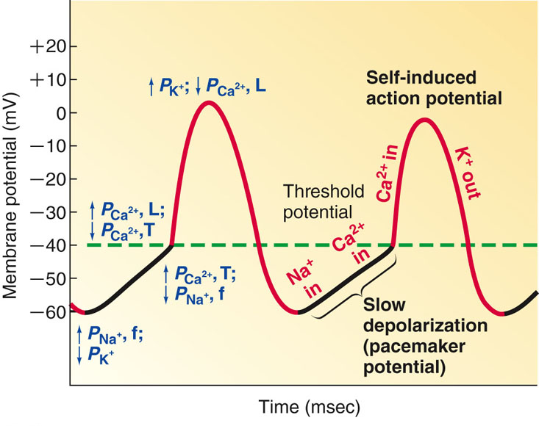
AUTORHYTHMICITY( PACE MAKER POTENTIAL)

Slide 9
Cause of Prepotential
Na⁺ going inside
Ca⁺⁺ going inside
↓ K⁺ going outside
After Prepotential we get Depolarization and Repolarization
Cause of Depolarization - Ca⁺⁺ going inside
Cause of Repolarization - K⁺ going outside

Slide 10
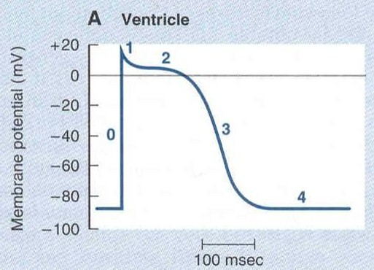
Myocardial Action Potential
( Excitability )
Once myocardial cells are stimulated by action potential originating in SA node, it produces its own action potential
Ventricular Muscle membrane has resting membrane potential of -90mV.
Action Potential of ventricular muscle fiber has four phases 0, 1, 2, 3 ,4.

Slide 11
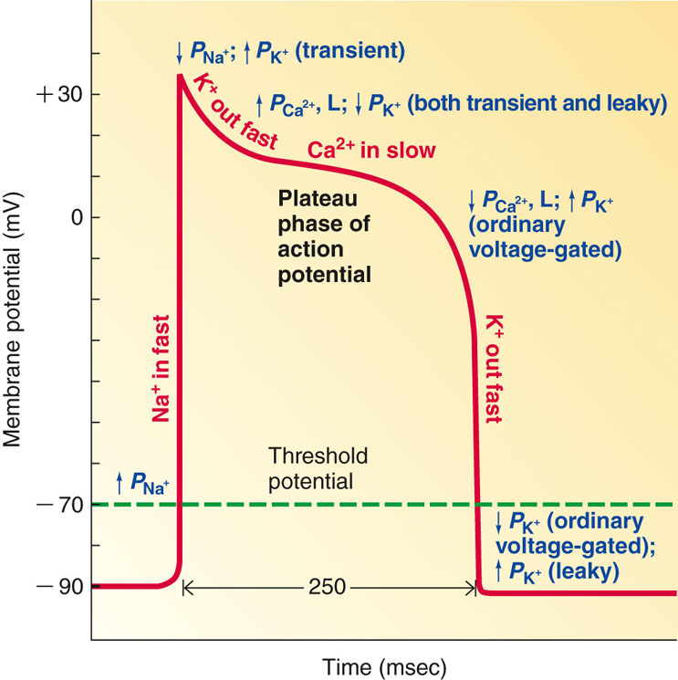
Ventricular action potential
Rapid depolarization (Phase 0) – due to Na+ influx
Rapid Repolarization (Phase 1) - Due to closure of Na+ channels
Slow depolarization (Phase 2) - this is called Plateau phase and is maintained for 200 – 300 ms – due to Ca++ influx
Repolarization (Phase 3) – due to K+ efflux
Resting Membrane Potential (Phase 4)

Slide 12
Electrical Activity of Heart
Because long refractory period occurs in conjunction with prolonged plateau phase, summation and tetanus of cardiac muscle is impossible
  Ensures alternate periods of contraction and relaxation which are essential for pumping blood

Slide 13
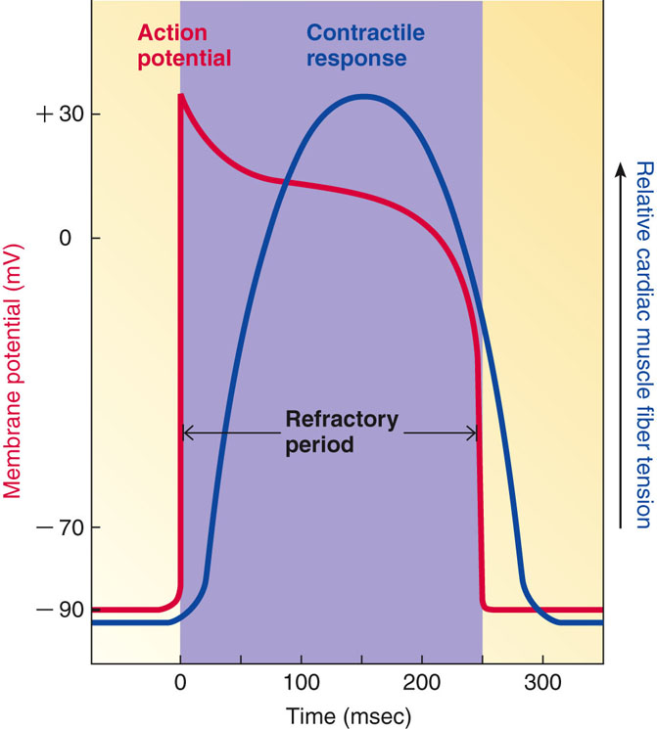
Relationship of an Action Potential and the Refractory Period to the Duration of the Contractile Response in Cardiac Muscle

Slide 14
Source of calcium for cross bridge cycling
Ca²⁺ entry through L-type channels in T tubules triggers larger release of Ca²⁺ from sarcoplasmic reticulum
  Ca²⁺ induced Ca²⁺ release leads to cross-bridge cycling and contraction
  90% of Ca²⁺ needed for contraction comes from sarcoplasmic reticulum

Slide 15
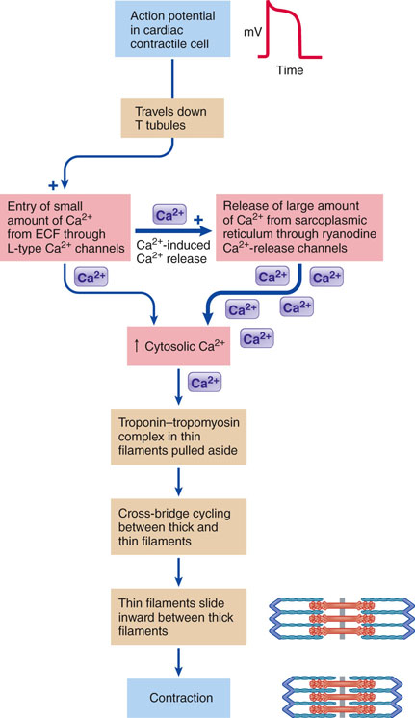
Excitation-Contraction Coupling in Cardiac Contractile Cells

Slide 16
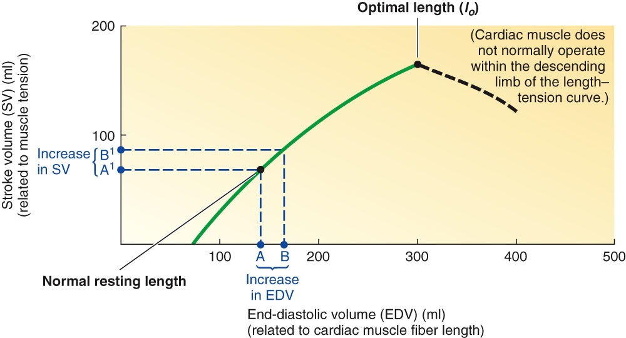
Length tension relationship

Slide 17
References
Human physiology by Lauralee Sherwood, 7th edition
Text book physiology by Guyton &Hall,12th edition
Text book of physiology by Linda .s contanzo,third edition

