Slide 1
Applied Aspects
(Clinical Consideration)
بسم الله الرحمن الرحيم
Dr.Mohammed Sharique Ahmed Quadri
Assistant Professor
Department Basic Medical Sciences
Division of Physiology
Faculty of Medicine
Almaarefa Colleges

Slide 2
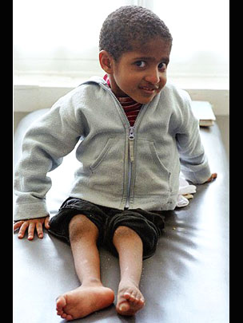
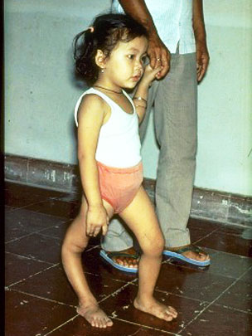
Disease of motor neurons
Poliomyelitis: cell bodies of motor neurons are destroyed by polio virus

Slide 3
Disease of motor neurons(continues)
Amyotrophic lateral sclerosis: Degeneration and eventual death of motor neurons
    Loss of motor control
    Muscle weakening, twitching, and an inability to move the arms, legs, and body. The condition slowly gets worse, it becomes hard or impossible to breathe.
    Progressive paralysis leading to death
    Exact cause is uncertain

Slide 4
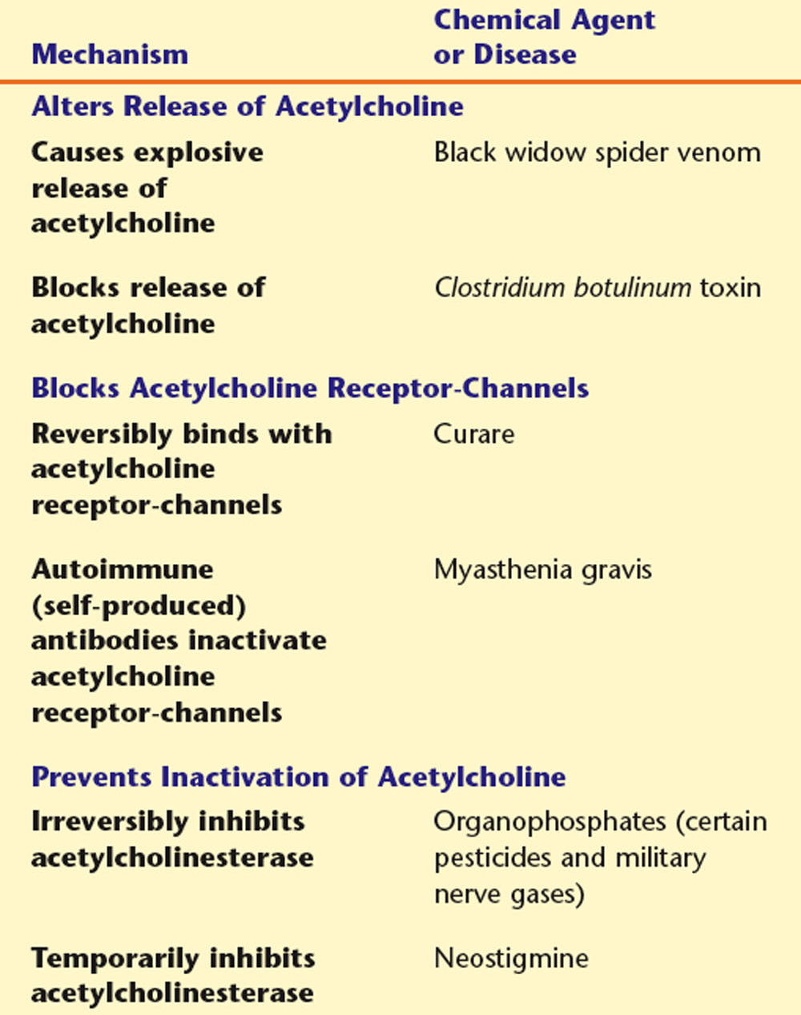
Chemical agents & diseases that affect Neuromuscular Junction

Slide 5
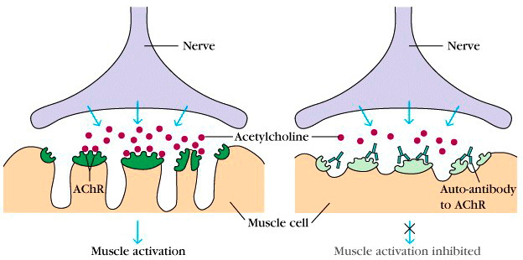
Myasthenia Gravis

Slide 6
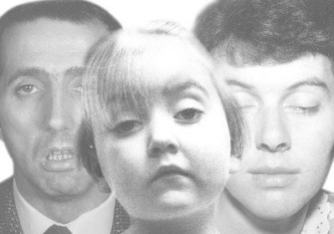
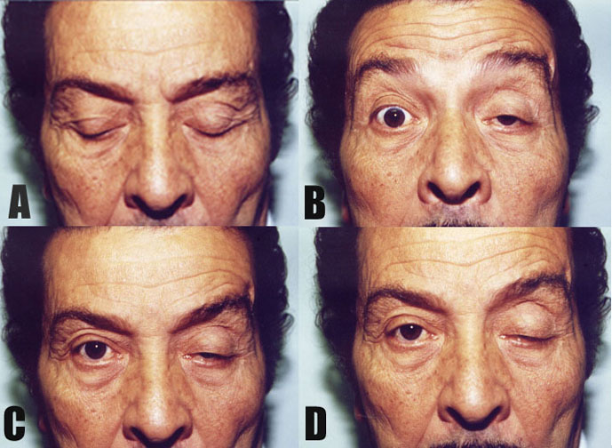
Myasthenia Gravis

Slide 7

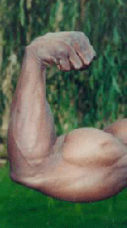
Muscle Hypertrophy
Size of muscles can be increase by regular bouts of anaerobic, short duration, high intensity, resistance training, such as weight lifting
Increase in diameter of fast glycolytic fibers
increased synthesis of actin and myosin filaments
Stress triggers signaling proteins that turn on genes that direct the synthesis contractile proteins

Slide 8
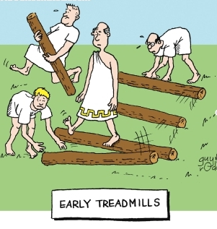

Slide 9
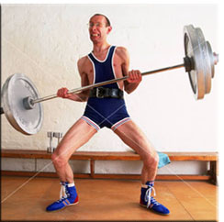
Muscle Injury

Slide 10
Strain Injuries to Muscle
Injury can occur to a muscle that is overstretched while unstimulated,
But most injuries occur during eccentric contraction, .
Relatively few injuries occur under isometric or isotonic (concentric) contraction conditions.
The site of injury is most often at the myotendinous junction

Slide 11
Strain Injuries to Muscle
In some cases, there is complete disruption of the muscle (avulsion), although usually separation is not complete.
Symptoms:
  Soreness
  Weakness,
  Delayed Swelling, And
  “Bunching up” in extreme cases
Delayed-onset muscle soreness, as often experienced after unaccustomed exercise, also results from strain injury, but on a smaller scale.

Slide 12
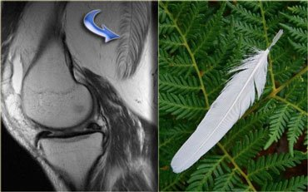
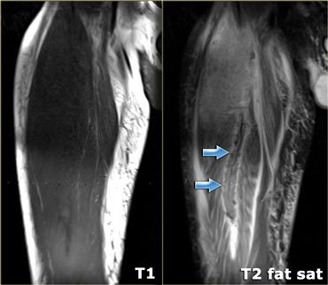
MRI PICTURES OF MUSCLE INJURIES

Slide 13
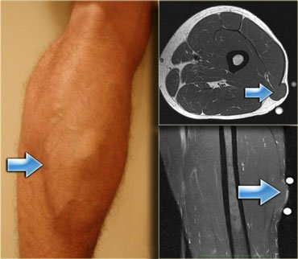
Strain Injuries to Muscle

Slide 14
Influence of Testosterone
Muscle fibers in males are thicker, larger and stronger than females , because of action of steroid hormone testosterone.
Testosterone promotes the synthesis of actin & myosin filaments
Use of Anabolic androgenic steroids by athletes – Really winners or losers ?

Slide 15
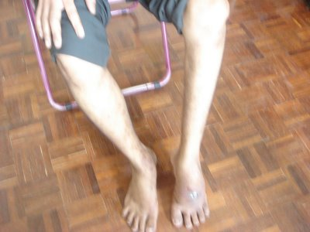
Muscle Atrophy
If muscle is not used its actin & myosin content decreases.
  Disuse atrophy :
    Plaster cast
    Prolonged bed confinement
    Space( loss of gravity )
  Denervation atrophy:

Slide 16
Muscular Dystrophy
A fatal Hereditary pathological conditions characterized by progressive degeneration of contractile elements .
Affects young boys leading to death before age of 20.
There are many different types of muscular dystrophy. They include:
    Becker muscular dystrophy
    Duchene muscular dystrophy
    Emery-Dreifuss muscular dystrophy
    Limb-girdle muscular dystrophy

Slide 17
Duchene Muscular Dystrophy
X-linked recessive disorder
Defective gene responsible for Duchene muscular dystrophy- gene normally produces dystrophine
Treatment under research
  Gene Therapy
  Cell Transplantation Approach
  Utrophin Approach
  Anti- Myostatin Approach

Slide 18
References
Human physiology by Lauralee Sherwood, 7th edition
Text book physiology by Guyton &Hall,12th edition
Text book of physiology by Linda .s contanzo,third edition

