Slide 1
Muscles of Thigh
Dr. Sama ul Haque

Slide 2
Objectives
Know the type and formation of hip joint.
Differentiate the stability and mobility between the hip joint and shoulder joint.
Identify the muscles that act at the hip joint.
Identify the muscles of the thigh in terms of their origin, insertion, nerve supply and actions.
Explain the relationships of contents of the femoral triangle to each other & to the surrounding bone and soft tissue landmarks.

Slide 3
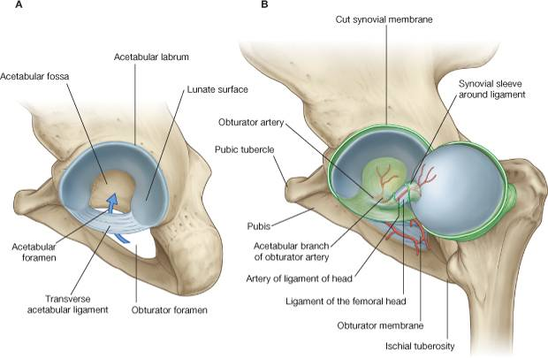
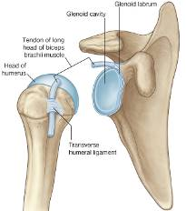
Hip Joint
Lateral View.
Shoulder
Lunate surface articulates with head of femur.

Slide 4
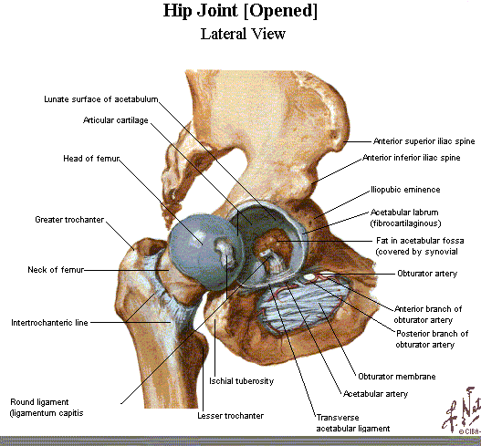
Hip Joint

Slide 5
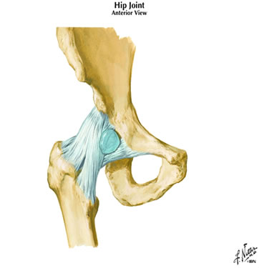
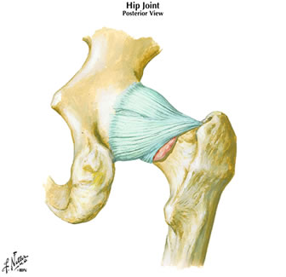
Hip joint: articular capsule
Anterior
Posterior
ischiofemoral
iliofemoral
crest
line
pubofemoral
Note: neck is bare here
Fibrous capsule:
Pubofemoral (medial), resists over abduction
Iliofemoral (anterior), resists hyperextension
Ischiofemoral (posterior), resists hyperextension

Slide 6
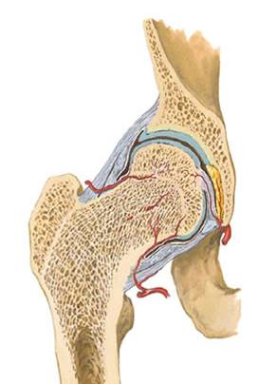
Hip joint: articular capsule
Blood supply to femoral head:
-Retinacular arteries
(from medial and lateral circumflex
femoral arteries, branches of profunda
femoral artery).
-Artery of ligament of head
(acetabular branch of obturator artery)
[deeper orbicular fibres of fibrous capsule]
[Synovial membrane:
reflects onto neck of femur]
Orbicular
Fibres
Retinacular
Arteries
artery of ligament of head

Slide 7
Thigh
Three Compartments:
Anterior, Medial and posterior
Lateral thigh consists of thickened fascia of the lower extremity called the Fascia Latae or Iliotibial Tract that serves as an insertion of the Tensor Fascia Latae muscle.

Slide 8
Thigh
Anterior compartment: knee extensors and some hip flexors; innervated by femoral nerve, blood supply by femoral artery and its branches.
Medial Compartment: Hip adductors (some rotation and flexion); innervated by obturator nerve and its branch, blood supply by branches of deep femoral artery and obturator artery.
Posterior compartment: Hip extensors and knee flexors; innervated by tibial or common peroneal nerves, blood supply by deep femoral artery.

Slide 9
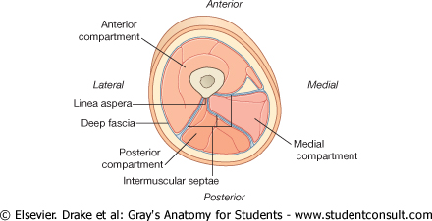
Functional compartments of the thigh
Hip
Flexion
Knee-extension
Hip
Adduction
Hip
Extension
Knee-flexion

Slide 10
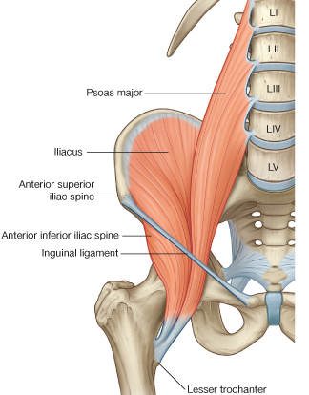
Hip Flexion
Chief flexor of HIP:
Iliopsoas
Psoas major
iliacus
Insertion – lesser trochanter
Femoral nerve (L2-L4):
- Main innervation of
anterior thigh.
Obturator nerve (L2-L4):
- Main innervation of
medial thigh.

Slide 11
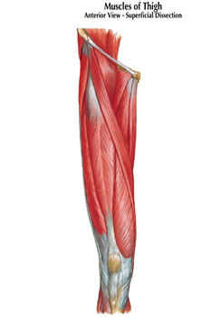
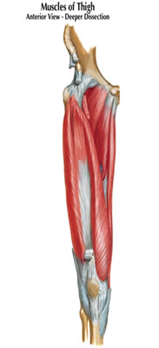
ANTERIOR THIGH.
Flexors of hip / Extensors of knee.
Sartorius
Tensor fascia lata
Pectinius
Rectus femoris
Vastus medialis
Vastus intermedius
Vastus lateralis
Quadriceps femoris =
rectus femoris + vasti
inserts into tibia via
patella
(patellar ligament) (tibial tuberosity)
tensor
fascia lata
pectinius
sartorius
rectus femoris
vastus intermedius
vastus lateralis
vastus
medialis

Slide 12
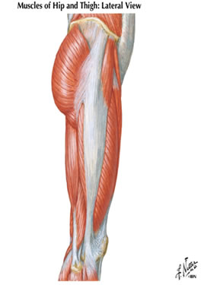
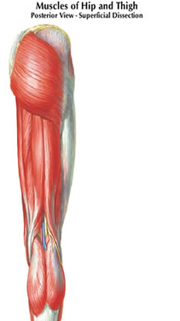
Hip extension
Gluteal region:
-Gluteus maximus
(most powerful extensor,
also lateral rotator)
Insertion:
Gluteal tuberosity
+
Iliotibial tract (band)
Gluteus
maximus
gluteus maximus
Tensor
Fasciae
Latae
iliotibial tract
FYI
Gluteus Maximus and Tensor Fascia Lata insert into Iliotibial Tract
- Iliotibial tract is a thickening of the deep fascia (fascia lata) that extends from the ilium to the tibia.
- Tension from contraction of gluteus maximus and tensor fasciae latae stabilizes the lower limb as a weight-bearing column.

Slide 13
Posterior Compartment
“Hamstrings”
Common Origin
Medial and Lateral Insertions

Slide 14
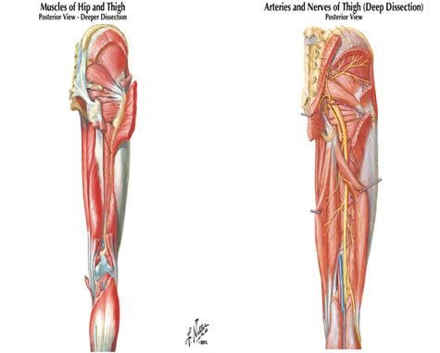
Posterior Compartment
of thigh:
Hamstring muscles.
-Extend hip
-Flex knee
-Common origin at ischial tuborosity.
-Innervated by
sciatic nerve
sciatic nerve
semimembranosus
semitendinosus
biceps
femoris
Posterior fibres of adductor magnus:
Origin from ischial tuborosity, supplied by sciatic nerve, extend hip.

Slide 15
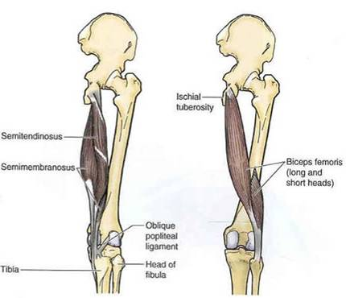
Hamstrings.
Two insert on medial side:
- semimembranosus
- semitendinosus
(Tibia)
Two insert on lateral side:
- biceps femoris
(Fibula)
Common origin
of extensors

Slide 16
Medial Compartment
Muscles
Gracilis, Adductor Longus, Adductor Brevis, Adductor Magnus
Common actions
Pulled groin

Slide 17
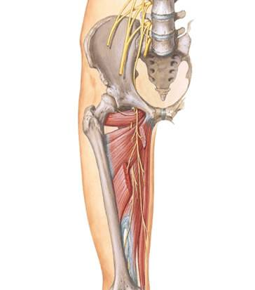
Hip Adduction
Medial Compartment
main function = adduction
Obturator externus
Adductor brevis
Adductor longus
Adductor magnus
Gracilis
Most innervated by:
Obturator nerve (L2-L4)
(lumbar plexus)
Exception:
-Hamstring component of
adductor magnus (extensor)
(tibial division of sciatic nerve)
obturator
externus
obturator
nerve
adductor brevis
Adductor
magnus
adductor longus
gracilis

Slide 18
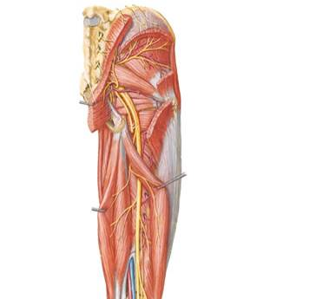
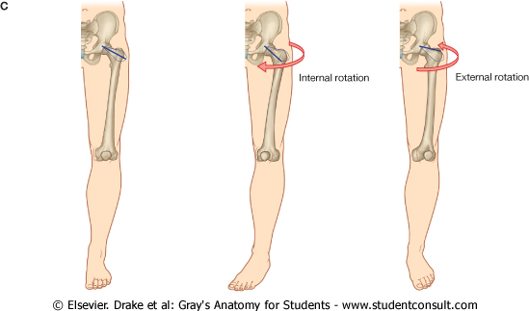
Lateral Rotation of the hip
gluteus medius
gluteus
maximus
gluteus minimus
Deep to gluteus maximus:
-abductors:
gluteus medius
gluteus minimus
(anterior fibres medially rotate)
-lateral (external) rotators:
piriformis
obturator internus
(associated gemelli)
quadratus femoris
[obturator externus is also a
lateral rotator]
superior
gamellus
piriformis
obturator
internus
quadratus
femoris
inferior
gamellus

Slide 19
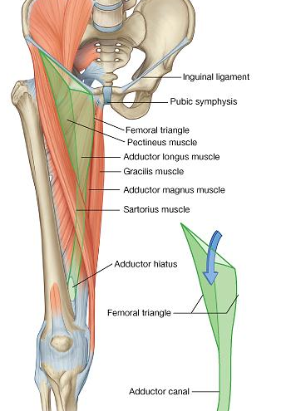
Femoral Triangle

Slide 20
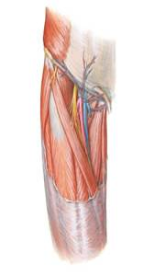
Femoral Triangle
Boundaries:
Inguinal ligament
Sartorius (lateral)
Adductor longus (medial)
Floor:
Iliopsoas, pectinius, adductor longus
Contents:
Femoral nerve
Femoral artery & deep (profunda)
femoral branch
Femoral vein
Great saphenous vein (superficial),
draining into femoral vein
Lymphatics
iliopsoas
pectinius
femoral
nerve
femoral
vein
femoral
artery
sartorius
adductor longus

Slide 21
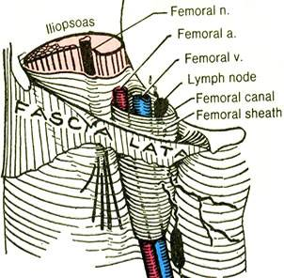
Femoral vessels
are enclosed by a
fascial sleeve
[femoral sheath]
which is deep to
the deep fascia
[fascia lata]
Lymphatics are
found medial to
the femoral vein
[femoral canal]

Slide 22
Summary: Movements of the Hip Joint (ball and socket).
Flexion - Anterior + medial compartments of thigh
(iliopsoas, sartorius, rectus femoris, adductor group)
Extension - Gluteal region /posterior compartment of thigh
(gluteus maximus, hamstrings, adductor magnus)
Adduction - Medial (adductor) compartment of thigh
Abduction - gluteus medius & minimus, Tenor Fascia Lata
Rotation:
Lateral - Gluteus maximus, lateral rotators
Medial - anterior parts of gluteus medius & minimus,
+ Tensor Fascia Lata

Slide 23
Blood Supply
Femoral Artery
Deep Femoral (Femoral Profunda)
Medial Circumflex
Lateral Circumflex
  Ascending Branch
  Lateral Branch
  Descending Branch

Slide 24
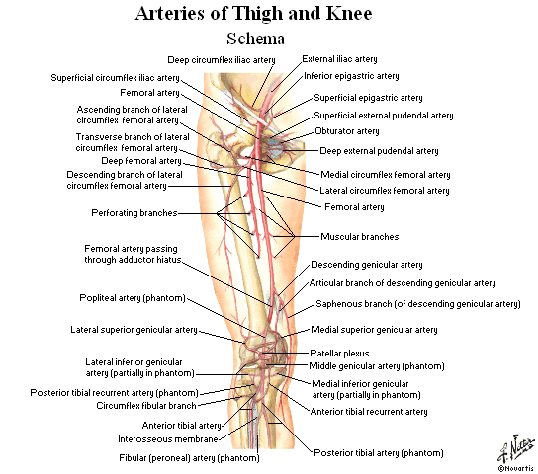
Blood Supply

Slide 25
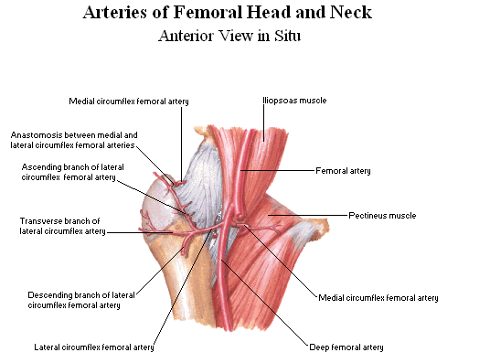
Blood Supply

Slide 26
Thank You

