Slide 1
Gluteal Region
Dr. Sama ul Haque

Slide 2
Objectives
Identify the bony landmarks of the pelvis and hip on the articulated skeleton and bones.
Enlist the prominent bony features of the femur.
Identify the muscles of the gluteal region in terms of their origin, insertion, nerve supply and actions.
Identify the superior gluteal and inferior gluteal nerves in relation to Piriformis muscle.
Explain how the anatomical position affects the muscle function.

Slide 3
The Gluteal Region
It extends from the iliac crest (waist) above to the gluteal fold below.
Buttock: The lower part of the gluteal region which presents a rounded bulge due to fat is called buttock.
Hip: It is the anterosuperior part of the gluteal region.

Slide 4
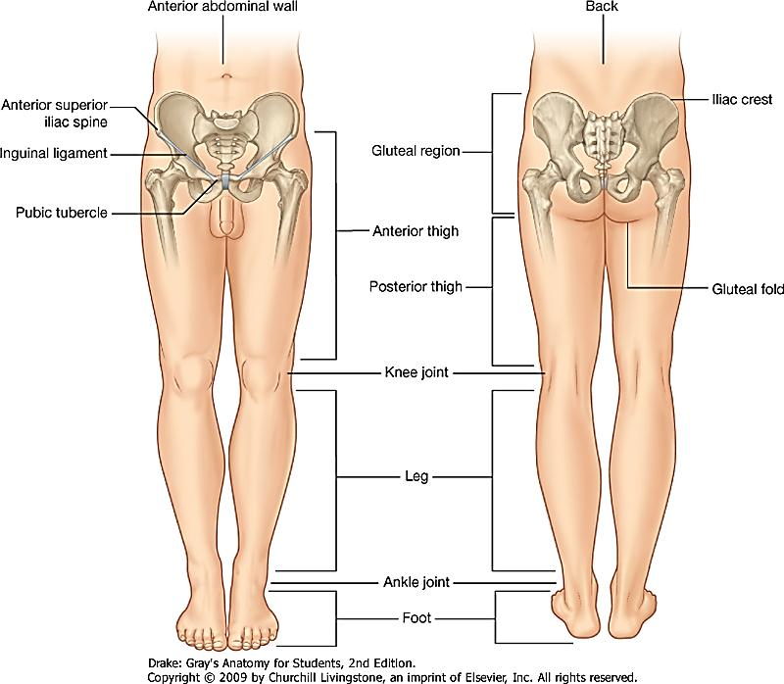

Slide 5
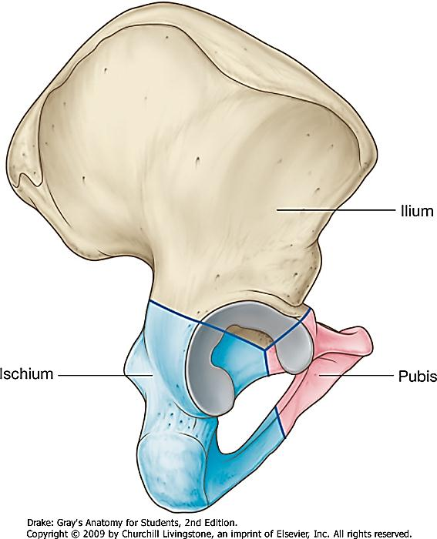
Hip Bone

Slide 6
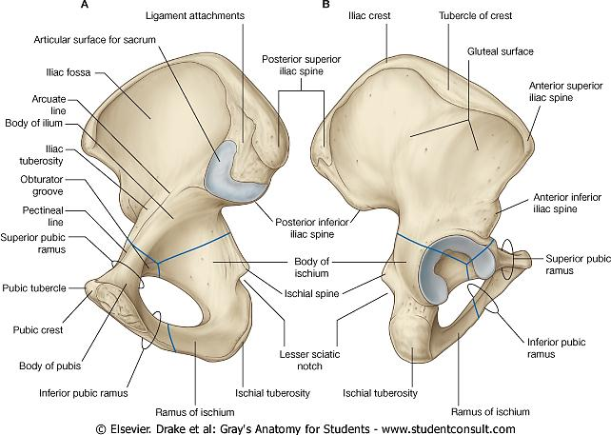

Slide 7
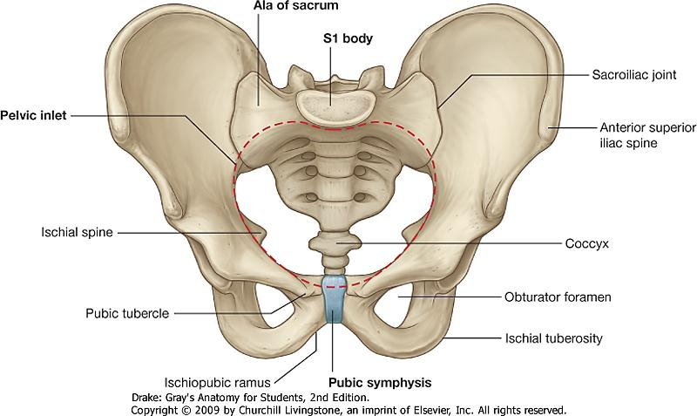
Bony Pelvis

Slide 8
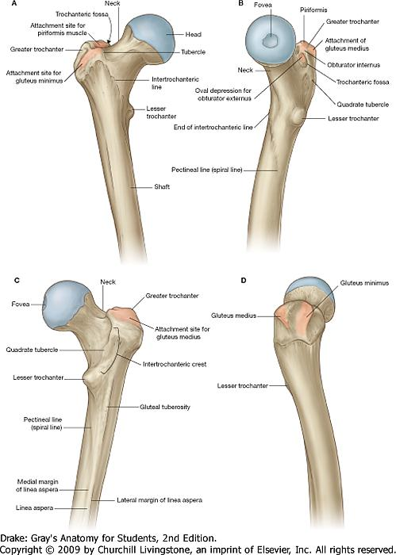
Femur
Femur

Slide 9
Femur

Slide 10
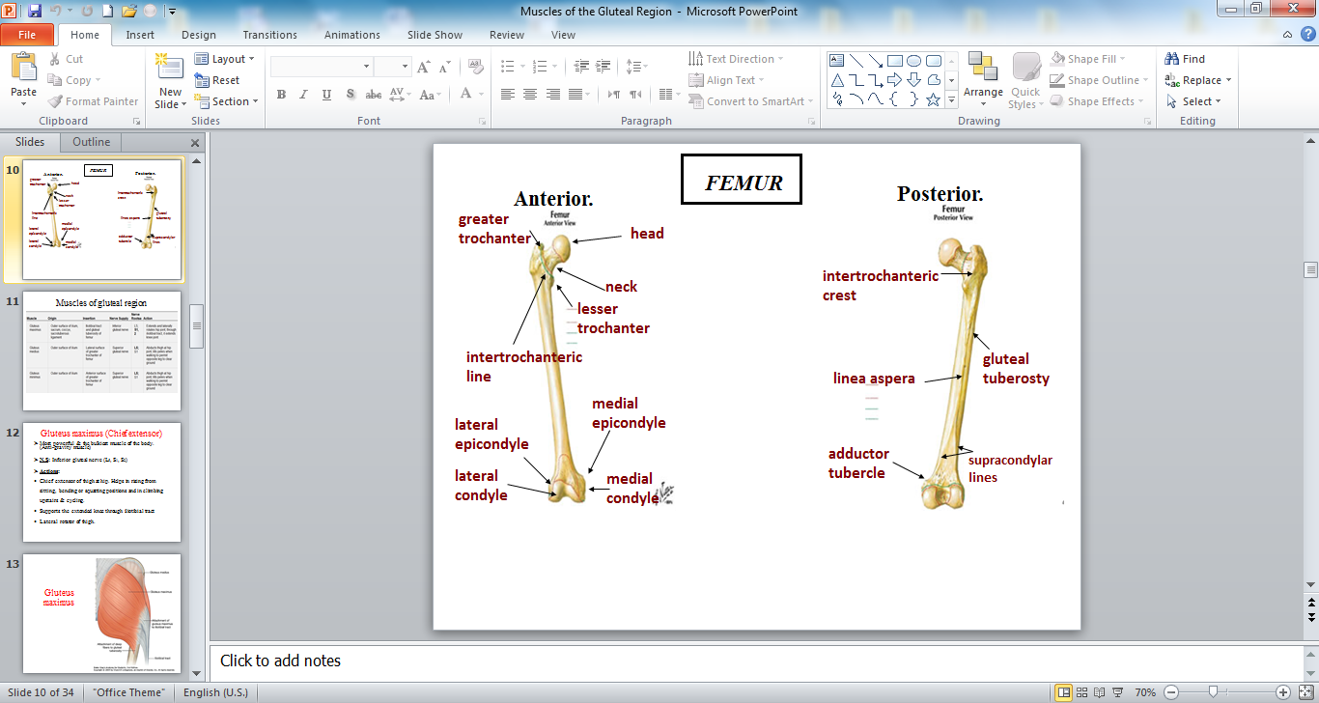

Slide 11
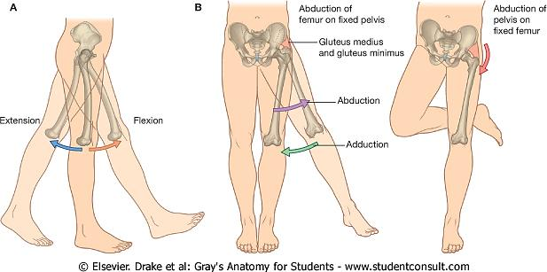
Movements at Hip Joint

Slide 12
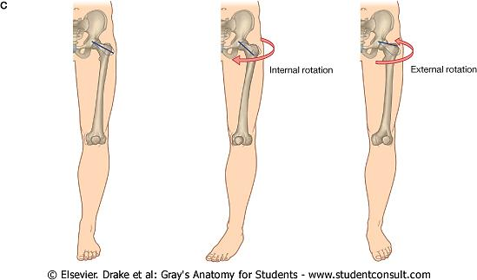
Movements at Hip Joint

Slide 13
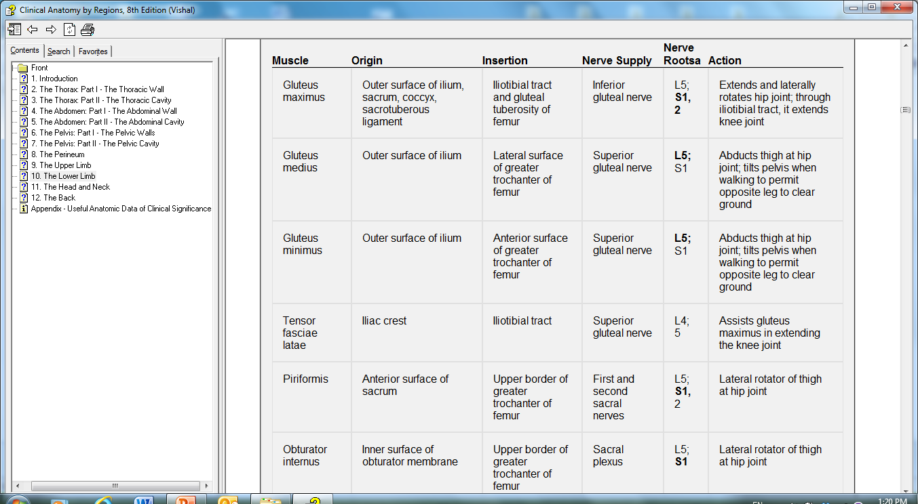
Muscles of gluteal region

Slide 14
Gluteus maximus (Chief extensor)
Most powerful & the bulkiest muscle of the body. (Anti-gravity muscle)
N.S: Inferior gluteal nerve (L₅, S₁, S₂)
Actions:
Chief extensor of thigh at hip. Helps in rising from sitting, bending or squatting positions and in climbing upstairs & cycling.
Supports the extended knee through iliotibial tract
Lateral rotator of thigh.

Slide 15
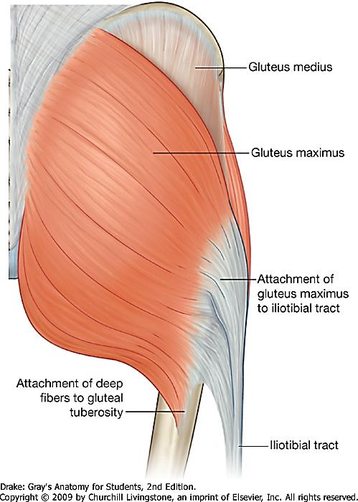
Gluteus maximus

Slide 16
Gluteus medius & Gluteus minimus
(Abductors)
Both fan shaped & lie under G. Maximus
N.S: Superior gluteal nerve (L₅, S₁,)
Actions:
Powerful abductor of thigh at hip joint.
Most important action is to prevent the opposite side of the pelvis tilting downwards as in walking & running.

Slide 17
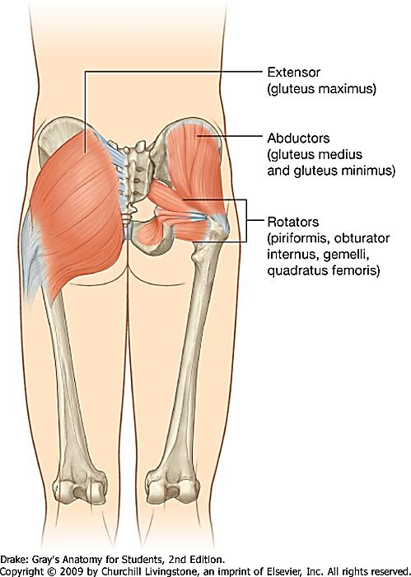
Gluteus medius and minimus

Slide 18
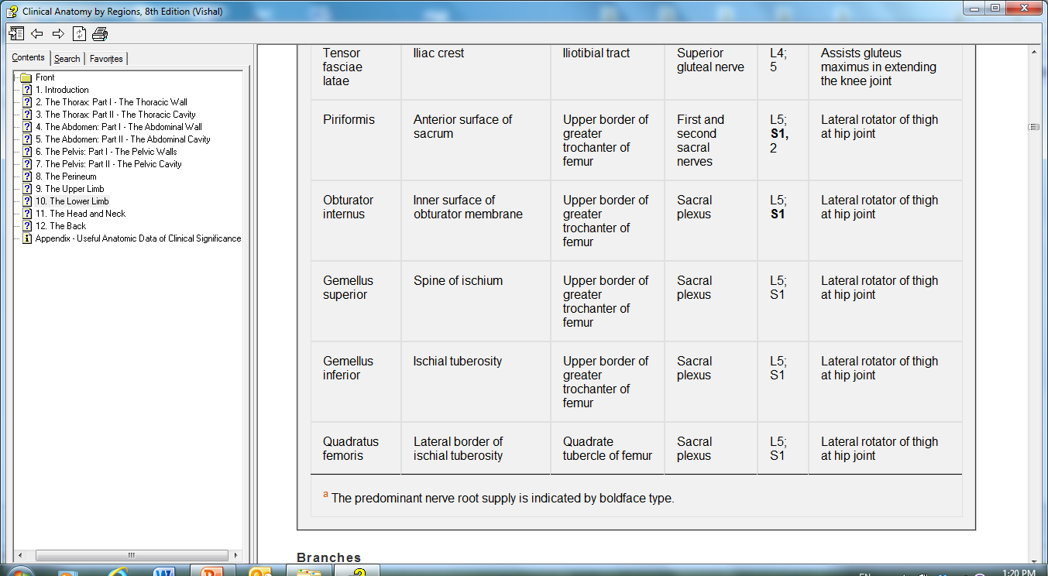
Muscles of gluteal region

Slide 19
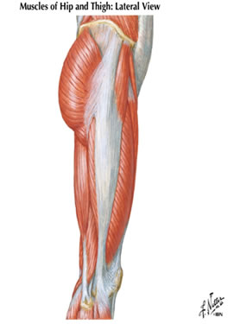
Tensor Fascia Latae
Gluteus
maximus
Tensor
Fasciae
Latae
iliotibial tract

Slide 20
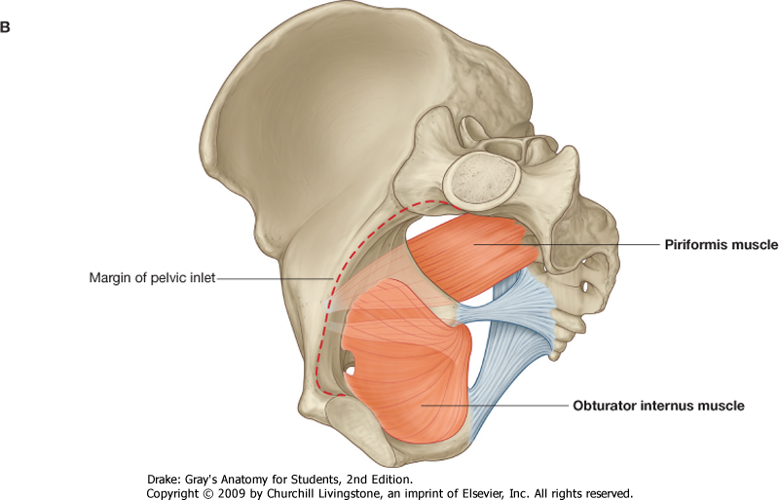
Piriformis & Obturator Internus (Origin)

Slide 21
Femur
Piriformis & Obturator Internus (Insertion)

Slide 22
Muscles of gluteal region

Slide 23
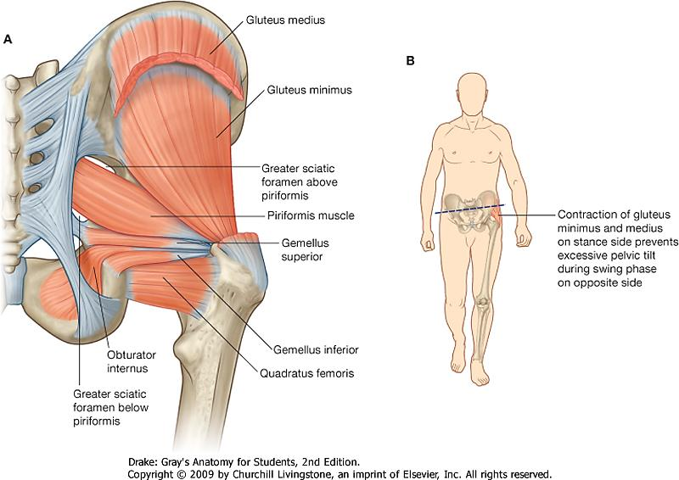
Gemellus Superior
Gemellus Inferior
Quadratus Femoris

Slide 24
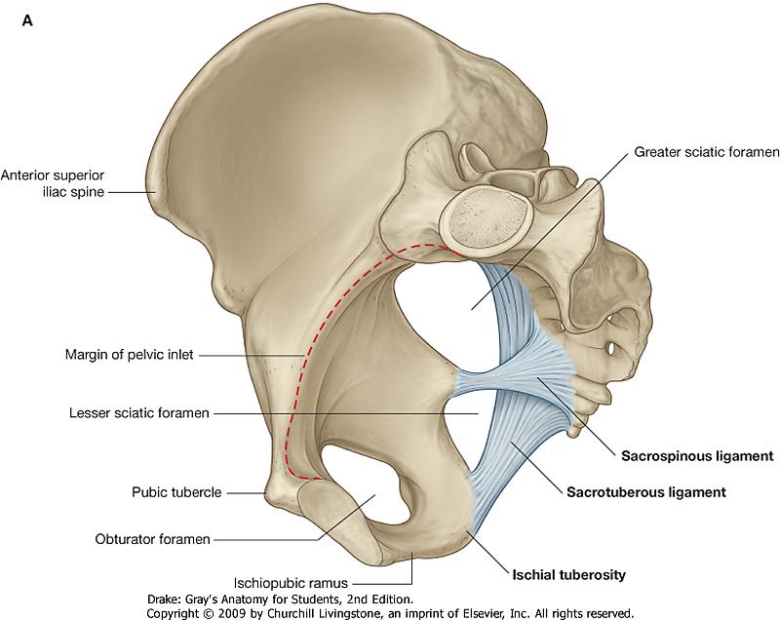
Greater and Lesser Sciatic Foramen

Slide 25
Structures passing through greater sciatic foramen
Piriformis Muscle
Above Piriformis:
Superior gluteal nerve
Superior gluteal vessels
3. Below Piriformis:
Inferior gluteal nerve
Inferior gluteal vessels
Sciatic nerve
Post. Cutaneous nerve of thigh
Nerve to quadratus femoris
Nerve to obturator internus
Pudendal nerve
Internal Pudendal vessels

Slide 26
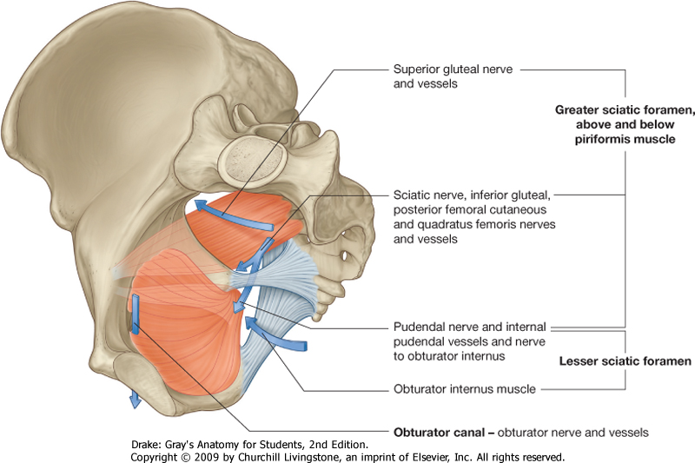
Structures passing through greater sciatic foramen

Slide 27
Structures passing through lesser sciatic foramen
Nerve to obturator internus
Pudendal nerve
Internal Pudendal vessels
Tendon of obturator internus
The first three structures after coming out of the pelvis through greater sciatic foramen, re-enter the pelvis by passing through the lesser sciatic foramen.

Slide 28
Structures passing through greater sciatic foramen

Slide 29
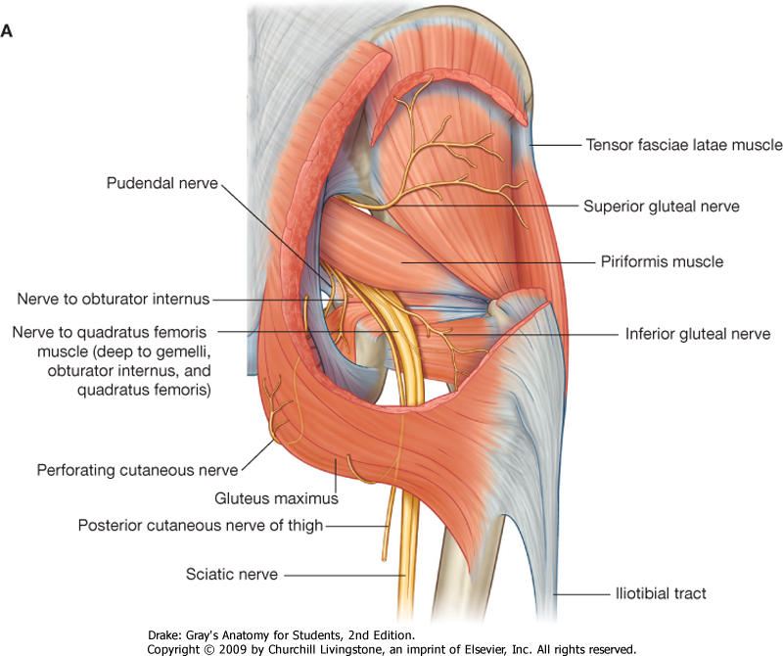

Slide 30
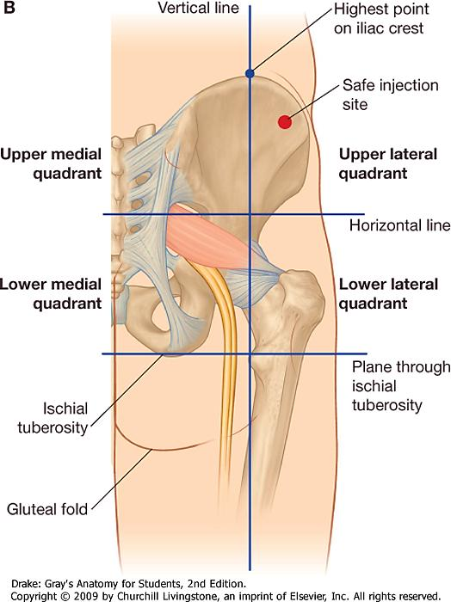
Site for Intramuscular Injection

Slide 32
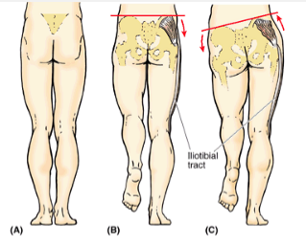
(A)Standing Position (B)During walk (C)Positive Trendelenburg Sign

Slide 33
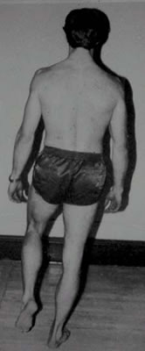
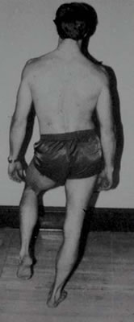
Normal Positive sign
Trendelenburg Sign
Loss of abductor function
(gluteus medius & minimus)
causes the pelvis to tilt down
when supporting the body
on the affected side (*).
(damage to superior gluteal
nerve).
This function of these
muscles is called
“stabilization of the pelvis”.
*

Slide 34
Thank You

