Slide 1
Objectives
Know the type and formation of hip joint.
Differentiate the stability and mobility between the hip joint and shoulder joint.
Identify the muscles that act at the hip joint.

Slide 2
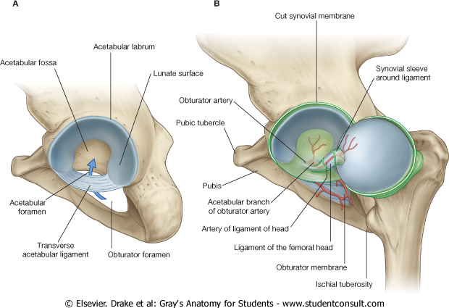
Hip joint
Is a synovial is a ball and socket joint.
Articulation between the head of the femur and the acetabulum.
The articular surfaces of the hip joint are:
the spherical head of the femur.
the lunate surface of the acetabulum.
The nonarticular acetabular fossa contains loose connective tissue.
The lunate surface and the head of the femur(except for the fovea) are covered by hyaline cartilage.

Slide 3
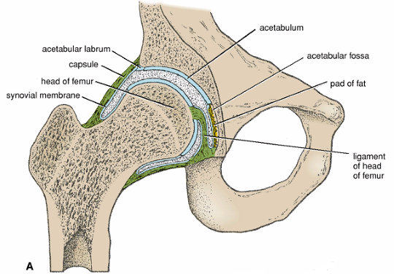

Slide 4
Capsule
The hip joint is enclosed within strong fibrous capsule lined by synovial membrane .
Proximally, it is attached to the acetabulum, and to the transverse acetabular ligament .
Distally, it is attached to the femoral neck posteriorly and anteriorly to the intertrochanteric line.

Slide 5
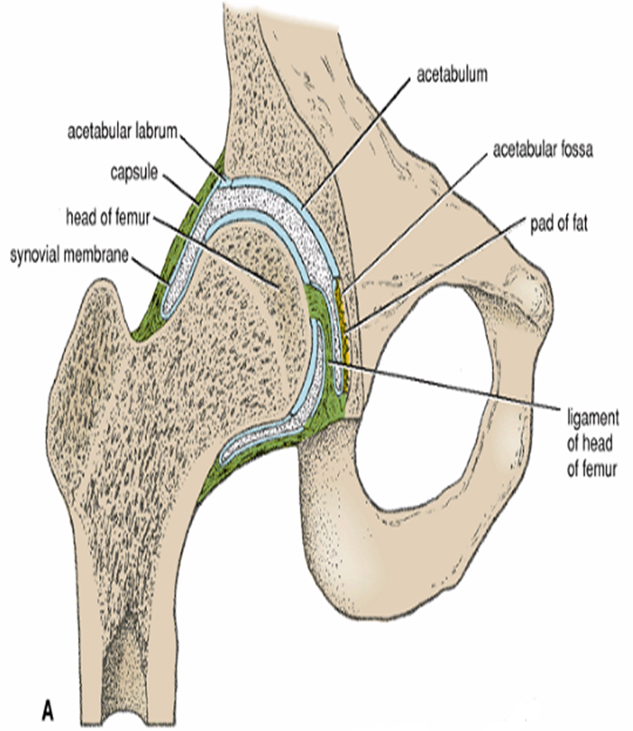
The synovial membrane lines the capsule and the nonarticular surfaces.
It reflects along the femoral neck to the edge of the femoral head forming retinacula (longitudinal synovial folds).
The arteries that supply the femoral head and neck course within the synovial folds.

Slide 6
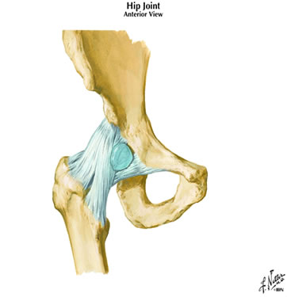
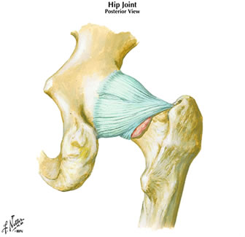
Ligaments
Anterior
Posterior
ischiofemoral
iliofemoral
crest
line
pubofemoral
Note: neck is bare here
Ligaments:
Pubofemoral (medial), resists over abduction
Iliofemoral (anterior), resists hyperextension
Ischiofemoral (posterior), resists hyperextension

Slide 7
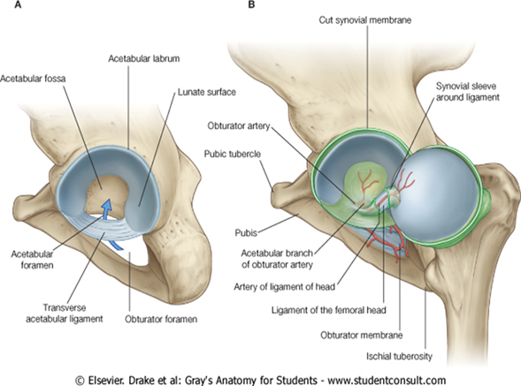
The transverse acetabular ligament is formed by the acetabular labrum as it bridges the acetabular notch

Slide 8
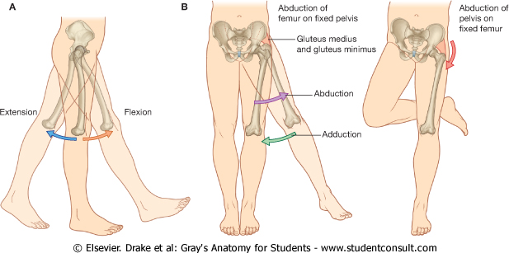
Movements at the hip joint include:
Flexion.
Extension,

Slide 9
Abduction.
Adduction.

Slide 10
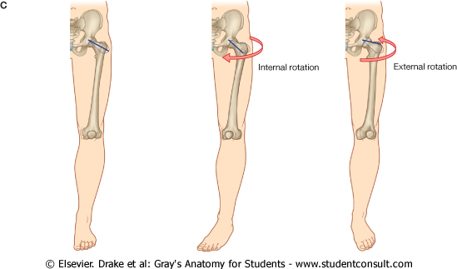
Medial and lateral rotation.
Circumduction.

Slide 11
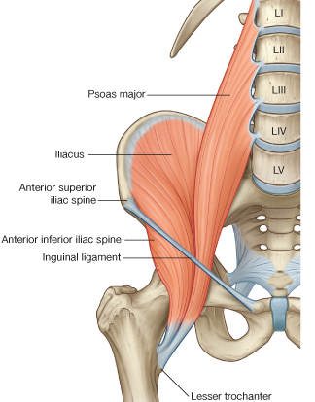
Hip Flexion
Chief flexor of HIP:
Iliopsoas
Psoas major
iliacus
Insertion – lesser trochanter
Femoral nerve (L2-L4):
- Main innervation of
anterior thigh.
Obturator nerve (L2-L4):
- Main innervation of
medial thigh.

Slide 12
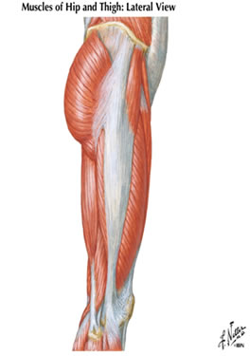
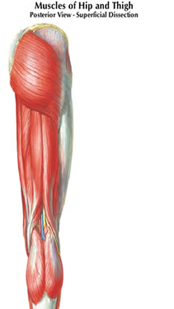
Hip extension
Gluteal region:
-Gluteus maximus
(most powerful extensor,
also lateral rotator)
Insertion:
Gluteal tuberosity
+
Iliotibial tract (band)
Gluteus
maximus
gluteus maximus
Tensor
Fasciae
Latae
iliotibial tract
FYI
Gluteus Maximus and Tensor Fascia Lata insert into Iliotibial Tract
- Iliotibial tract is a thickening of the deep fascia (fascia lata) that extends from the ilium to the tibia.
- Tension from contraction of gluteus maximus and tensor fasciae latae stabilizes the lower limb as a weight-bearing column.

Slide 13
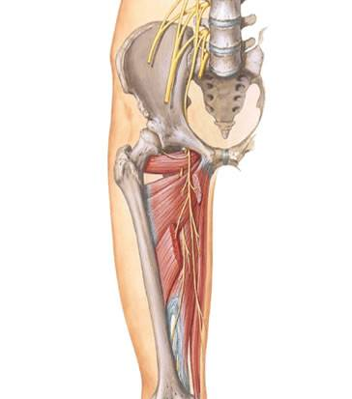
Hip Adduction
Medial Compartment
main function = adduction
Obturator externus
Adductor brevis
Adductor longus
Adductor magnus
Gracilis
Most innervated by:
Obturator nerve (L2-L4)
(lumbar plexus)
Exception:
-Hamstring component of
adductor magnus (extensor)
(tibial division of sciatic nerve)
obturator
externus
obturator
nerve
adductor brevis
Adductor
magnus
adductor longus
gracilis

Slide 14
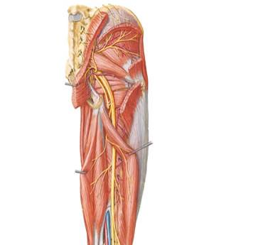
Lateral Rotation of the hip
gluteus medius
gluteus
maximus
gluteus minimus
Deep to gluteus maximus:
-abductors:
gluteus medius
gluteus minimus
(anterior fibres medially rotate)
-lateral (external) rotators:
piriformis
obturator internus
(associated gemelli)
quadratus femoris
[obturator externus is also a
lateral rotator]
superior
gamellus
piriformis
obturator
internus
quadratus
femoris
inferior
gamellus

Slide 15
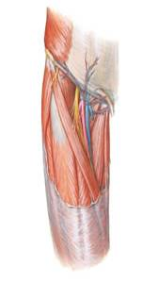
Femoral Triangle
Boundaries:
Inguinal ligament
Sartorius (lateral)
Adductor longus (medial)
Floor:
Iliopsoas, pectinius, adductor longus
Contents:
Femoral nerve
Femoral artery & deep (profunda)
femoral branch
Femoral vein
Great saphenous vein (superficial),
draining into femoral vein
Lymphatics
iliopsoas
pectinius
femoral
nerve
femoral
vein
femoral
artery
sartorius
adductor longus

Slide 16
Summary: Movements of the Hip Joint (ball and socket).
Flexion - Anterior + medial compartments of thigh
(iliopsoas, sartorius, rectus femoris, adductor group)
Extension - Gluteal region /posterior compartment of thigh
(gluteus maximus, hamstrings, adductor magnus)
Adduction - Medial (adductor) compartment of thigh
Abduction - gluteus medius & minimus, Tenor Fascia Lata
Rotation:
Lateral - Gluteus maximus, lateral rotators
Medial - anterior parts of gluteus medius & minimus,
+ Tensor Fascia Lata

Slide 17
Vascular supply to the hip joint is predominantly through branches of the:
obturator artery.
medial and lateral circumflex femoral arteries.
superior and inferior gluteal arteries.
first perforating branch of the deep artery of the thigh. The articular branches of these vessels form a network(anatomosis) around the joint .

Slide 18
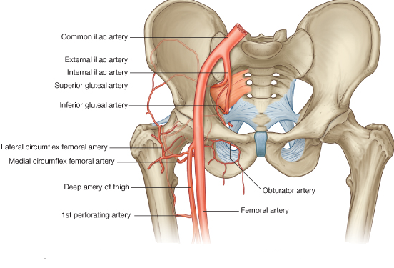

Slide 19
The Trochanteric Anastomosis:
The trochanteric anastomosis provides the main blood supply to the head of the femur.
The nutrient arteries pass along the femoral neck beneath the capsule .
The following arteries take part in the anastomosis:
the superior gluteal artery.
the inferior gluteal artery.
the medial femoral circumflex artery.
and the lateral femoral circumflex artery.

Slide 21
The Cruciate Anastomosis
The cruciate anastomosis is situated at the level of the lesser trochanter of the femur.
The following arteries take part in the anastomosis:
the inferior gluteal artery.
the medial femoral circumflex artery.
the lateral femoral circumflex artery.
the first perforating artery, a branch of the profunda artery.

Slide 23
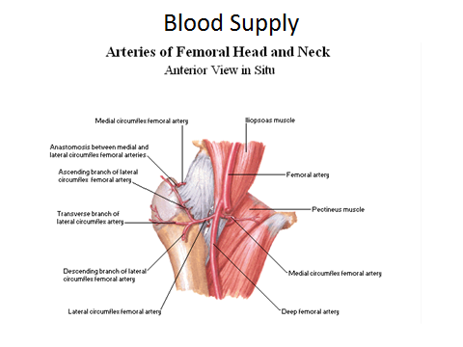

Slide 24
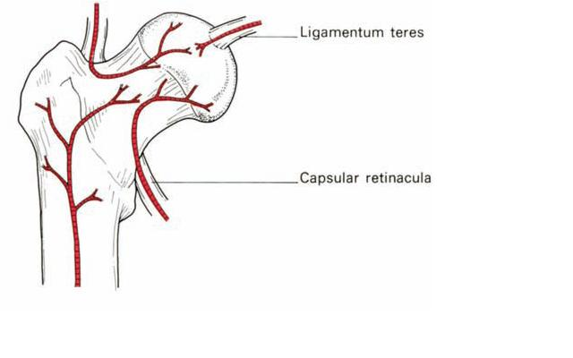

Slide 25
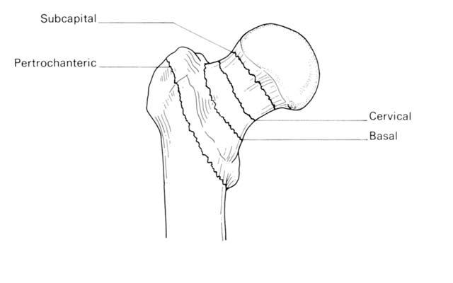

Slide 26
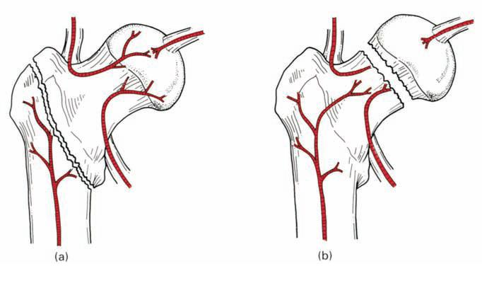

Slide 27
The hip joint is innervated by articular branches (Hilton’s Law) from:
the femoral.
obturator.
superior gluteal nerves
the nerve to the quadratus femoris.
sciatic nerve.

