Slide 1
Elbow Joint
Dr Rania Gabr

Slide 2
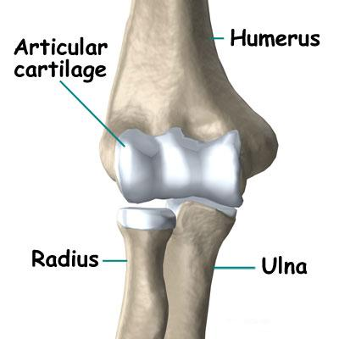

Elbow Joint
Type:
Uniaxial, Synovial Hinge joint
Articulation:
  Trochlea and capitulum of the humerus above
  Trochlear notch of ulna and the head of radius below
  The articular surfaces are covered with articular (hyaline) cartilage.
Capitulum
Trochlea
Trochlear notch

Slide 3
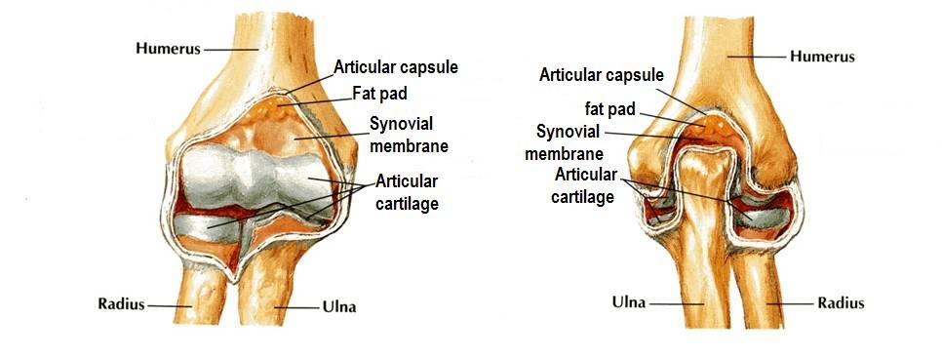
Capsule
Anteriorly: attached
  Above to the humerus along the upper margins of the coronoid and radial fossae and to the front of the medial and lateral epicondyles and
  Below to the margin of the coronoid process of the ulna and to the anular ligament, which surrounds the head of the radius.

Slide 4
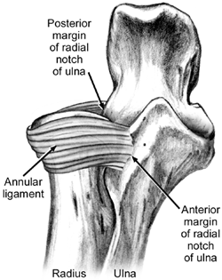
Posteriorly:
attached
  Above to the margins of the olecranon fossa of the humerus and
  Below to the upper margin and sides of the olecranon process of the ulna and to the anular ligament.

Slide 5
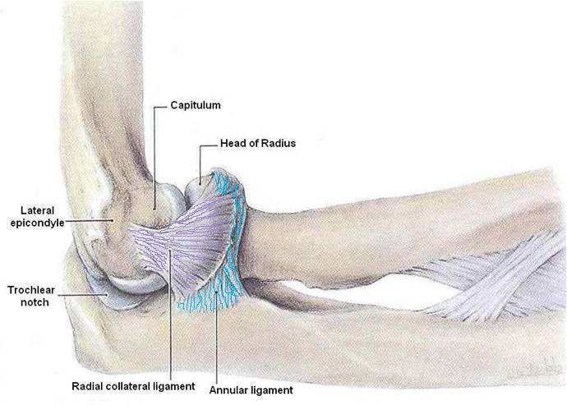
Ligaments
Lateral (radial collateral) ligament
Triangular in shape:
Apex attached to the lateral epicondyle of humerus
Base attached to the upper margin of annular ligament.

Slide 6
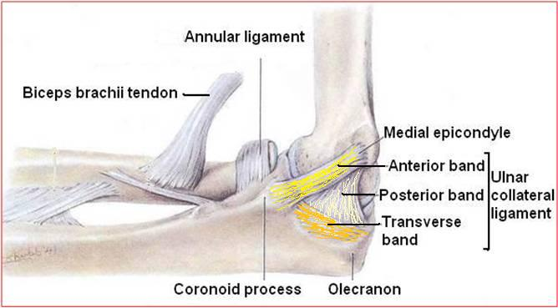
Medial (ulnar collateral) ligament
Composed of three parts (bands)
  Anterior strong cord-like band: between medial epicondyle and the coronoid process of ulna
  Posterior weaker fan-like band: between medial epicondyle and the olecranon process of ulna
  Transverse band: passes between the anterior and posterior bands

Slide 7
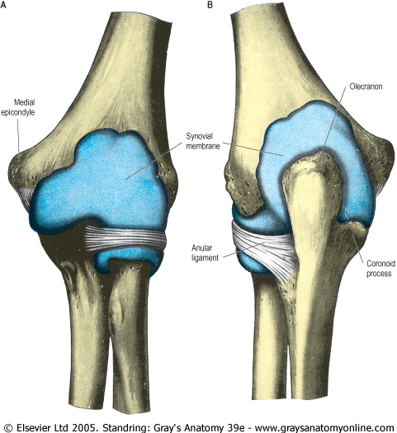
Synovial Membrane
This lines the capsule and covers fatty pads in the floors of the coronoid, radial, and olecranon fossae
Is continuous below with synovial membrane of the superior radioulnar joint

Slide 8
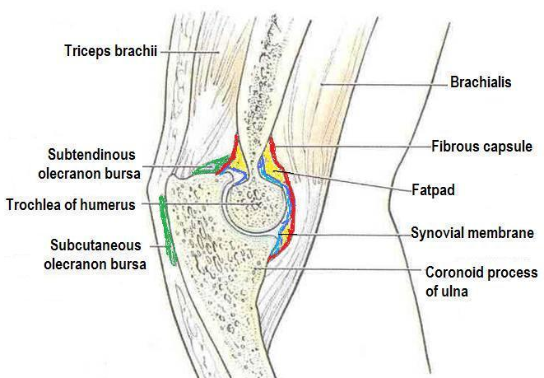
Relations
Anterior: Brachialis, tendon of biceps, median nerve, brachial artery
Posterior: Triceps muscle, small bursa intervening
Lateral: Common extensor tendon & the supinator
Medial: Ulnar nerve
Bursae around the elbow joint:
Subcutaneous olecranon bursa
Subtendinous olecranon bursa

Slide 9
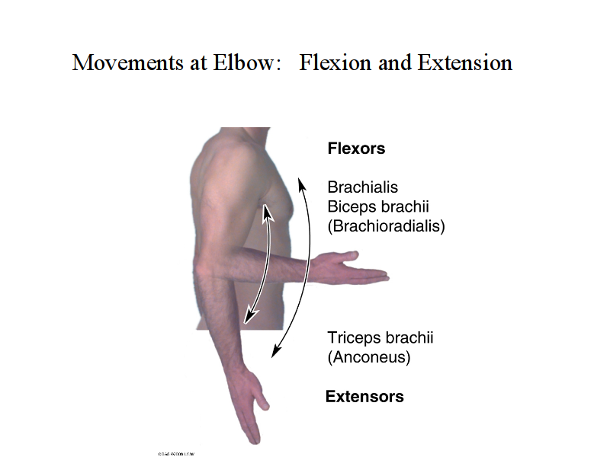
Movements
Movements possible are
Flexion & Extension
Flexion is limited by the anterior surfaces of the forearm and arm coming into contact.
Extension is limited by the tension of the anterior ligament and the brachialis muscle.
The joint is supplied by branches from the median, ulnar, musculocutaneous, and radial nerves.

Slide 10
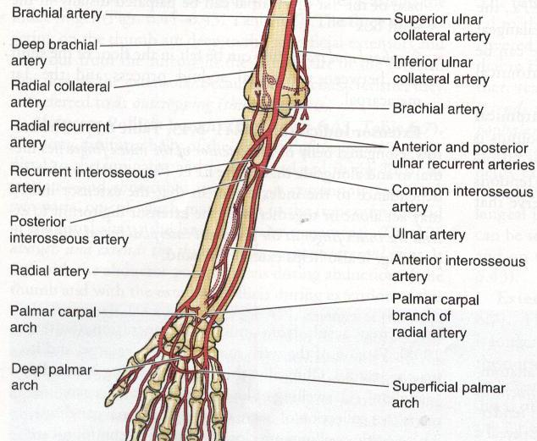
Blood supply of the Elbow joint

Slide 11
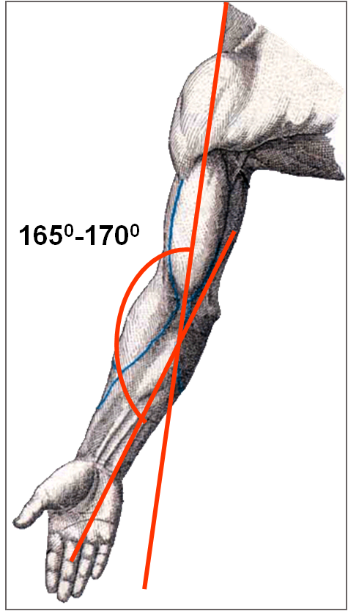
Carrying Angle
It is The angle between the long axis of the arm and the long axis of the extended of the forearm
Opens laterally
Is about 170 degrees in male and 167 degrees in females
Disappears when the elbow joint is flexed
Permits the forearms to clear the hips in swinging movements during walking, and is important when carrying objects

Slide 12
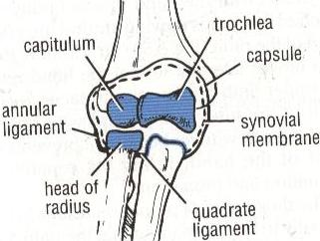
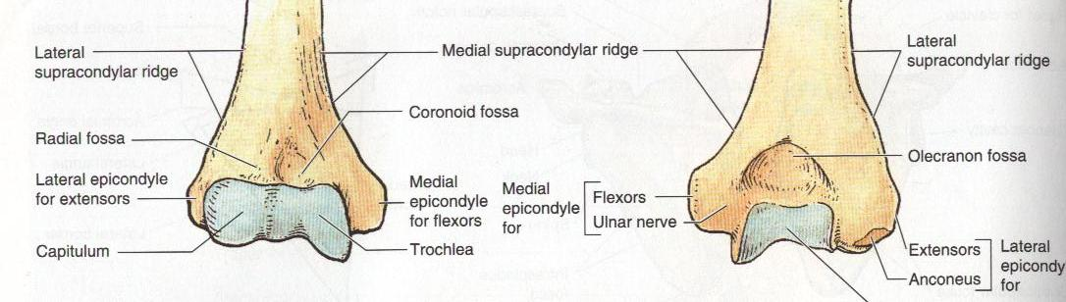
Stability
The elbow joint is a stable joint because of the:
  Wrench-shaped articular surface of the olecranon and the pulley-shaped trochlea of the humerus
  Strong medial and lateral ligaments.

Slide 13
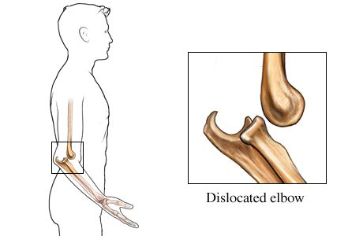
Elbow Injuries
Elbow dislocations are common, and most are posterior.
  Posterior dislocation usually follows falling on the outstretched hand.
  Posterior dislocations of the joint are common in children because the parts of the bones that stabilize the joint are incompletely developed.

Slide 14
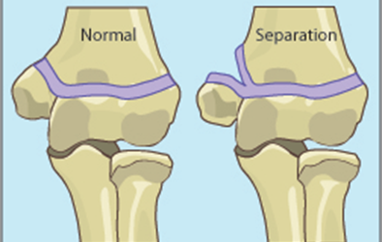
Avulsion of the epiphysis of the medial epicondyle is also common in childhood because the medial ligament is much stronger than the bond of union between the epiphysis and the diaphysis.

Slide 15
Epicondylitis:
inflammation or microdamage to collagenous tissues on either lateral or medial side of the distal humurus.
Lateral epicondylitis is known as “tennis elbow.” This injury is caused by chronic inflammation of the attachment of the extensor carpi radialis brevis and extensor digitorum to the lateral epicondyle.
Medial epicondylitis is called “Golfer`s elbow”

Slide 16
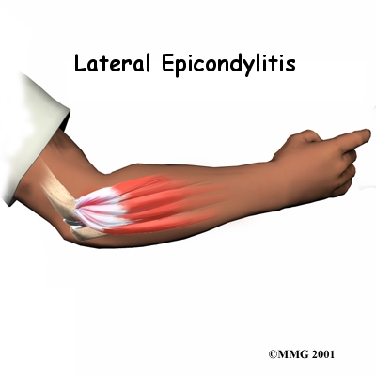
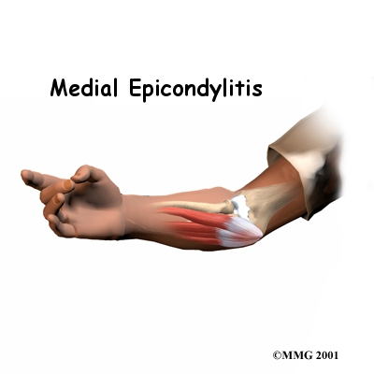
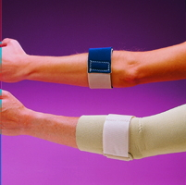
Epicondylitis

Slide 17
Elbow fracture –
frequently accompany elbow dislocations.
The most common is a fracture
of the medial epicondyle, and they occur
especially in the middle to late adolescent
age group where the epicondylar epiphysis
has not yet closed.
Dislocations/fractures in this age group can
be caused by repeated forceful acts such as
pitching a baseball or serving in tennis.

Slide 18
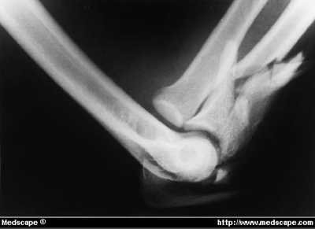
Which bone is fractured?

Slide 19


