Slide 1
Muscles of the Anterior Forearm

Slide 2
Objectives
Name and identify the muscles in the anterior (flexor/pronator) and posterior (extensor/supinator) compartments of the forearm, noting their relations.
Name and identify the neurovascular structures in the anterior and posterior compartments of the forearm, noting their relations.
Discuss the functions of the muscles in the anterior and posterior compartment of the forearm.

Slide 3
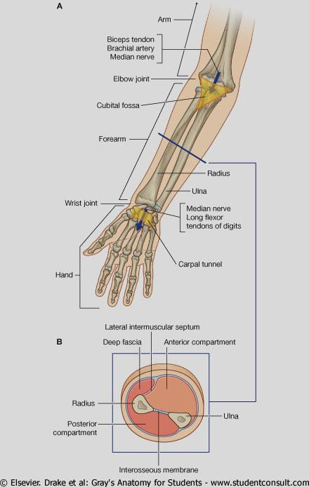
Functional organization
of
Anterior and posterior Compartments of forearm.

Slide 4
Names of the Muscles of forearm
Many of them
Long names: good guide to location and function
Location: ie. superficial / deep
radial / ulnar
(which side is the thumb on??)
Function: ie. flexor / extensor
adductor / abductor
Does it act on the thumb (pollux) or the fingers (digits)?

Slide 5
Functional Organization
Anterior compartment – flexor / pronator
Posterior Compartment – extensor / supinator
Flex the wrist ………[flexor]
Extend the wrist ……..[extensor]
Pronate the forearm ……..[pronator]
Acting on wrist (carpus) only ……[carpi]
Acting on fingers ……..[digiti / digitorum]
Acting on thumb (pollux) ……[pollicus]

Slide 6
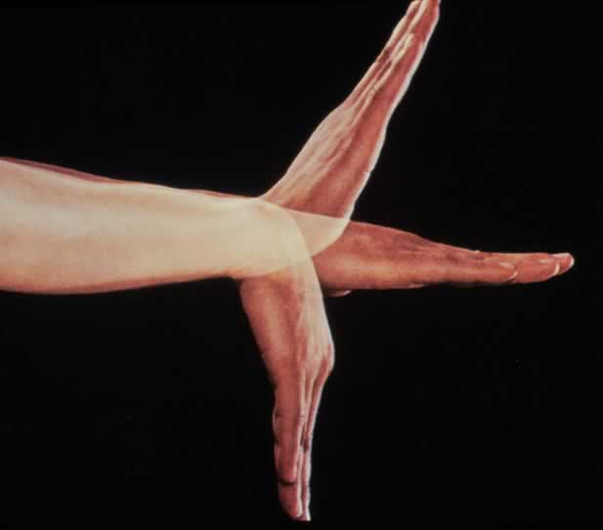
Flexion / Extension at the wrist joint.
Extension
Flexion

Slide 7
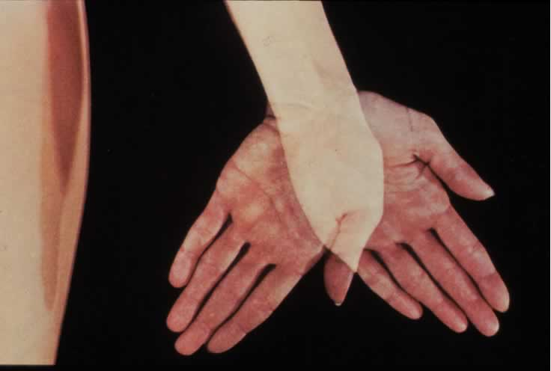
Adduction / abduction at the wrist joint.
Ad-duction
Ab-duction

Slide 8
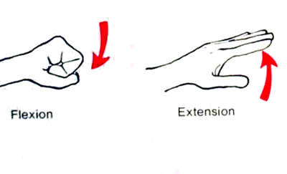
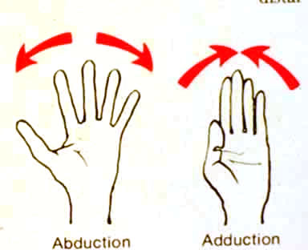
Movements of fingers.
MCP (condyloid joints): flexion / extension
abduction / adduction
IP (hinge joints): flexion / extension
X
X

Slide 9
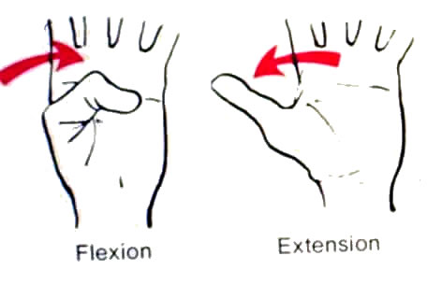
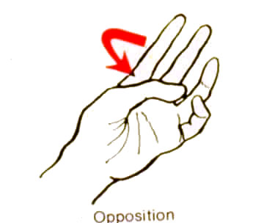
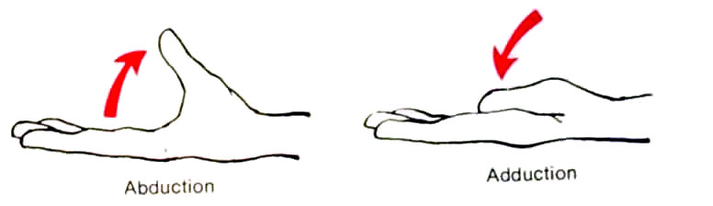
Movements of the thumb – a specialized digit, occur at
right angles to the fingers. Mainly at the CMC (saddle) joint.
MCP – condyloid; IP – hinge (like fingers).

Slide 10
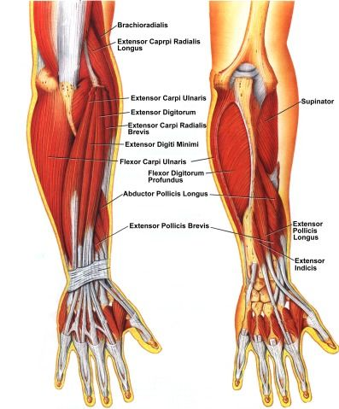
Muscles of Forearm

Slide 11
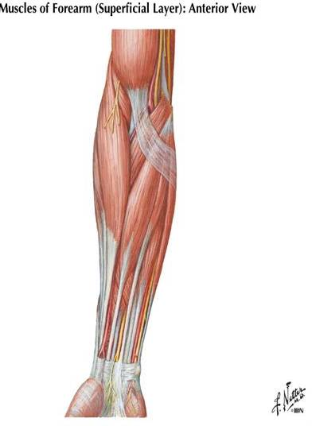
Anterior compartement of forearm
Flexor / pronator Compartment
Divided into:
Superficial group(5)
From lateral to medial:
- Pronator teres
Flexor carpi radialis
Palmaris longus
Flexor digitorum
superficialis,
Flexor carpi ulnaris
And :- ……
Protonator teres
Brachioradialis
flexor carpi radialis
palmaris longus
flexor digitorum superficialis
flexor carpi ulnaris

Slide 12
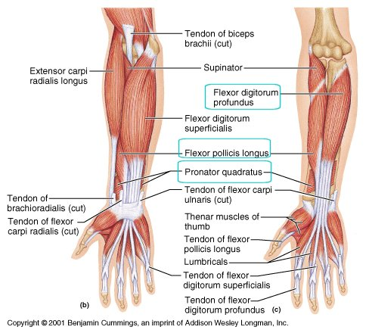
Anterior compartement of forearm
Flexor / pronator Compartment
DEEP GROUP (3)
Flexor pollicis longus (FPL)
Flexor digitorum profundus (FDP)
Pronator quadratus (PQ)

Slide 13
SUPERFICIAL GROUP
ORIGINS:
All 5 muscles have a HUMERAL HEAD
(arising from the front of medial epicondyle of humerus: Common flexor origin).
IN ADDITION:
3 out of 5 muscles have an ULNAR HEAD:
PT & FDS: arise from medial border of coronoid process of ulna
FCU: arises from medial surface of olecranon process & posterior border of shaft of ulna
One muscle has a RADIAL HEAD:
FDS: arises from oblique line & anterior border of shaft of radius

Slide 14
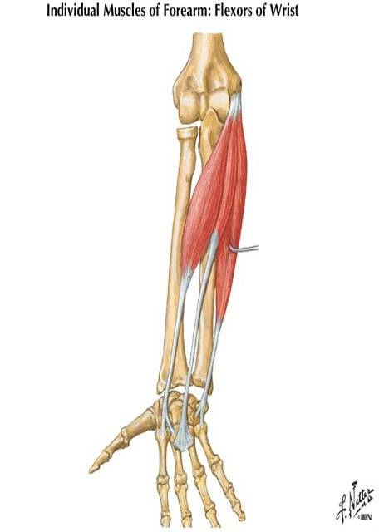
SUPERFICIAL GROUP
Functional organization:
3 muscles mainly flex at the wrist.
Flexor carpi radialis
Palmaris longus
Flexor carpi ulnaris
Any “carpi” is inserted into metacarpal bone
FCR :(flexion + abduction of wrist joint): inserted into 2nd & 3rd metacarpal bones
FCU :(flexion + adduction of wrist joint): inserted into 5th metacarpal bone (+ pisiform & hamate)
PL :(flexion of wrist joint): inserted into palmar aponeurosis
Flexor Carpi Radialis
Palmaris Longus
Flexor Carpi ulnaris

Slide 15
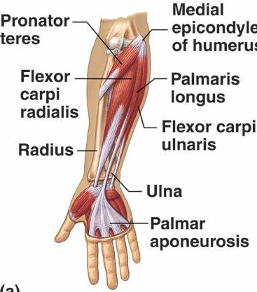
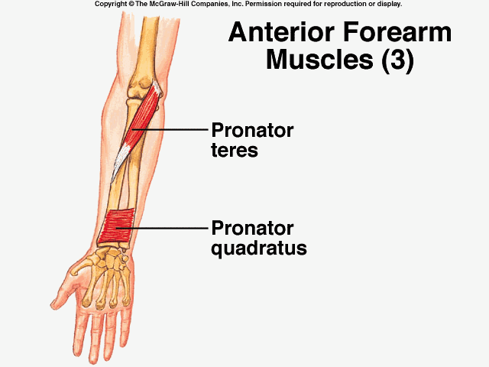
Pronator Teres
One pronator of radioulnar joints Pronator Teres produces powerful pronation
Any muscle acting on radioulnar joint must be inserted into radius
Origin:
  Medial epicondyle of humerus
Insertion: middle of lateral surface of shaft of radius (point of maximum curvature)

Slide 16
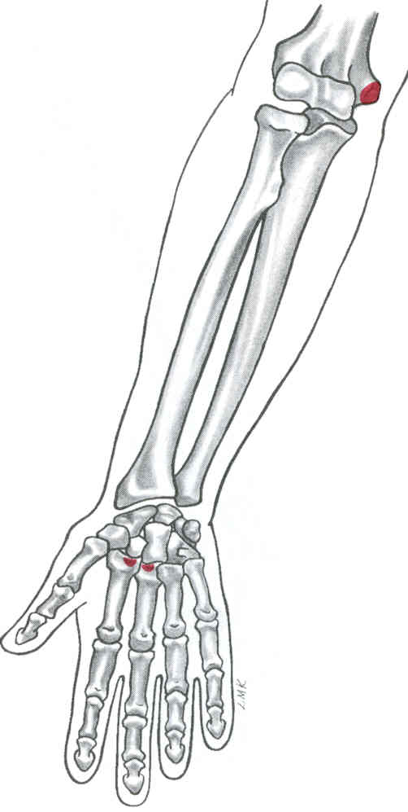
Flexor Carpi Radialis
Origin:
  Medial epicondyle of humerus
Insertion:
  Base of 2nd & 3rd metacarpals, anterior (palmar surface)

Slide 17
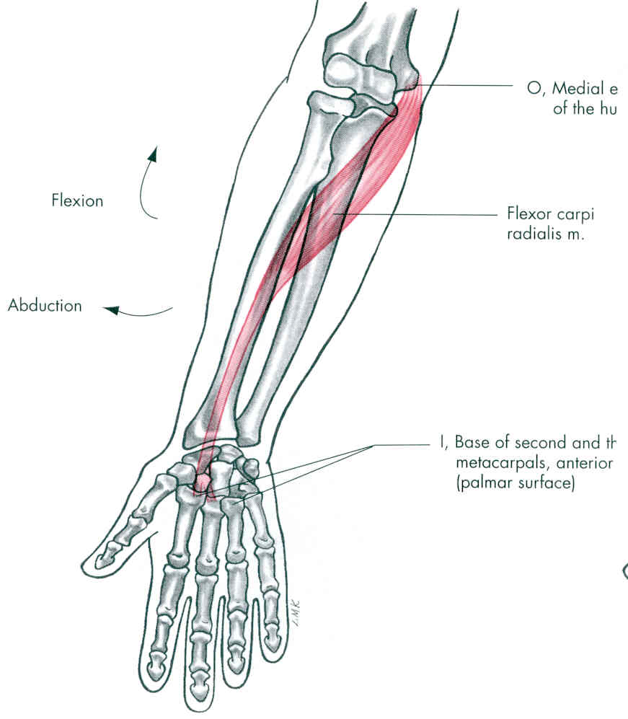
Flexor Carpi Radialis
Action:
  Flexion of wrist
  Abduction of wrist
  Weak flexion of elbow
Innervation:
  Median nerve (C6,7)

Slide 18
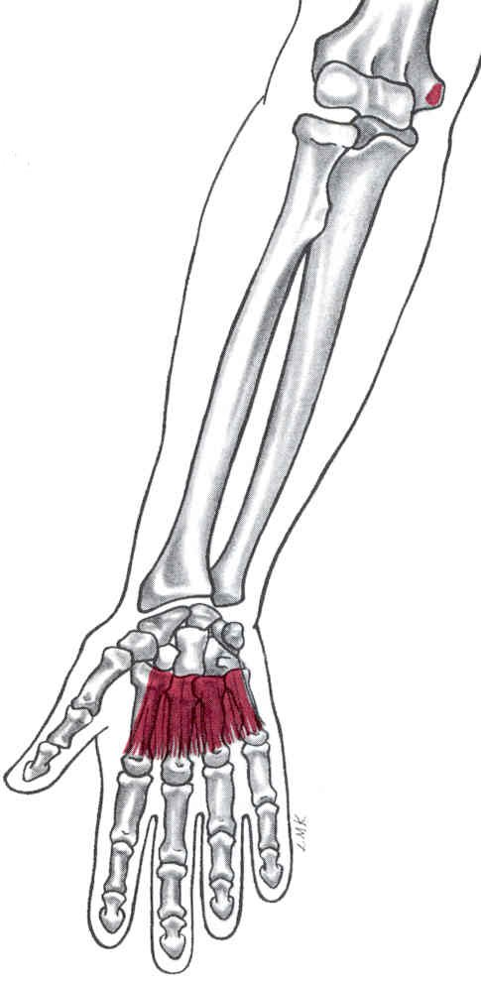
Palmaris Longus
Origin:
  Medial epicondyle of humerus
Insertion:
  Palmar aponeurosis of the 2nd, 3rd, 4th, & 5th metacarpals

Slide 19
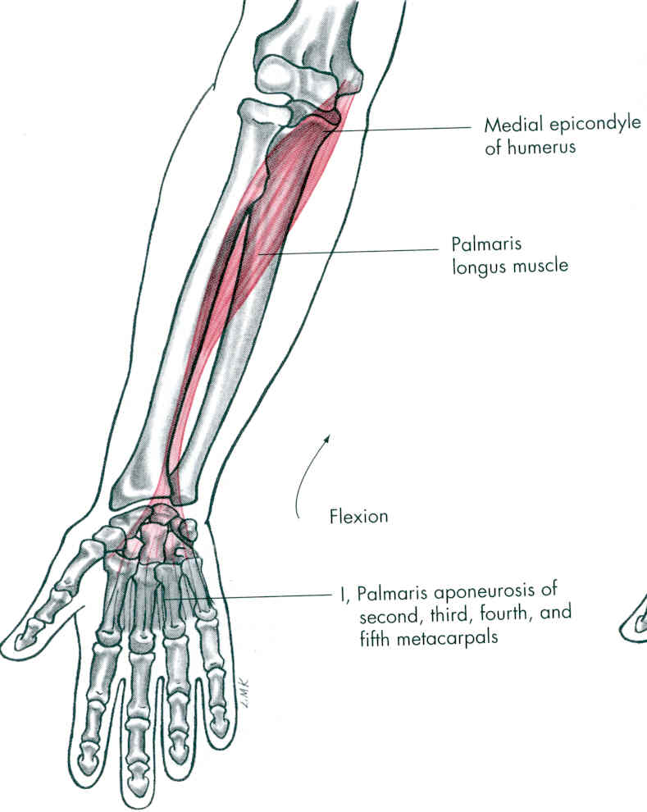
Palmaris Longus
Action:
  Flexion of wrist
  Weak flexion of elbow
Innervation:
  Median nerve (C6,7)

Slide 20
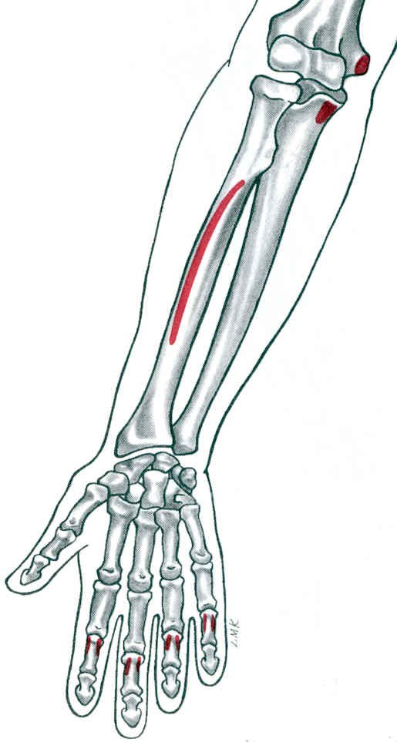
Flexor Digitorum Superficialis
Origin:
  Humeral head:Medial epicondyle of humerus
  Ulnar Head: medial coronoid process
  Radial Head: upper 2/3 of anterior border of radius

Slide 21
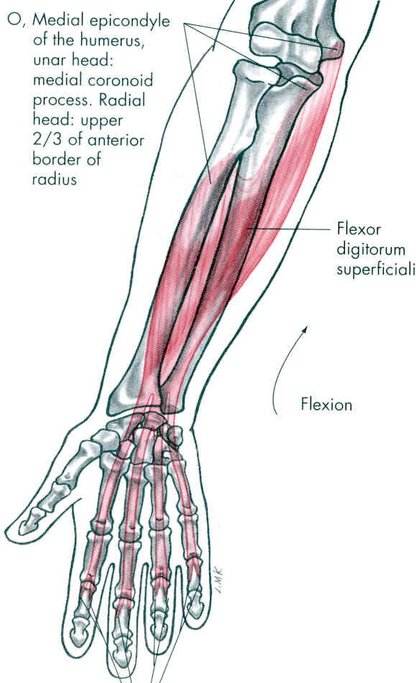
Flexor Digitorum Superficialis
Insertion:
by 4 tendons into the middle phalanges of medial 4 fingers
Action:
produces flexion of proximal interphalangeal & metacarpophalangeal joints of medial 4 fingers

Slide 22
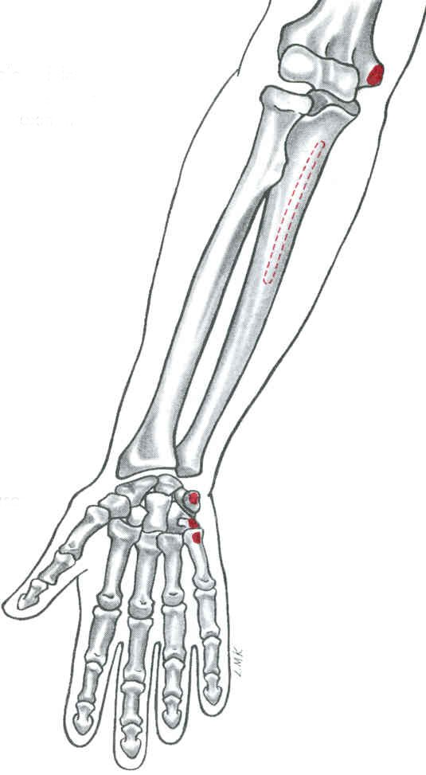
Flexor Carpi Ulnaris
Origin:
  Medial epicondyle of humerus
  Posterior aspect of the proximal ulna
Insertion:
  Pisiform, hamate, & base of 5th metacarpal

Slide 23
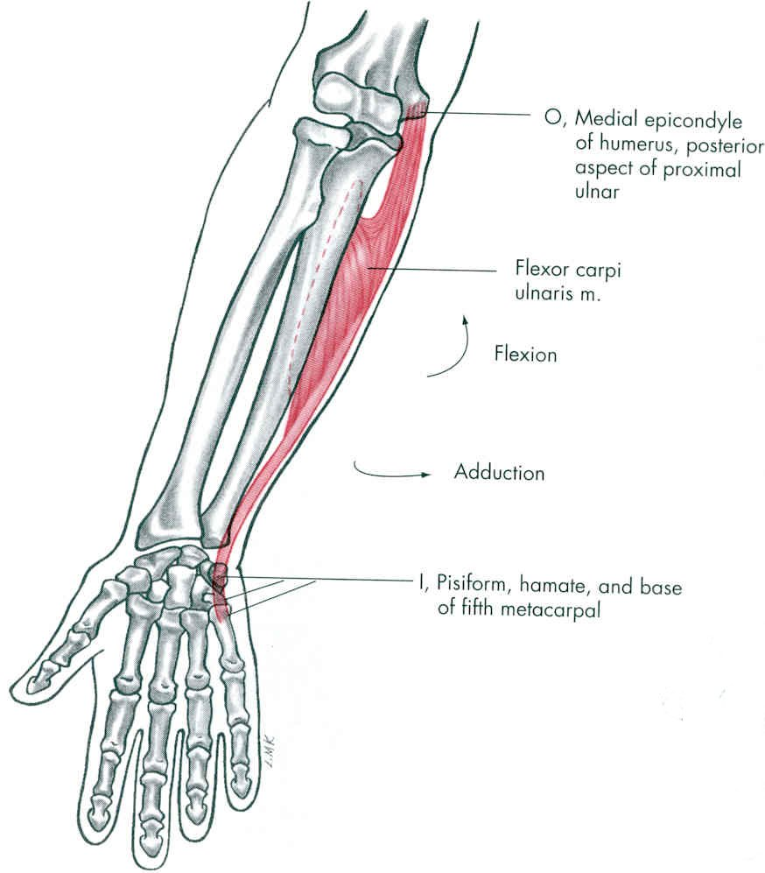
Flexor Carpi Ulnaris
Action:
  Flexion of wrist
  Adduction of wrist
  Weak flexion of elbow
Innervation:
  Ulnar nerve (C8, T1)

Slide 24
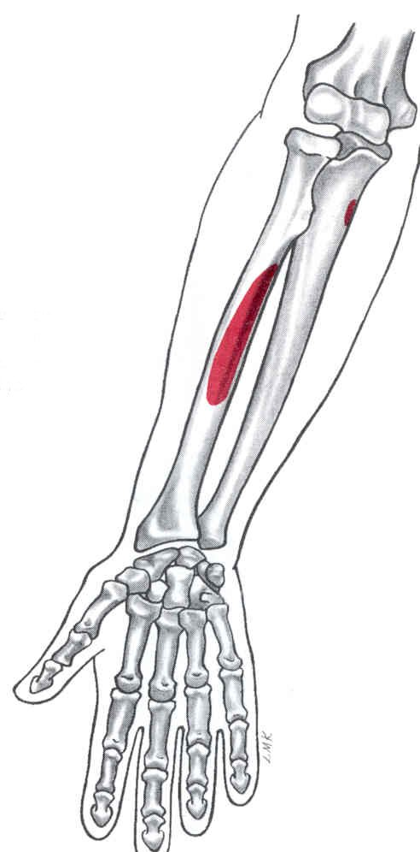
Flexor Pollicis Longus
DEEP GROUP
Origin:
  Middle anterior surface of radius(+ interosseous membrane)
  Anterior medial border of ulna (just distal to coronoid process)
Insertion:
  Base of distal phalanx of thumb (palmar surface)

Slide 25
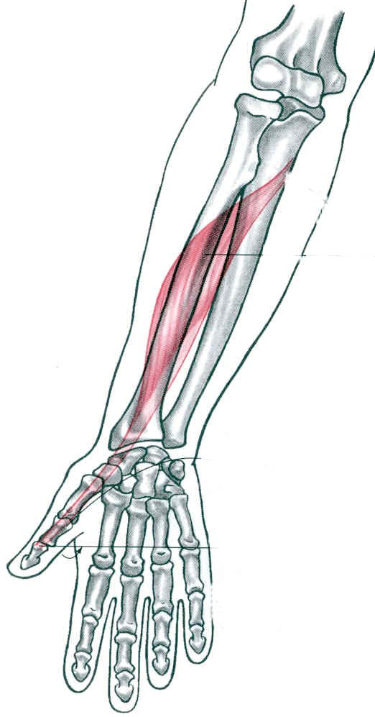
Flexor Pollicis Longus
Action:
  Flexion of thumb
  Flexion of wrist
Innervation:
  Median nerve (C8, T1)

Slide 26
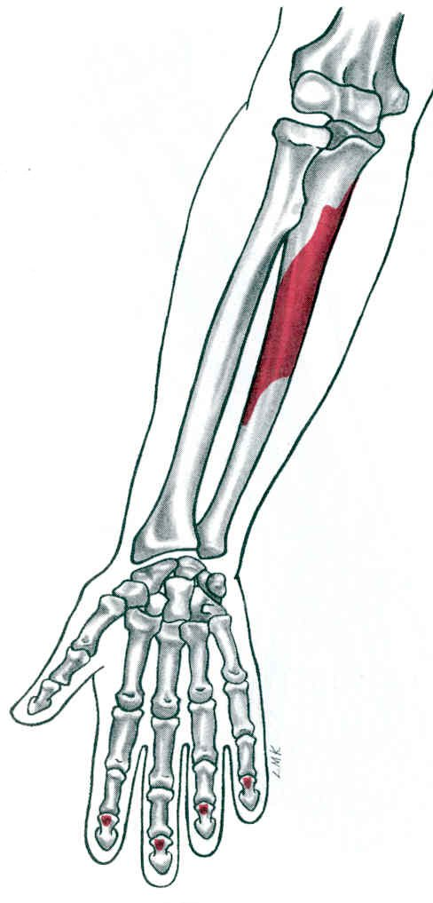
Flexor Digitorum Profundus
Origin:
  Proximal ¾ of anterior & medial ulna
Insertion:
  Base of distal phalanxes of the 4 fingers

Slide 27
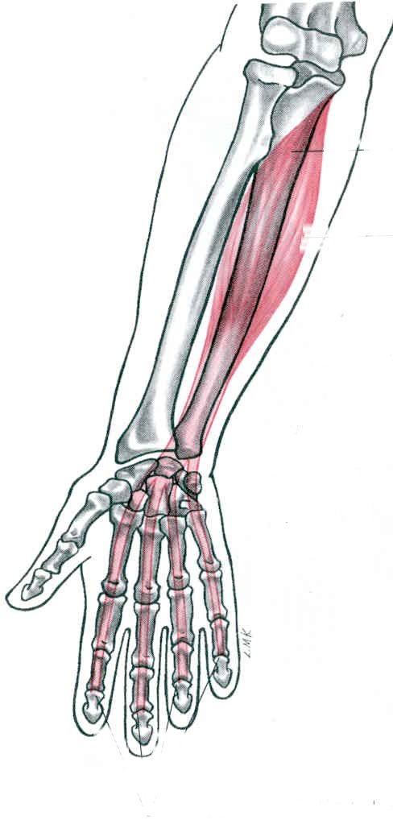
Flexor Digitorum Profundus
Action:
  Flexion of fingers
  Flexion of wrists
Innervation: Double innervation
  Median nerve (C8, T1) to 2nd & 3rd fingers
  Ulnar nerve (C8, T1) to 4th & 5th fingers

Slide 28
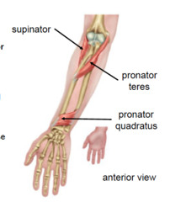
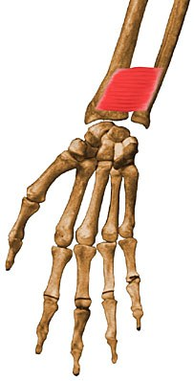
PRONATOR QUADRATUS
ORIGIN: Lower ¼ of anterior surface of shaft of ulna
INSERTION: Lower ¼ of anterior surface of shaft of radius
ACTION: main pronator of radioulnar joints

Slide 29
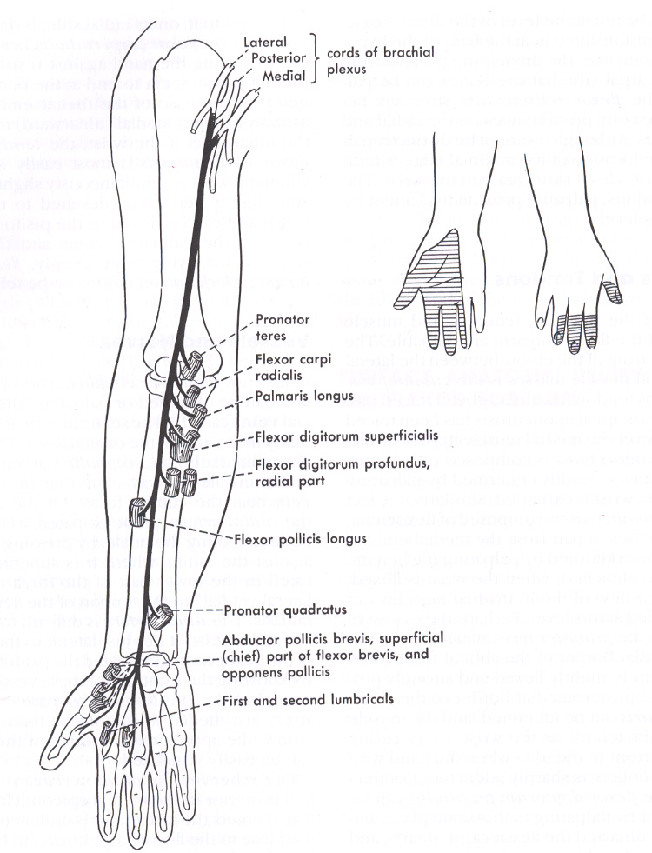
Nerve Supply
All forearm muscles are innervated by the MEDIAN nerve EXCEPT:
1 ½ muscles
  flexor carpi ulnaris
  ulnar side of the flexor digitorum profundus
Plus: All thenar ms except adductor pollicis

Slide 30
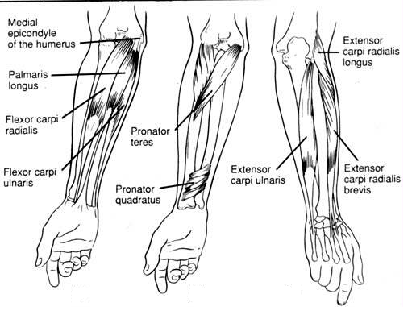
Muscles of the Forearm

Slide 31
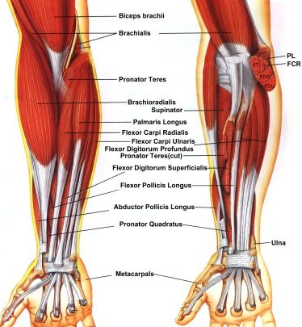
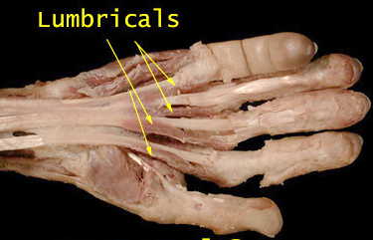
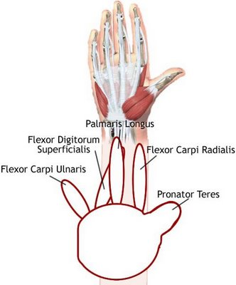
Anterior Fore Arm
Pass
Fail
Pass
Fail

Slide 32
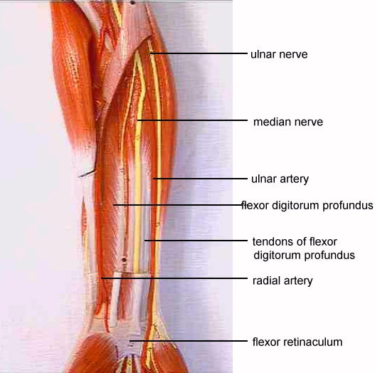
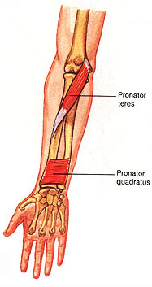
Ant Fore arm
Wrist Flexors
FCU+FCR
FDS
FDP
PL
Wrist Add
FCU
Wrist Abd
FCR
Nerve Supply

Slide 33
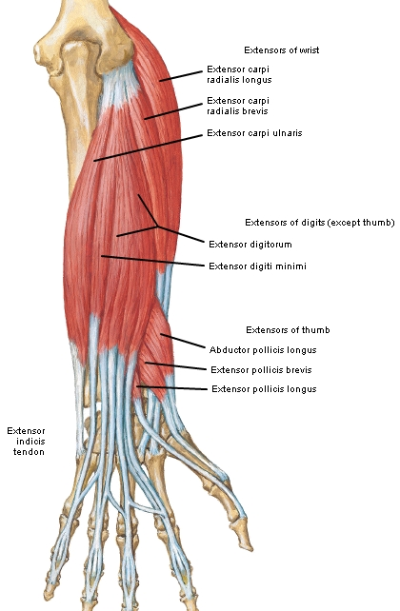
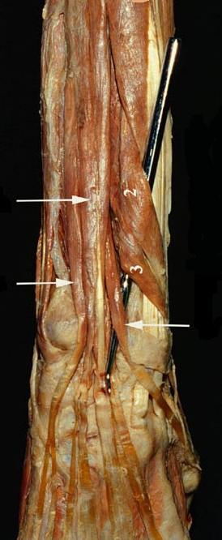
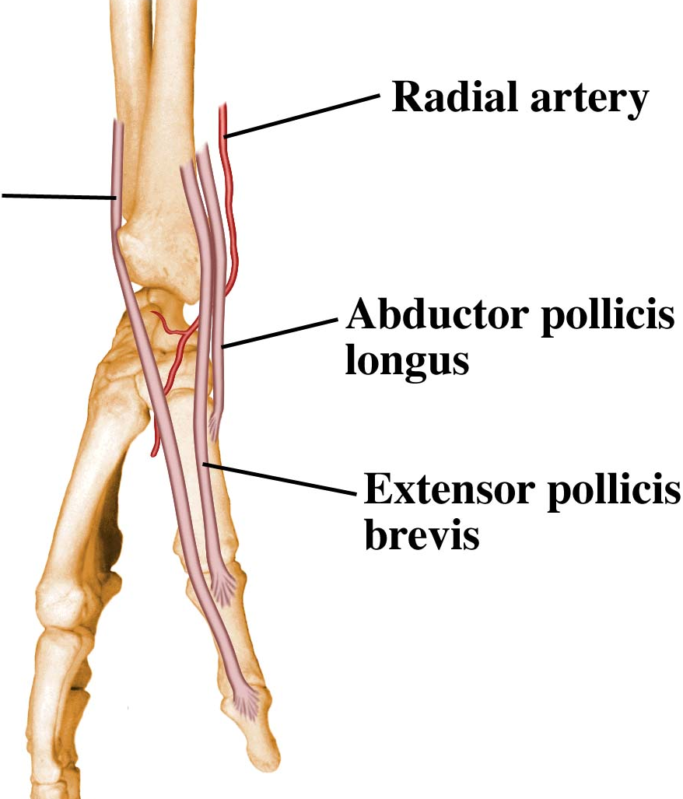
Post. Forearm
Superficial disection
Nerve Supply
Radial Nerve
Anatomical snuff box

Slide 34
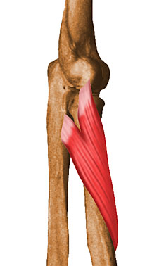
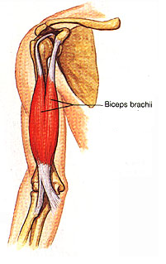
Rotators of the Radius
Pronators
Biceps Brachii
Supinator

Slide 35
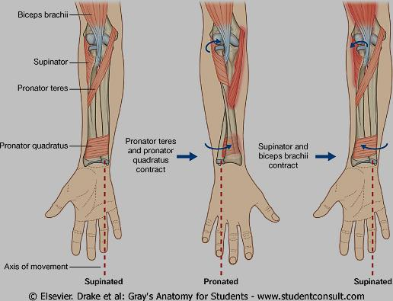
Pronation / Supination:
Occurs at radio-ulnar jts.
Proximal:
Head of radius
articulates with radial notch of ulna (pivot jt). It is held in place by the annular ligament.
Distal – Radius pivots around the fixed distal end of ulna (pivot jt).
Radio-ulnar articulation is stabilized by interosseus membrane.

Slide 36
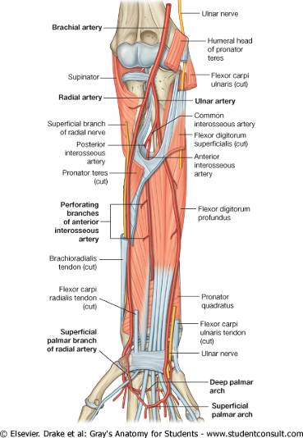
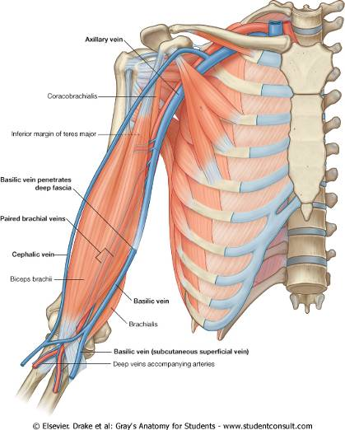
Course of radial and ulnar arteries in forearm
Axillary vein:
continuation of basilic vein

Slide 37
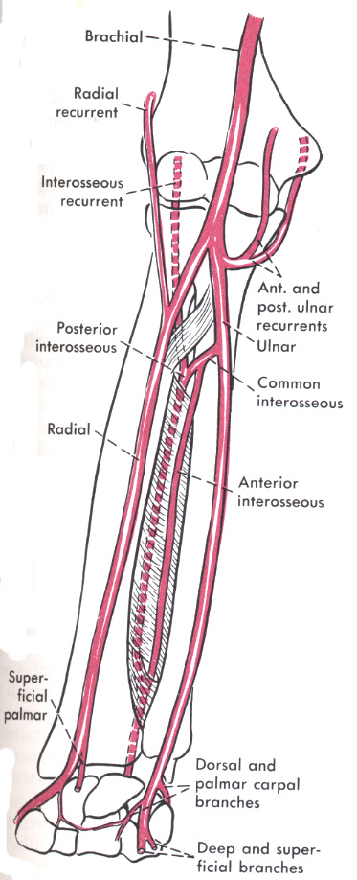
Radial & Ulnar Arteries
lateral
medial
Radial artery
Ulnar artery
Common interosseous
Anterior
Posterior
Dorsal and palmer carpal branches
Dorsal and palmer carpal branches
Deep (superficial) palmar arches
superficial (deep)palmar arches

Slide 38
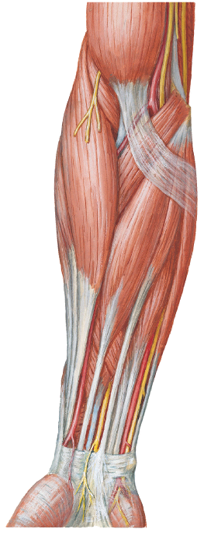
RELATION OF ARTERIES,
NERVES AND TENDONS
AT THE WRIST
NANAN
Superficial Radial Nerve
Radial Artery
Median Nerve
Ulnar Artery
Ulnar Nerve
MOVING LATERAL TO MEDIAL
1-9
Brachioradialis
Superficial Radial n.
Radial Artery
Flexor Carpi Radialis
5. Median Nerve
Flexor Digitorum Superficialis
Ulnar Artery
Ulnar Nerve
9. Flexor Carpi Ulnaris
Thumb
Notes:
Pulanous Longous

Slide 39
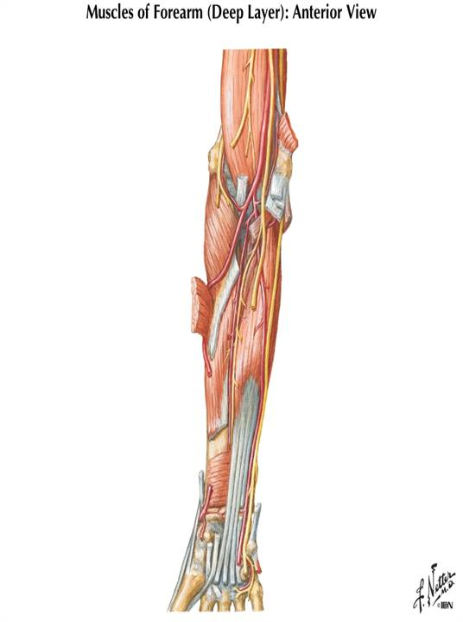
Neurovasculature (deep).
Lateral:
radial artery
radial nerve
Midline:
median nerve
anterior interosseus a.
anterior interosseus n.
(deep branch of median)
Medial:
ulnar artery
(gives off common interosseus artery divides into anterior and posterior branches)
ulner nerve
radial n
radial a.
ulnar a
ulnar n
median n
anterior interosseus a + n

Slide 40
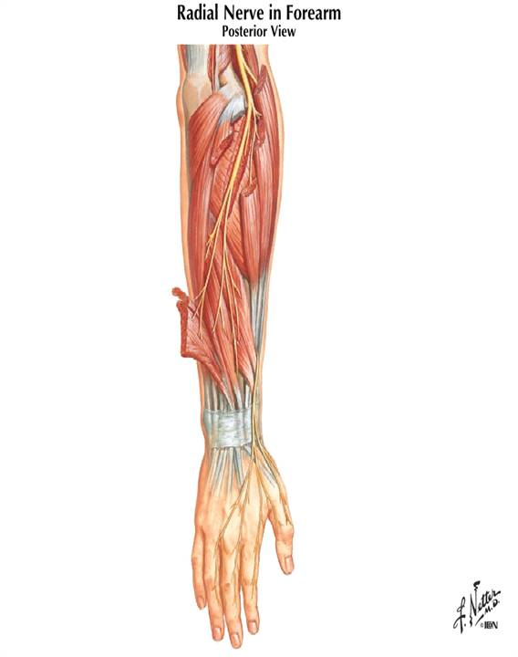
Radial Nerve
Neurovasculature.
Radial nerve and its branches supply
all muscles in posterior compartment, including brachioradialis (!).
- superficial radial nerve
- deep radial nerve
- posterior interosseus nerve.
Posterior interosseus artery runs between superficial and deep muscles
Brachioradialis
Deep branch
posterior interosseus branch
Superficial branch

Slide 41
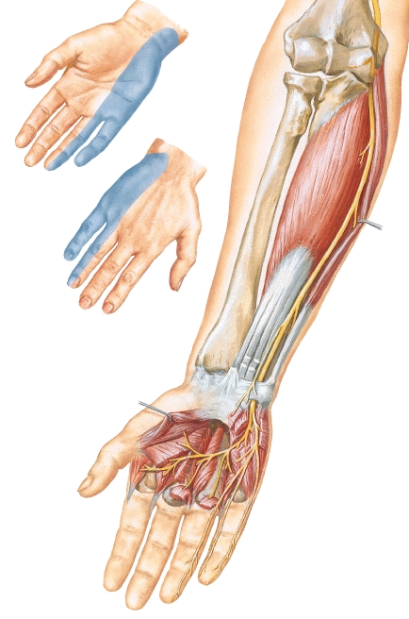
Ulnar Nerve
Medial ½ of FDP
FCU
All hand muscles except muscle groups(lateral 2 lumbricals and thenar muscles )

Slide 42


Thank you!

