Slide 1
Muscles of the Arm and Cubital Fossa

Slide 2
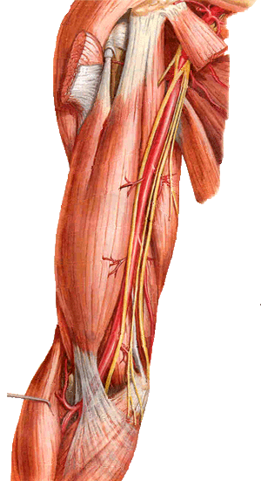
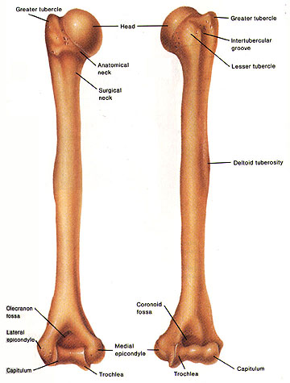
The Arm
Bone of the Arm Humerus
Shoulder
A R M
Posterior
view
Anterior
view
Elbow

Slide 3
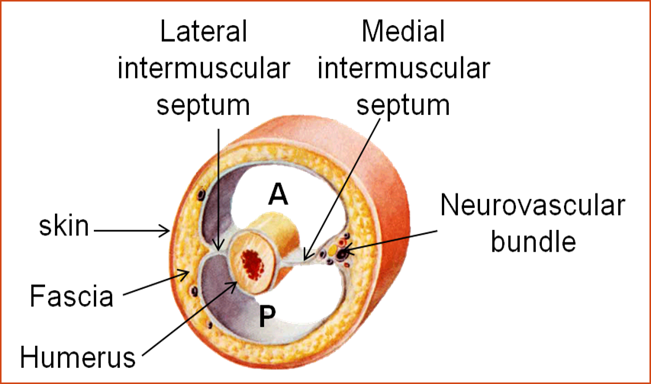
The muscles of the arm are divided into 2 compartments by means of 2 intermuscular septa
Medial & lateral intermuscular septa arise from the deep fascia of the arm& attach to the medial & lateral borders of the humerus dividing the arm into 2 compartments :
Anterior compartment → flexor muscles
Posterior compartment→ extensor muscles

Slide 4
Extensor Comp. | Flexor Comp. | Item
Triceps (3heads). | Corachobrachialis,biceps brachii and brachialis. | Muscles
Radial nerve. | Musclocutaneous nerve. | Motor nerve supply
Profunda brachii artery. | Brachial artery. | Blood Supply

Slide 5
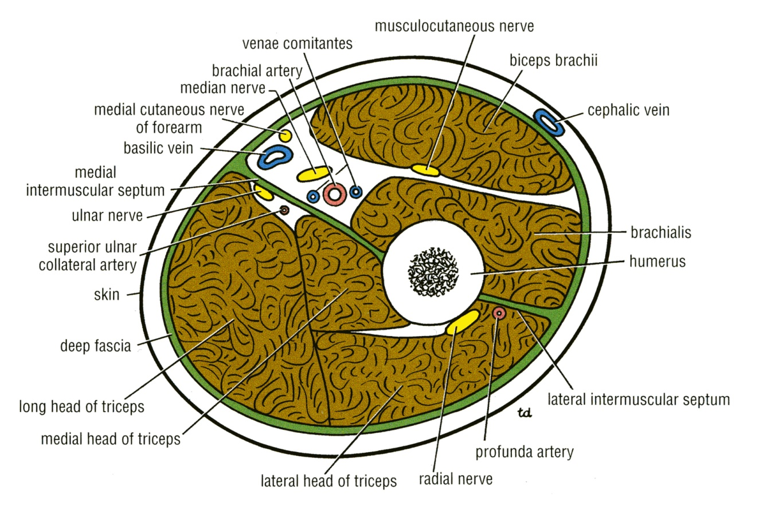
Contents of Anterior Fascial Compartment
Muscles:
Biceps brachii, Coracobrachialis, Brachialis
Blood Vessels: Brachial artery, Basilic vein
Nerves : MusculocutaneousMedian
Medial cutaneous nerve of the arm

Slide 6
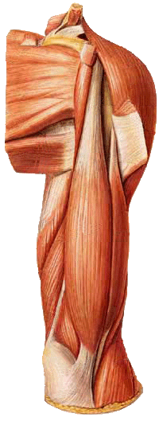
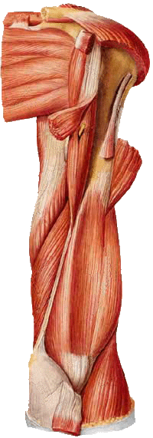
Muscles of the Anterior Compartment
Coracobrachialis
Biceps brachii
Brachialis

Slide 7
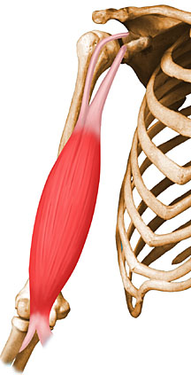
BICEPS BRACHII
ORIGIN :
BY 2 HEADS→
Short (medial) head: tip of coracoid process
  2. Long ( Lateral ) head: supraglenoid tubercle of the scapula (intracapsular)
  The Two heads join in the middle of the arm

Slide 8
BICEPS BRACHII
Insertion :
Biceps tendon →posterior part of radial tuberosity
Medial side of biceps tendon → bicipital aponeurosis → blends with deep fascia on medial border of forearm
Biceps brachii
Tendon inserted to radial tuberosity
Bicipital
aponeurosis
Bicipital
aponeurosis

Slide 9
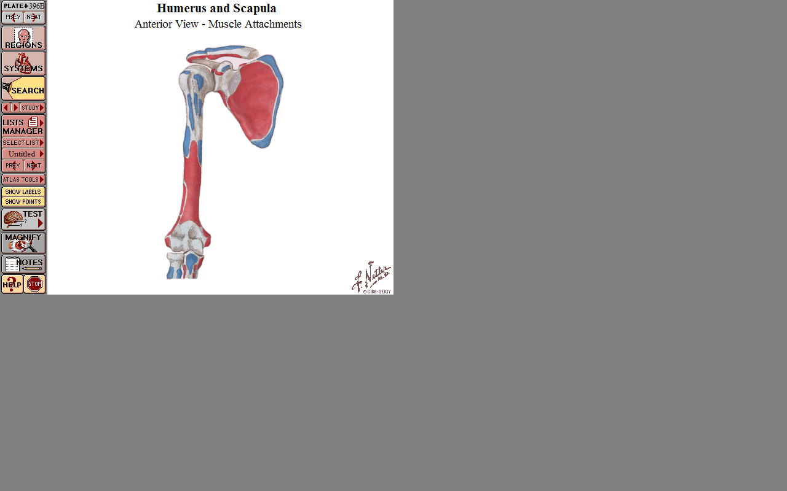
Origin of long head
of biceps from
supraglenoid tubercle
Origin of short head of biceps
from tip of coracoid process
Insertion of biceps tendon
into posterior part of radial
tuberosity

Slide 10
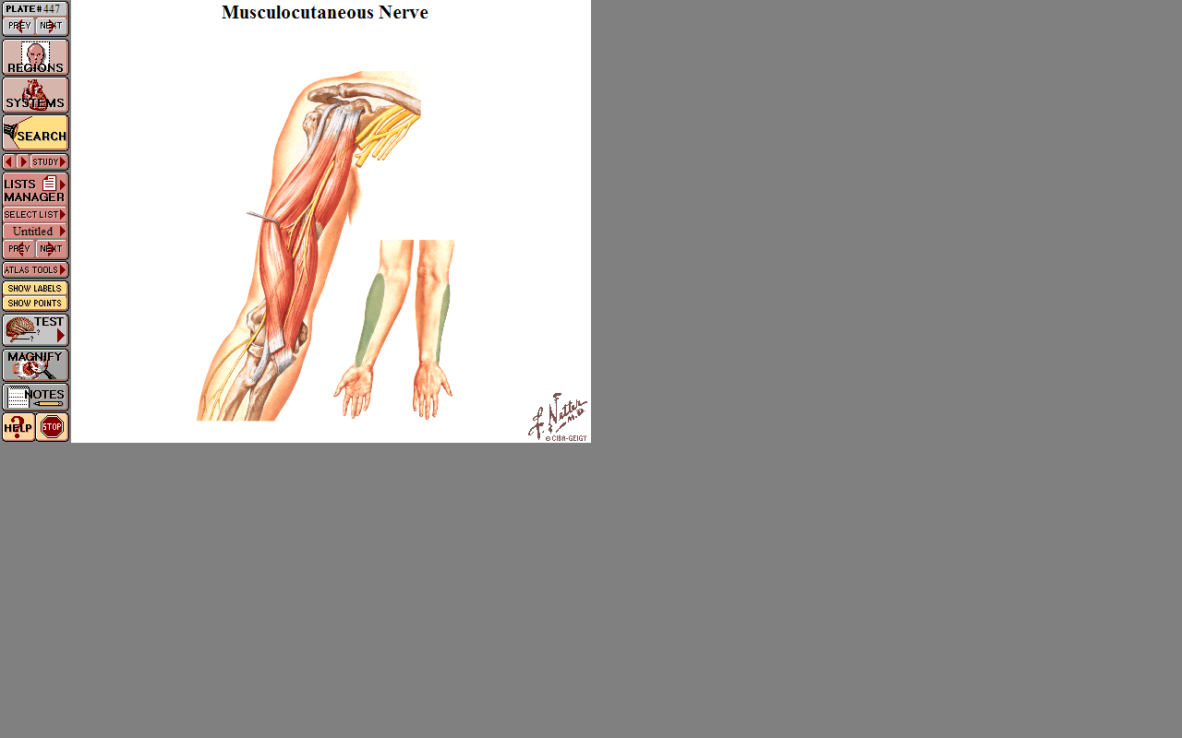
BICEPS BRACHII
Nerve supply: Musculocutaneous nerve

Slide 11
Action of biceps brachii :
Powerful supinator of forearm
Flexion of elbow joint
  Weak flexor of shoulder
Long head helps to keep humeral head in contact with glenoid cavity during movements of shoulder joint

Slide 12
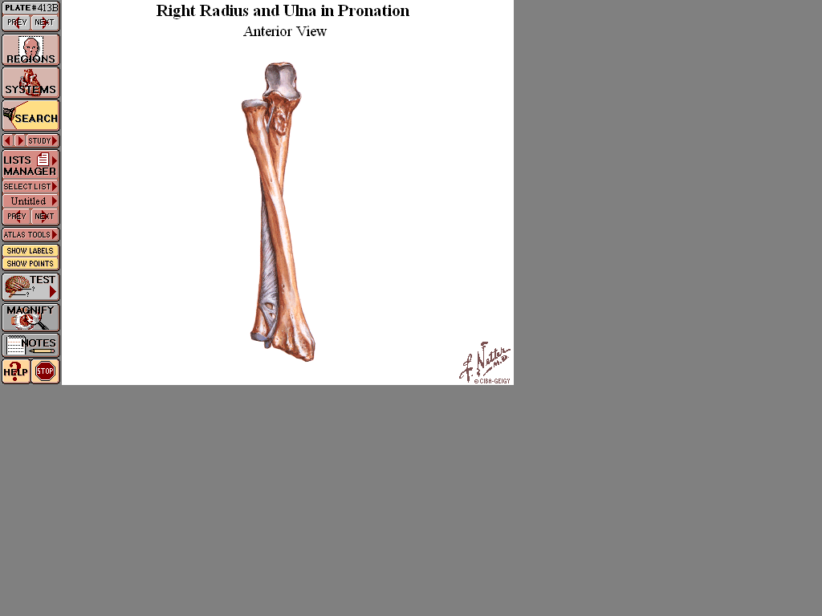
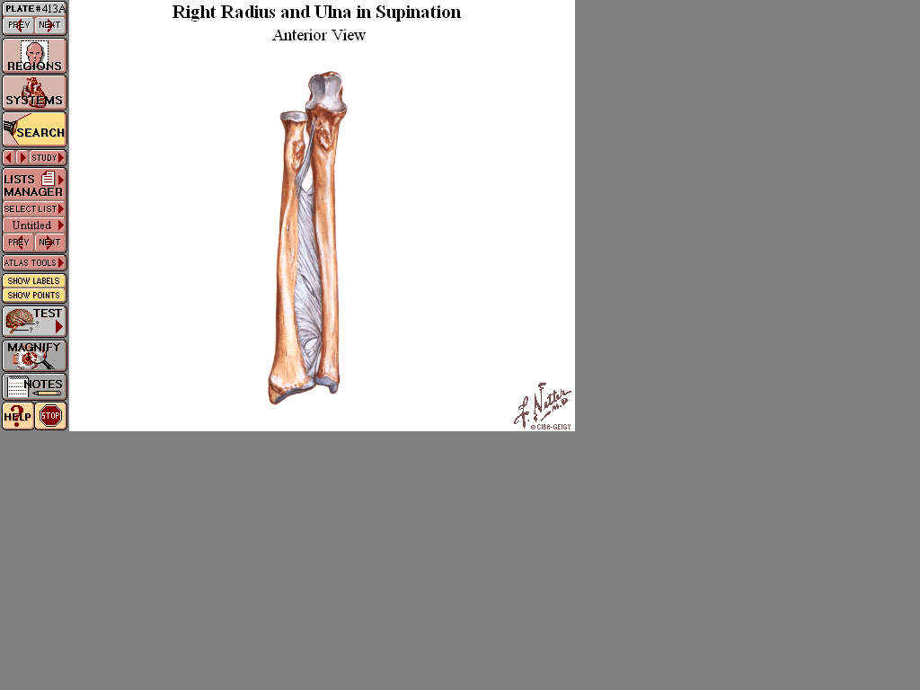
Radius crosses over ulna like X in pronation
Radius returns parallel to ulna in supination

Slide 13
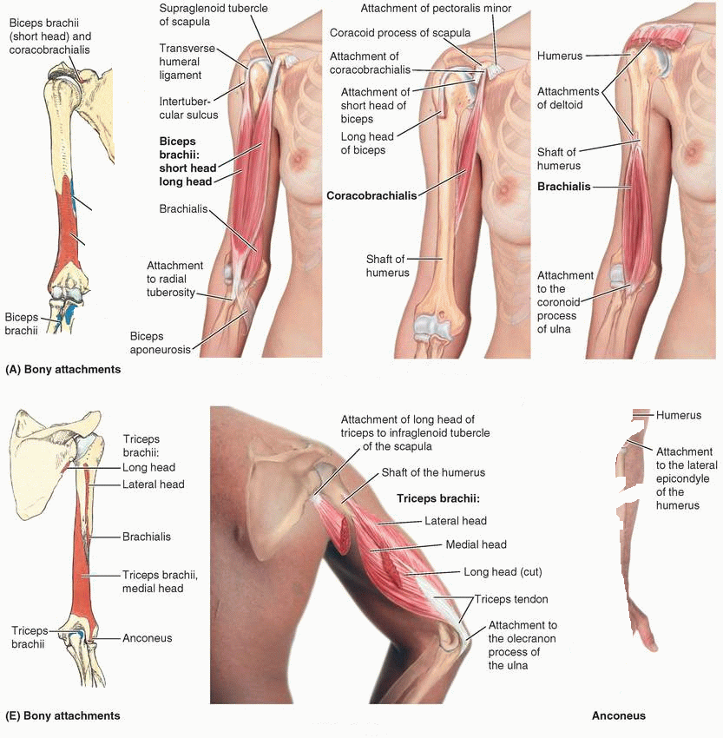
Coracobrachialis
Origin: Tip of the coracoid process
Insertion: Middle of the medial side of the shaft of the humerus
Nerve supply: Musculocutaneous
Action: Flexor & a weak adductor of the arm

Slide 14
?
?

Slide 15
Brachialis
Origin: front of the lower half of humerus
Insertion: anterior surface of coronoid process of ulna
Nerve supply: Musculocutaneous & Radial
Action: Strong flexor of the forearm

Slide 16
Contents of the Posterior Fascial Compartment
Muscles:
Triceps
Vessels: Profunda brachii
Ulnar collateral arteries
Nerves:
Radial
Ulnar

Slide 17
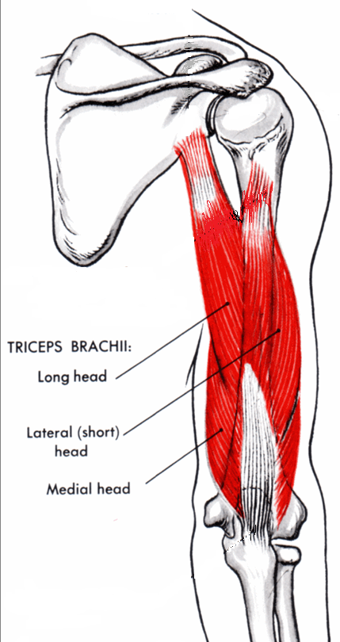
Muscle of the Posterior Compartment
Triceps brachii

Slide 18
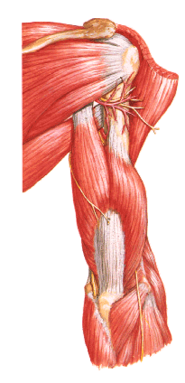
Triceps Muscle
Origin : By 3 heads (long,lateral& medial)
Long head→ infraglenoid tubercle
Lateral head→ posterior surface of humerus above the spiral groove

Slide 19
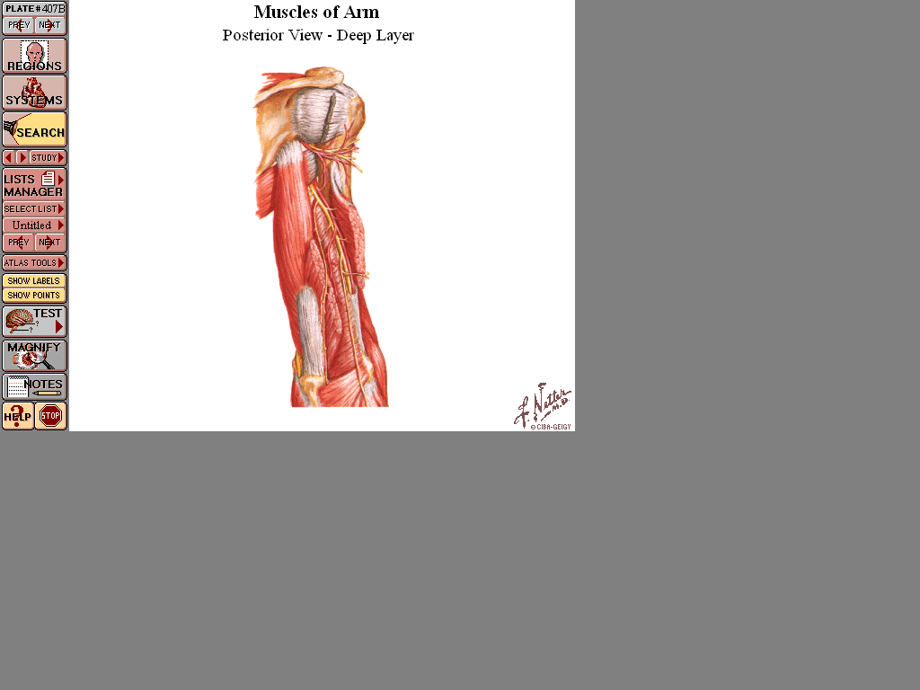
Triceps Muscle
Medial head→ post. surface of humerus below spiral groove
Insertion → upper surface of olecranon process of ulna
Nerve supply: Radial nerve
Action: Strong extensor of the elbow joint

Slide 20
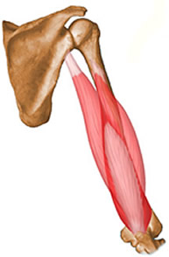
Origin of Triceps
Lateral head of
triceps from
posterior surface
of humerus
above spiral groove
Medial head of
triceps from
posterior surface
of humerus
below spiral
groove
Long head of
triceps from
infraglenoid
tubercle

Slide 21
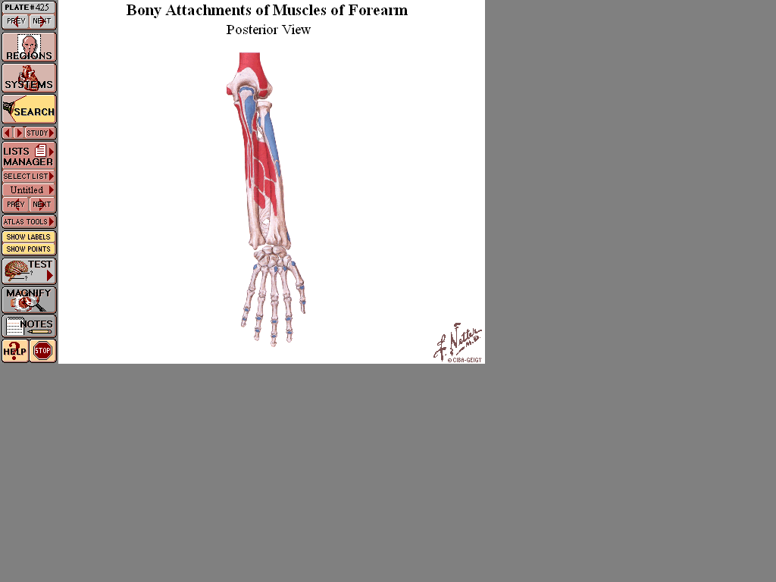
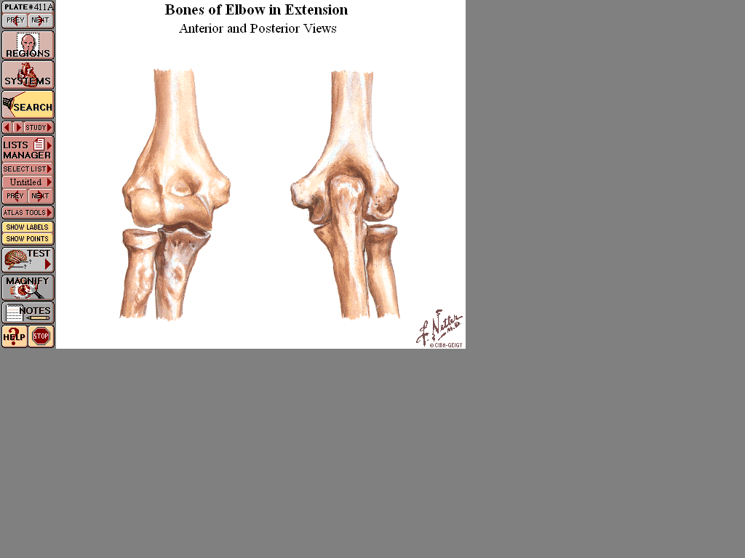
Triceps Muscle Insertion
Into posterior part of upper
surface of olecranon process
of ulna

Slide 22

Articularis cubiti (subanconeus ):
Few fibers from the deep surface of lower part of medial head of triceps become inserted into the back of the elbow joint capsule
Action→ pulls capsule of elbow joint posteriorly during extension of elbow joint

Slide 23
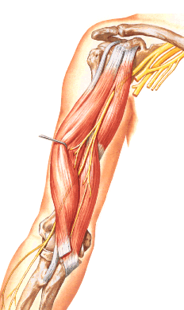
Musculocutaneous nerve:
Branch from lateral cord of brachial plexus
Enters arm by piercing coracobrachialis
Runs downwards and laterally between biceps and brachialis
Ends lateral to biceps tendon, by becoming the lateral cutaneous nerve of the forearm.

Slide 24
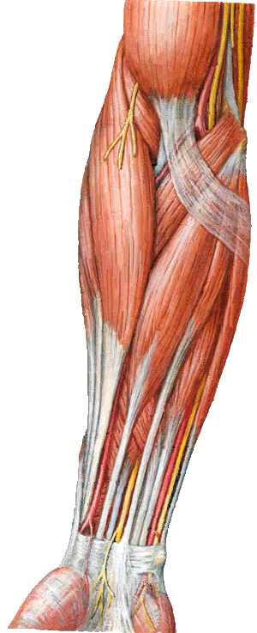
Cubital Fossa
The cubital fossa is a triangular depression on the anterior aspect of the
elbow

Slide 25
Boundaries
Base: line drawn through the two epicondyles of humerus
Laterally: brachioradialis
Medially: pronator teres
Roof: skin, superficial & deep fascia and bicipital aponeurosis
Floor: brachialis medially and supinator laterally.
Brachioradialis
Pronator teres

Slide 26
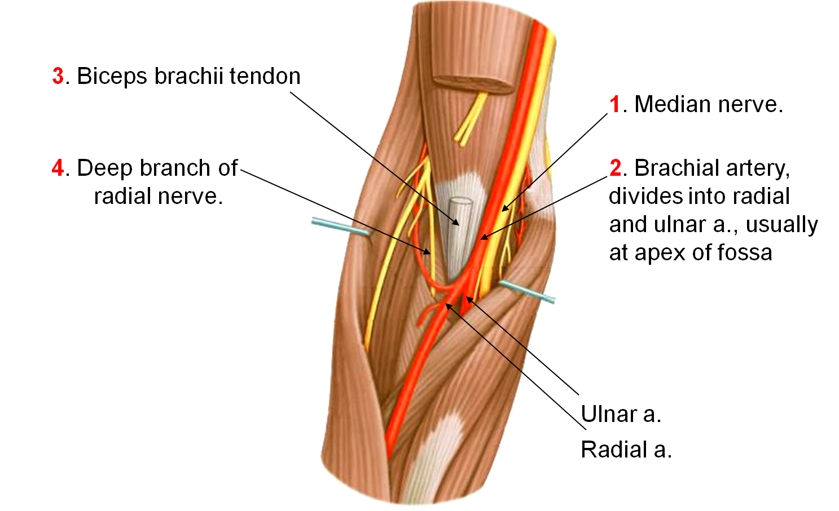
Contents of the Cubital Fossa
(From medial to lateral side)

Slide 27

THANK YOU

