Slide 1
Brachial Plexus

Slide 2
Objectives
Describe the brachial plexus
Make a list of contributing spinal nerves.
Discuss the general arrangement of this plexus.
Locate the plexus in the axilla and note important relations to blood vessels.
Make a list of the terminal main branches of brachial plexus.

Slide 3
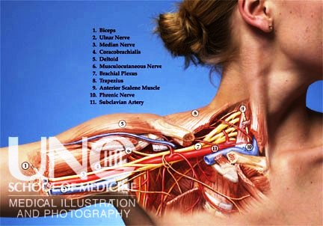
Location of Brachial plexus

Slide 4
Brachial Plexus is a network of nerves that is present at the root of the neck to enter the upper limb.
Brachial Plexus is present in the posterior triangle of the neck & axilla.
It is formed by the union of the anterior Rami of the
C 5th, 6th, 7th & 8th and the 1st thoracic spinal nerve.

Slide 5
Formation
Roots of C5 & C6 unite to form---- Upper trunk
Root of C7 continuous as the-------- Middle trunk
Roots of C8 & T1 unite to form---- Lower trunk

Slide 6
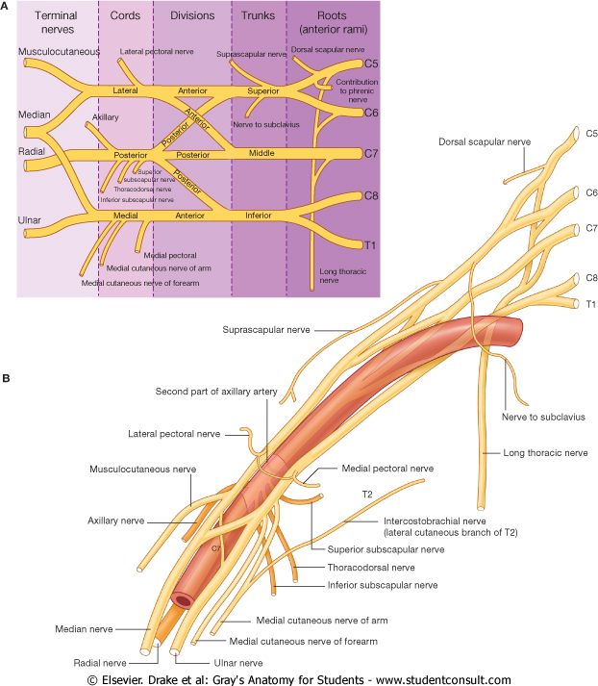
The Plexus can be divided into 5 stages:
Roots: in the posterior∆
Trunks: in the posterior∆
Divisions: behind the clavicle (in cervico-axillary canal)
Cords: in the axilla
Branches: in the axilla
The first 2 stages lie in the posterior triangle, while the last 2 sages lie in the axilla.
6
Notes:
6

Slide 7
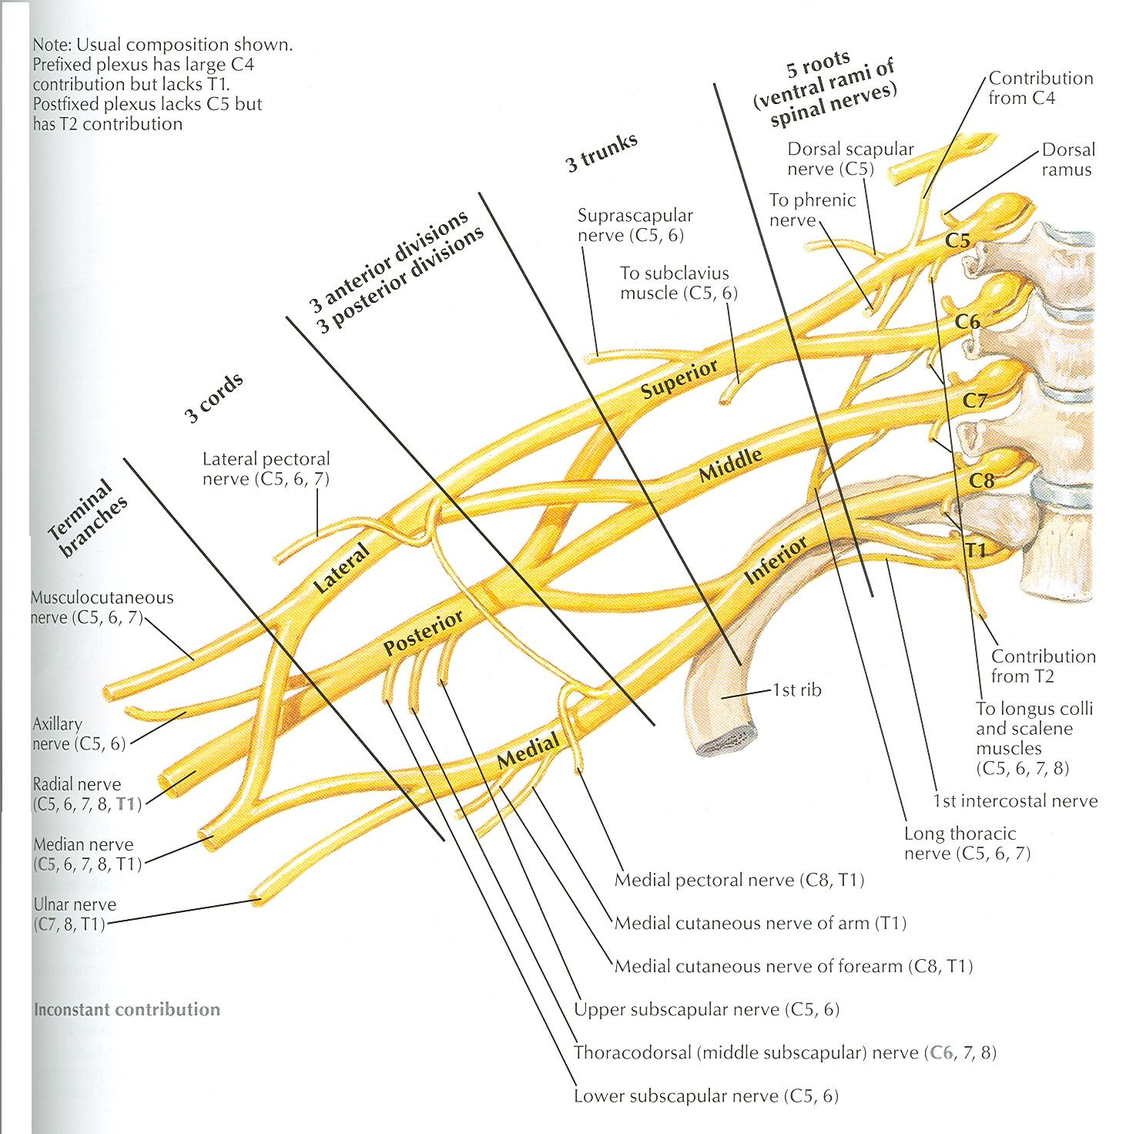
The anterior divisions of the upper and middle trunks unite to form the Lateral cord.
The anterior division of the lower trunk continues as the Medial cord.
All the posterior divisions of three trunks join to form the Posterior cord.
7
Notes:
7

Slide 8
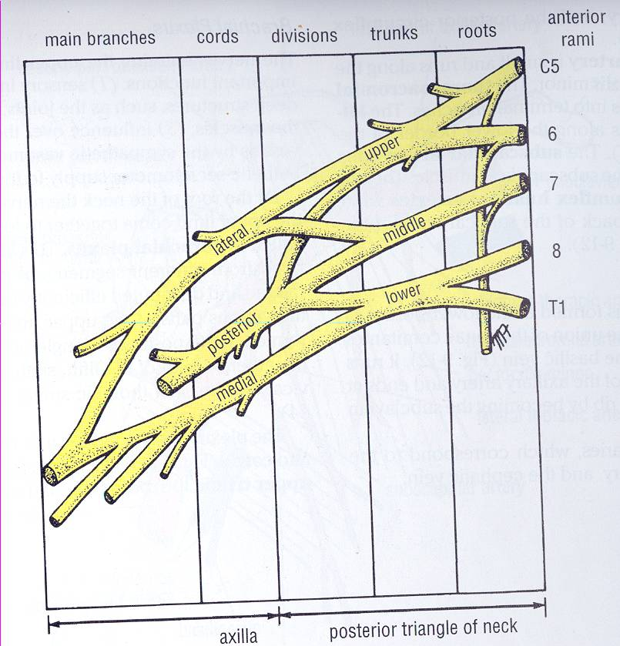
CORDS & BRANCHES
Branches
  All three cords will give branches, those will supply their respective regions

Slide 9
BRANCHES
(A) From Roots:
1. C5: Nerve to rhomboids (dorsal scapular nerve).
2. C5,6 &7: Long thoracic nerve
(B) From Trunks (upper trunk):
  Nerve to subclavius
  Suprascapular nerve (supplies supraspinatus & infraspinatus)

Slide 10
(C)BRANCHES From Cords
Lateral Cord
(2LM)
.Lateral pectoral n
.Lateral root to median n
.Musculocutaneous n
C5
C6
C7
C8
T1
Medial cord
(4MU)
.Medial pectoral n.
.Medial root to median n.
.Medial cutaneous n of arm.
.Medial cutaneous n of forearm.
.Ulnar n.
Posterior Cord
(ULTRA)
.Upper subscapular n
.Lower subscapular n
.Thoracodorsal n
.Radial n
.Axillary n

Slide 11
Lateral cord-3 | Medial cord-5 | Posterior cord-5
Lateral pectoral nerve. | Medial pectoral nerve. | Axillary nerve.
Musculocutaneous nerve. | Ulnar nerve. | Radial nerve.
Median nerve (lateral root). | Median nerve (medial root). | Upper & lower subscapular nerves.
 | Medial cutaneous nerve of arm & forearm. | Thoracodorsal or N. to latissimus dorsi.

Slide 12
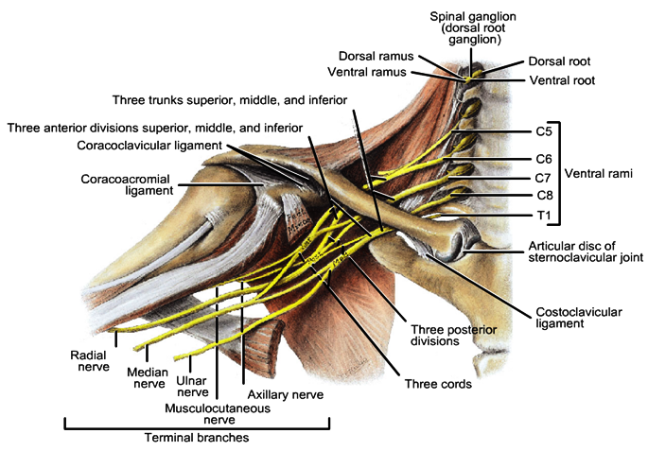
Relations of Brachial plexus

Slide 13
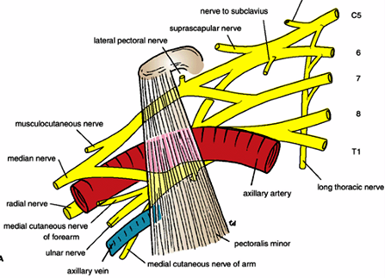
Relations of Brachial plexus

Slide 14
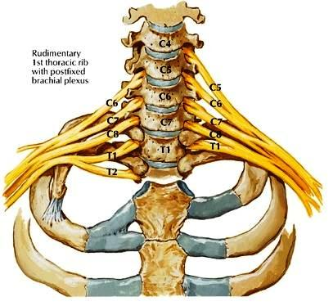
Postfixed Brachial Plexus

Slide 15
Brachial Plexus Injuries
In Infants:
During Difficult Delivery:
Shoulder dystocia

Slide 16
Brachial Plexus Injuries
In Adults:
Sports most commonly associated:
Football, baseball, basketball,
volleyball, wrestling, and
gymnastics.
Nerve injuries can result from: Blunt force trauma, poor posture or chronic repetitive stress.

Slide 17
Brachial Plexus Injuries
Patients generally present with pain and/or muscle weakness.
Some patients may experience muscle atrophy.

Slide 18
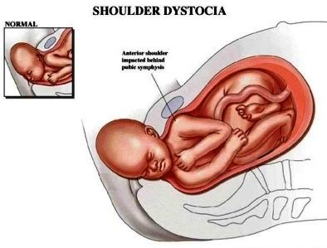

Slide 19
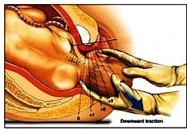

Slide 20
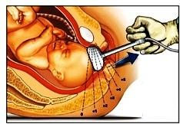
Vacuum Extractor delivery

Slide 21
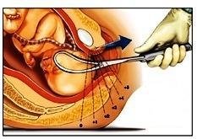
Forceps delivery

Slide 22
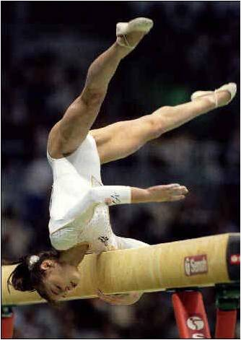
Falling on Shoulder

Slide 23
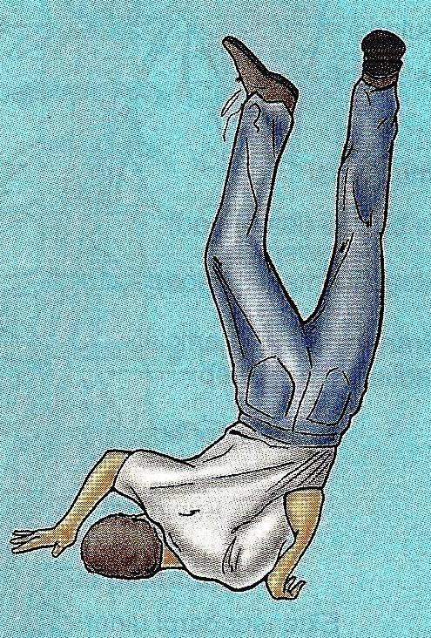

Slide 24
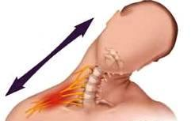
Excessive Stretching

Slide 25
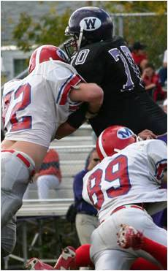

Slide 26
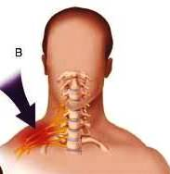
Direct Blow

Slide 27
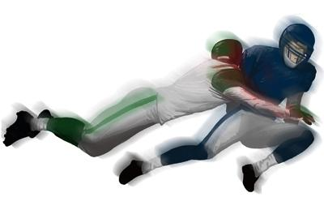

Slide 28
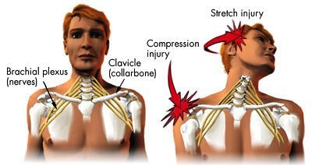

Slide 29
Erb- Duchenne palsy
Damage to the upper trunk: C5, 6
The most commonly involved nerves are the suprascapular nerve, musculocutaneous nerve, and the axillary nerve:
paralysis and atrophy of the deltoid, biceps, and brachialis muscles.(supra and infraspinatus)
Clinical Appearance:
Motor Loss:
Arm hangs by side
➔ Adducted Shoulder (Deltoid)
➔ Medially Rotated Arm (infraspinatus
➔ Extended Elbow (brachialis and biceps)
➔ Pronated Elbow (biceps)
Sensory Loss:
➔ Lateral aspect of Upper Limb

Slide 30
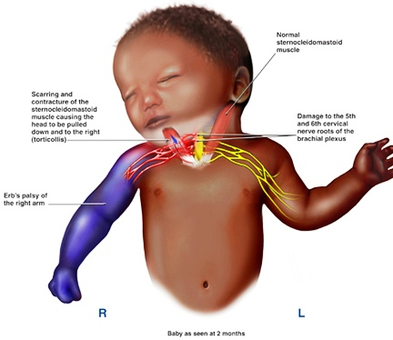

Slide 31
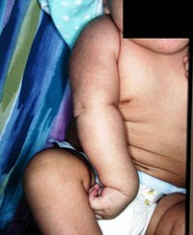

Slide 32
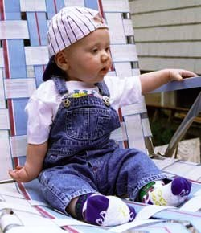

Slide 33
klumpke paralysis or Palsy
Injury to Inferior part of Plexus (C8, T1)
Occurrence:
Excessive abduction of arm.
Less common than Injury to Superior part of
Plexus.

Slide 34
klumpke paralysis or Palsy
Clinical Appearance:
Motor Loss:
➔ Small muscles of Hand:( Interossei, thenar, hypothenar)
➔Flexors of the wrist and fingers: ( Flexor carpi ulnaris, ulnar half of flexor digitorum profundus)
➔Dilator pupillae, Levator palpebrae superioris (T1): Horners syndrome
Sensory Loss:
➔ Medial aspect of Upper Limb

Slide 35
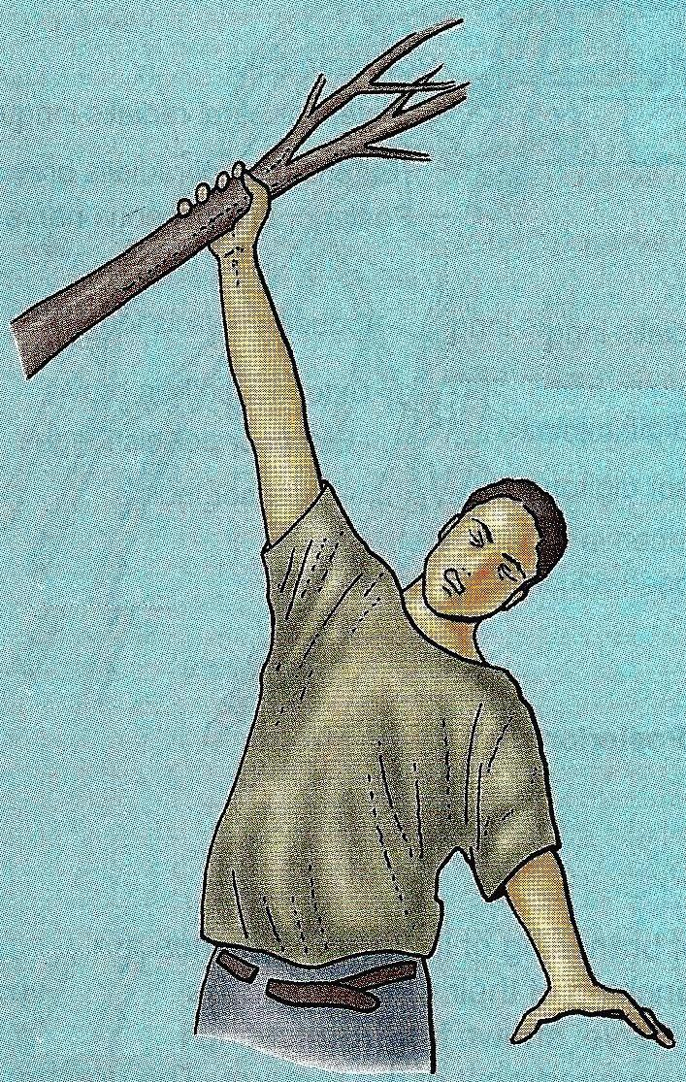
Person grasping something to prevent a fall

Slide 36
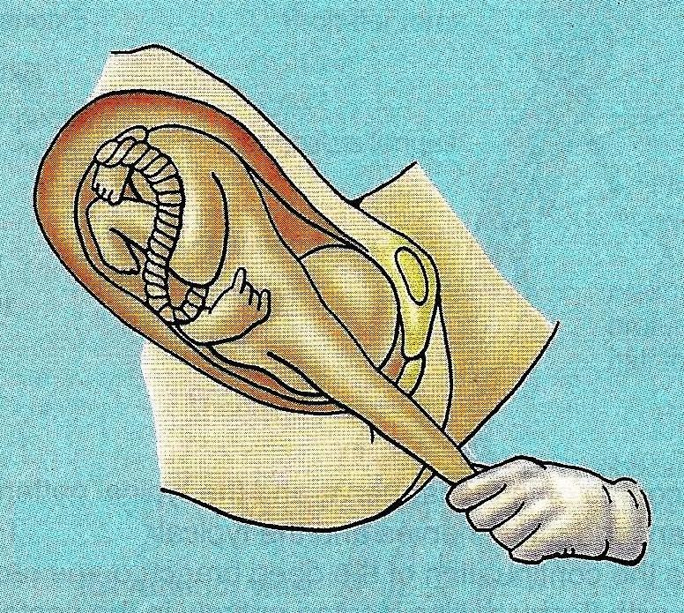
Baby’s upper limb is pulled excessively during delivery

Slide 37
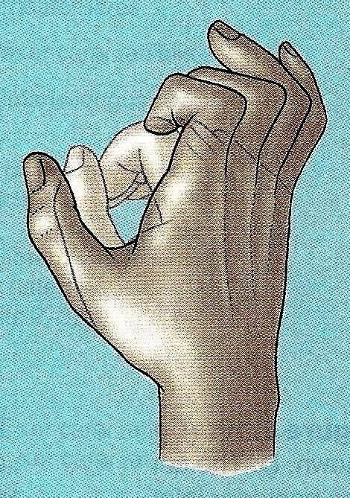
Claw Hand

Slide 38

Claw Hand

Slide 39
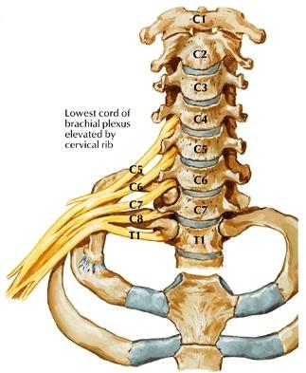
Cervical Rib
Involves Inferior part of Plexus

Slide 40
What is
Waiter’s tip or Porter’s tip position?

Slide 41


