Slide 1
Anatomy of the Axilla
Dr Rania Gabr

Slide 2
Objectives
Define axilla.
Give its boundaries and contents.

Slide 3
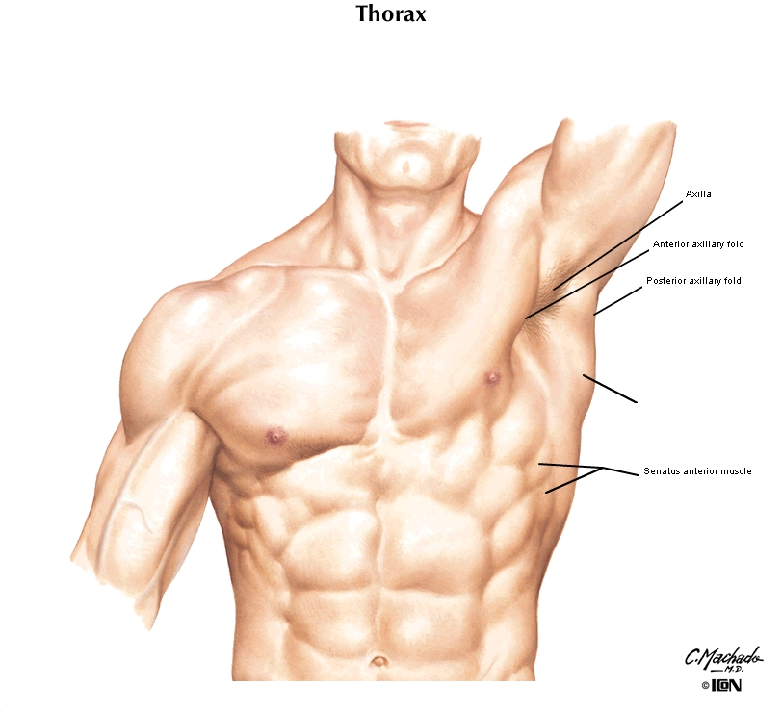
Axilla(Arm pit)

Slide 4
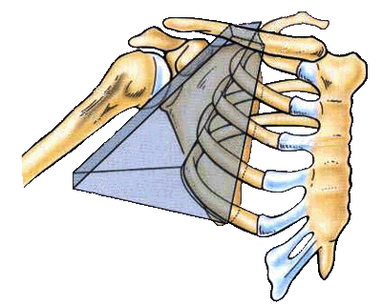
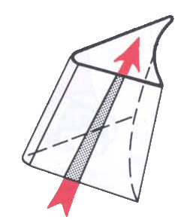
AXILLA
A pyramid-shaped space between the upper part of the arm and the side of the chest through which major neurovascular structures pass between neck & thorax and upper limbs.
Axilla has an apex, a base and four walls.

Slide 5
Axilla is a space
4 Sided pyramid
Apex connected to the neck=Inlet
Base Arm pit= Outlet
Anterior wall
Posterior wall
Medial wall
Lateral wall

Slide 6
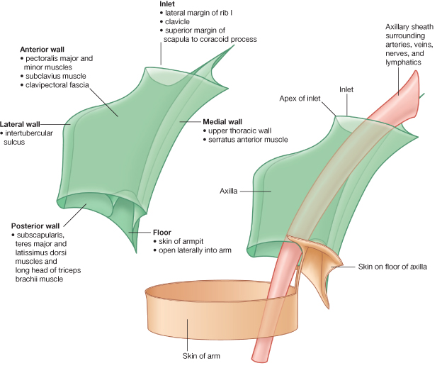

Slide 7
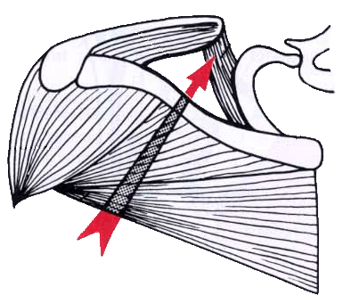
Boundaries of the Axilla
Apex:
Is directed upwards & medially to the root of the neck.
It is called
  Cervicoaxillary canal.
It is bounded, by 3 bones:
  Clavicle anteriorly.
  Upper border of the scapula posteriorly.
  Outer border of the first rib medially.
1
C
L
A
R
I
B
V
I
C
L
E

Slide 8
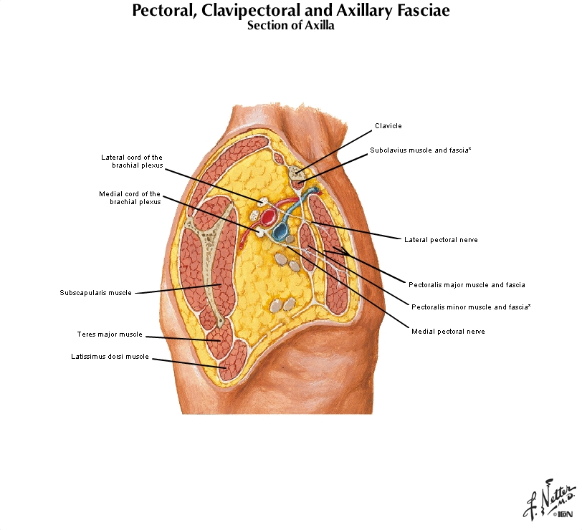
Base
Axillary fascia and Skin of the arm pit

Slide 9
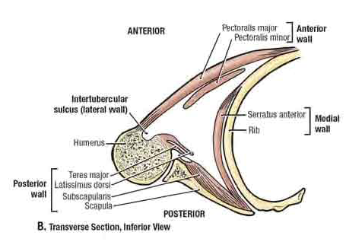
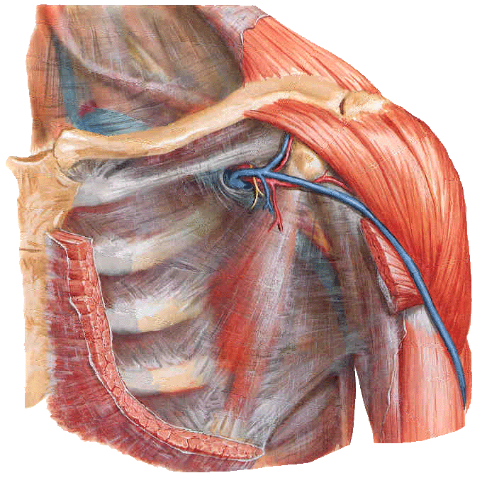
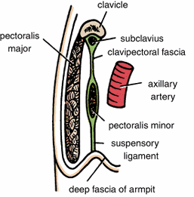
Anterior wall
Pectoralis major
Pectoralis minor
Subclavius muscles
Clavipectoral fascia

Slide 10
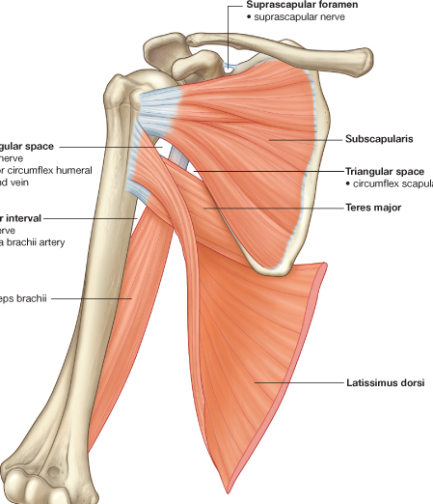
Posterior wall:
Is formed by:
  Subscapularis.
  Latissimus dorsi.
  Teres major muscles.

Slide 11
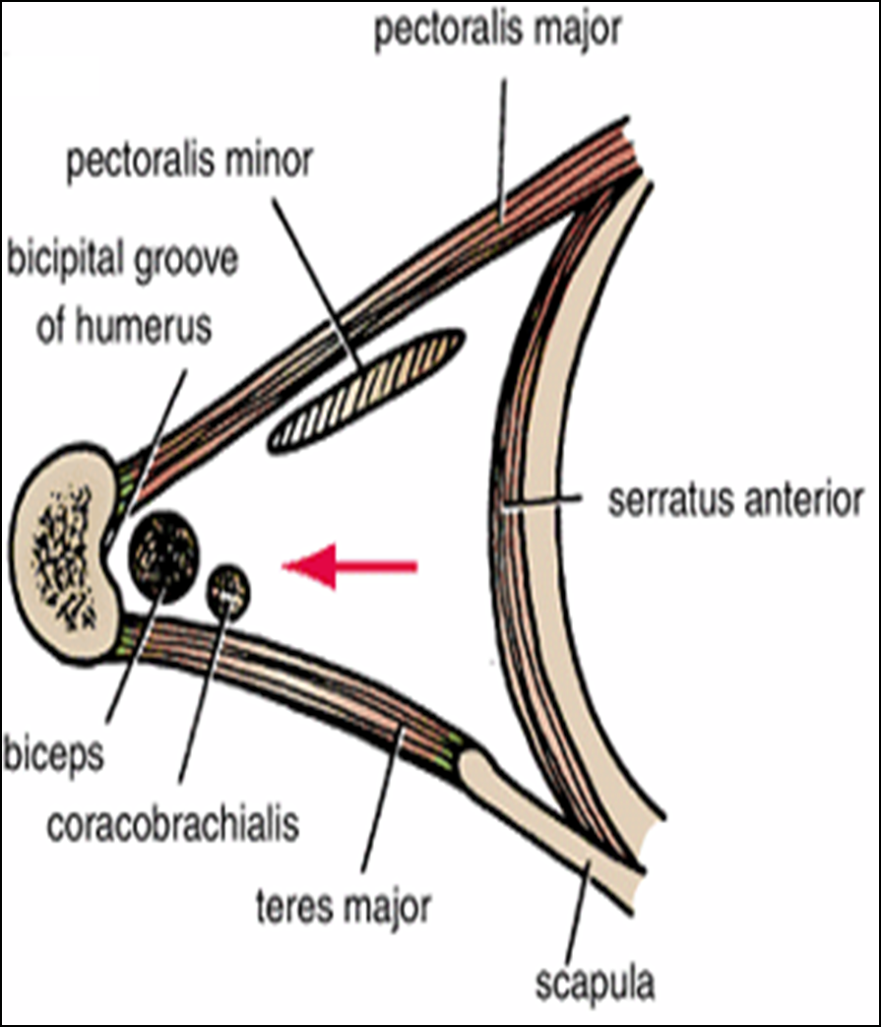
The medial wall:
It is wide and formed by:
  Serratus anterior.
  Upper 4-5 ribs & Intercostal muscles .

Slide 12

The lateral wall:
It is narrow and formed by:
  Coracobrachialis.
  Biceps brachii.
  Bicepital groove of the humerus.

Slide 13
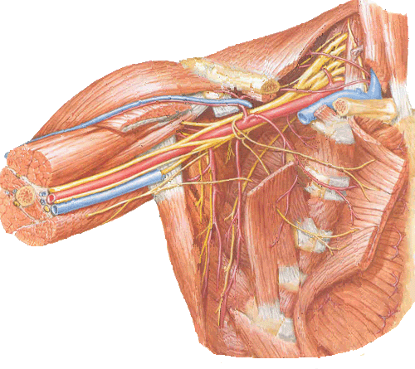
Contents of The Axilla
Axillary a. & v.
Cords and branches of the brachial plexus
Axillary artery and its branches.
Axillary vein and its tributaries.
Axillary lymph nodes.
Axillary lymphatic vessels
Axillary fat.
Loose connective tissue.
Brachial plexus
The neurovascular bundle is enclosed in connective tissue sheath, called ‘axillary sheath’

Slide 14
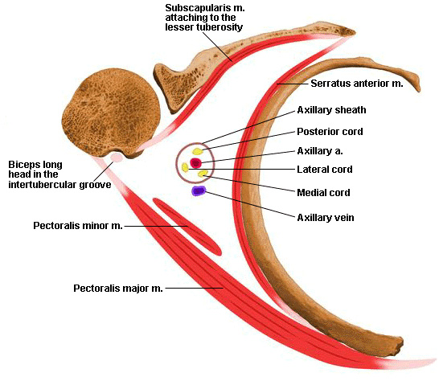
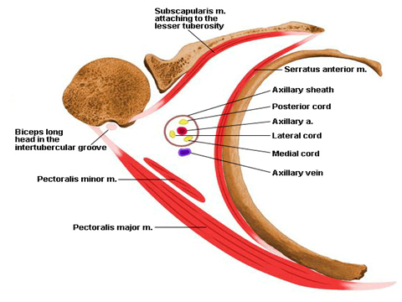

Slide 15


