Slide 1
Wrist and Hand

Slide 2
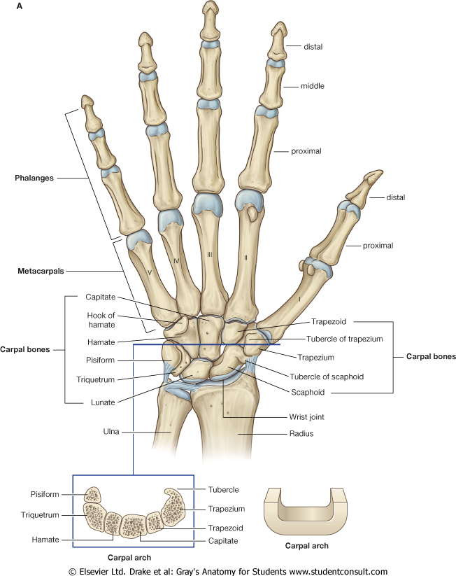
Wrist

Slide 3
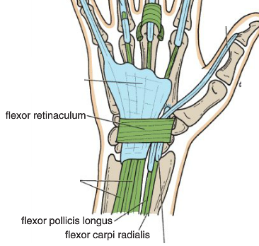
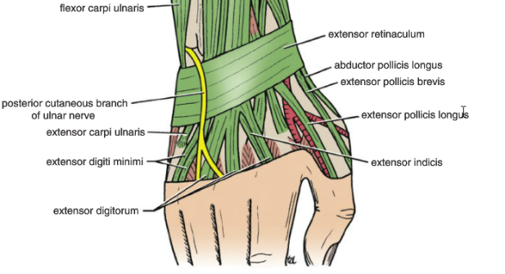
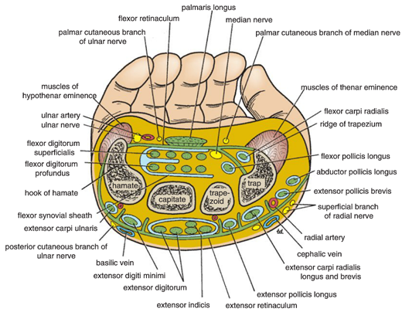
The Wrist
Flexor & Extensor Retinaculae
They are Bands of Deep Fascia of the wrist
  Function:
    Hold the long flexor and extensor tendons in position at the wrist.
  Attachments:
    Flexor Retinaculum :
    Medially
      Pisiform & Hook of Hamate.
    Laterally:
      Scaphoid & Trapezium.
      Extensor Retinaculum
      Medially: Pisiform &Triquterum
      Laterally : Distal end of Radius

Slide 4
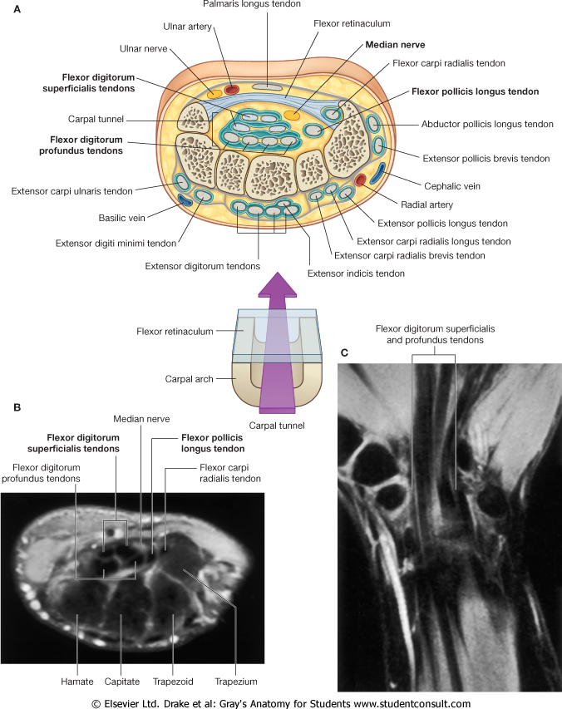

Slide 5
FLEXOR RETINACULUM
Medial to Lateral
Structures passing Superficial:
  Ulnar nerve
  Ulnar artery
  Palmar cutaneous branch of ulnar nerve
  Palmaris longus
  Palmar cutaneous branch of median nerve
Structures passing Deep
  Flexor digitorum superficialis &flexor digitorum profundus
  Median nerve
  Flexor pollicis longus
  Flexor carpi radialis

Slide 6
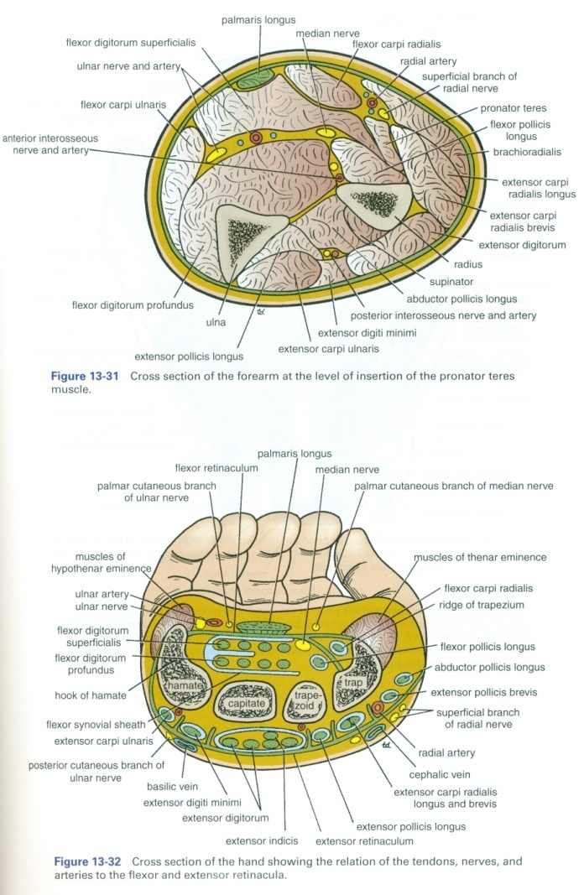
EXTENSOR RETINACULUM
Structures passing Superficial :
  Dorsal cutaneous branch of the ulnar nerve
  Basilic vein
  Cephalic vein
  Superficial branch of the radial nerve
Structures passing Deep:
  Extensor carpi ulnaris
  Extensor digiti minimi
  Extensor digitorum and Extensor indicis
  Extensor pollicis longus
  Extensor carpi radialis longus and brevis
  Extensor pollicisbrevis
  Abductor pollicis longus
Medial to Lateral

Slide 7
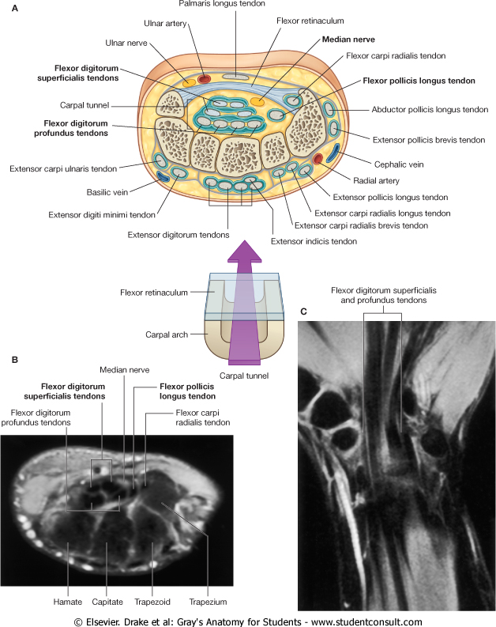
Carpal Tunnel
It is a Fibro Osseous Tunnel formed from:
Concave anterior surface of the Carpal bones & covered by Flexor Retinaculum
Contents
  (Structures Beneath Flexor Retinaculum
    Flexor digitorum Superficialis & Profundus
    Median nerve
    Flexor pollicis longus
    Flexor carpi radialis

Slide 8
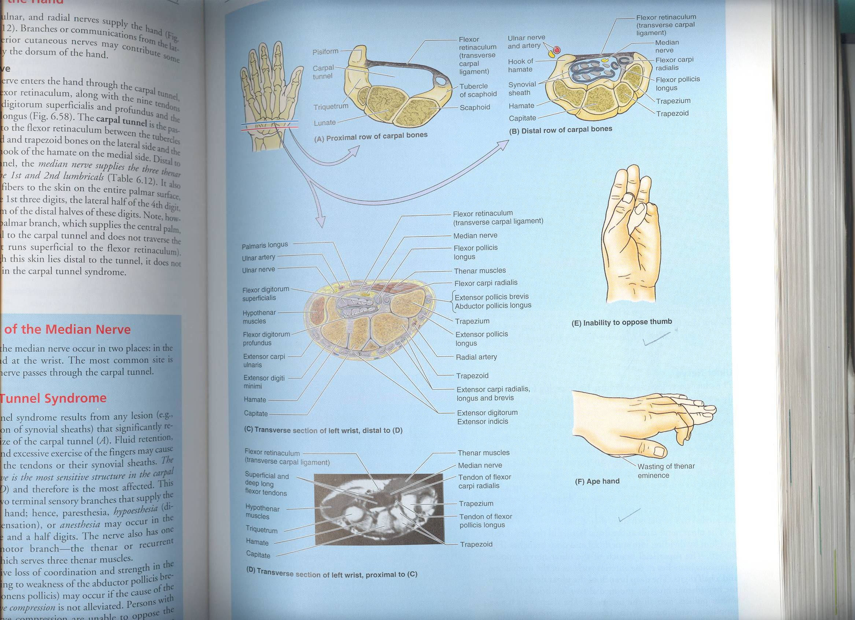
Carpal Tunnel Syndrome
Definition:
The compresion of median nerve in the carpal tunnel is called carpal tunnel syndrome
Causes:
  The exact cause of the compression is unknown but the thickening of the synovial sheaths of the flexor tendons or arthritic changes in carpal bones are responsible in many cases
Manifestations:
  Burning pain “pins & needles” especially in the lateral 3 1/2 fingers.
  Weakness or atrophy of the thenar muscles Ape Hand.
  Inability to oppose the thumb.
The condition is relieved by decompressing the tunnel by making a longitudinal incision through flexor retinaculum

Slide 9
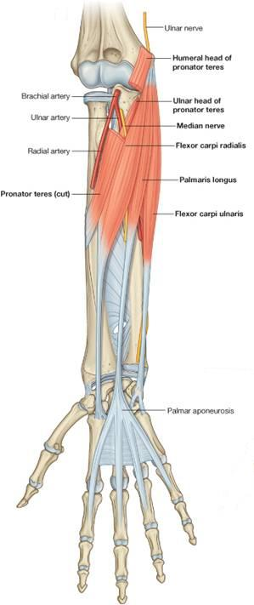
HAND
Palmar Aponeurosis
It is the Thickened deep fascia of the hand
Triangular in shape
Occupies the central area of the palm
The apex is attached to the distal border of flexor retinaculum and receives the insertion of palmaris longus tendon.
Base divides at the bases of the fingers into four slips that pass into the fingers
Functions:
  Gives firm attachment to the overlying skin and improves the grip.
  Protects the underlying tendons, vessels & nerves.

Slide 10
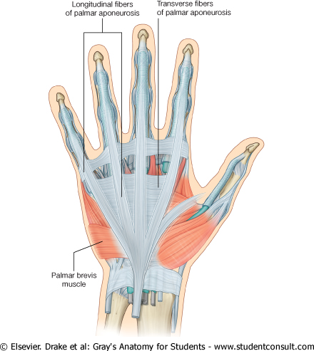
Palmaris Brevis
ORIGIN | INSERTION | NS | ACTION
Flexor retinaculum & Palmar aponeurosis | Skin of Palm | Ulnar (Sup. Branch) | Corrugation of skin to improve grip of palm

Slide 11
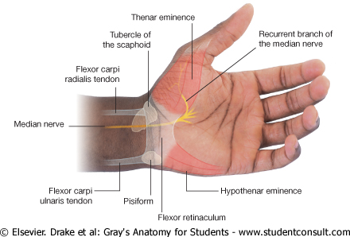
Short Muscles of Thumb & Little Finger

Slide 12
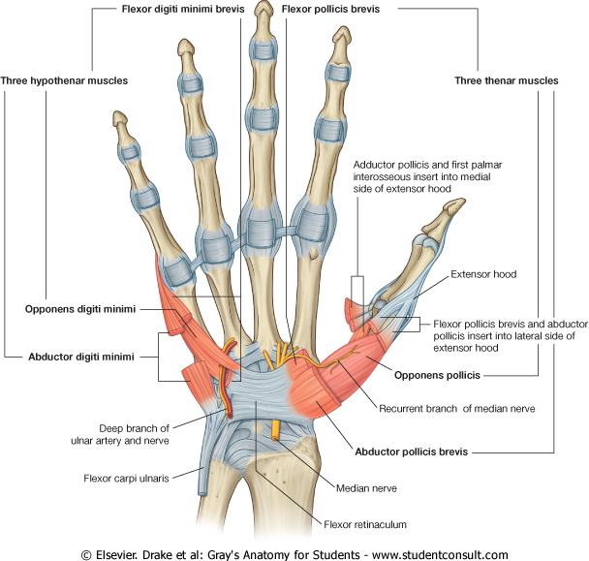
Hypothenar Eminence
Act | NS | Ins | Orig | Name
AB | Ulnar | Base of prox imal phalanx | Pisiform | Abductor Digiti minimi
FLX |  | Base of prox imal phalanx | Flexor REtinaculum | Flexor (Dig minimi)
Pulls the 5th metac forward (Cupping the palm) |  | Medial Border of 5th Merta carpal | FR | Opponens (Dig minimi)

Slide 13
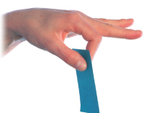
Thenar Eminence
ACT | NS | INS | ORIG | Name
AB | Median | Base of proximal phalanx of thumb | FR, Scaphoid, & Trapezium | Abductor pollicis brevis
FLX |  | Base of proximal phalanx of thumb | FR | Flexor Pollicis brevis
opposition |  | Shaft of the metacarpal of thumb | FR | Opponens pollicis

Slide 14
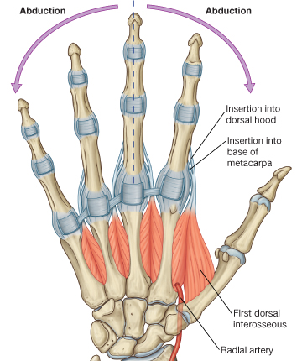
Finger Movements

Slide 15
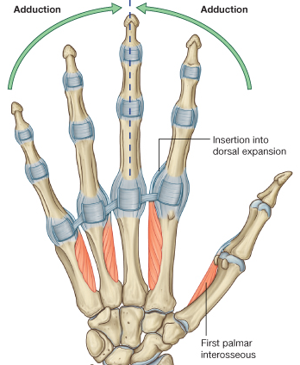
Finger Movements

Slide 16
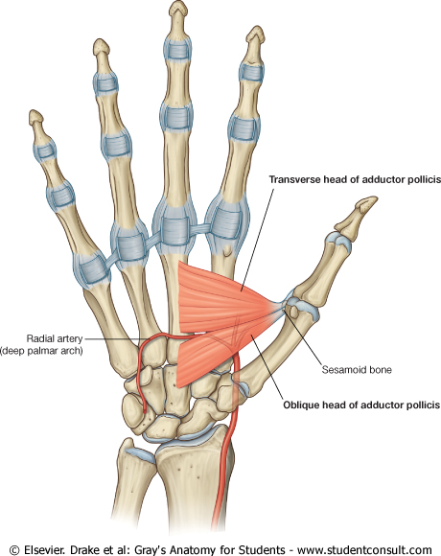
Adductor Pollicis Brevis
NS | ACT | INSER | Name
Ulnar | Adduction of thumb | base of proximal phalanx of thumb | Oblique head 2nd & 3rd metacarpal Transverse head 3rd metacarpal

Slide 17
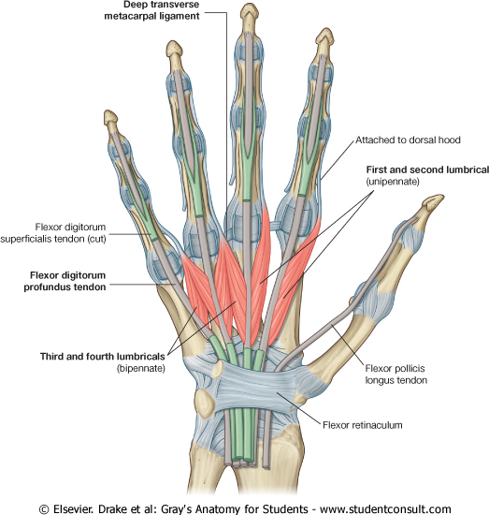
Insertion of Tendons of Flexor Dig Superficialis
Each Tendon
  Divides into two halves pass around the profundus tendon
  The two halves Meet on the posterior aspect of Profundus tendon & Reunite
  Divides into two slips attached to the borders of middle phalanx

Slide 18
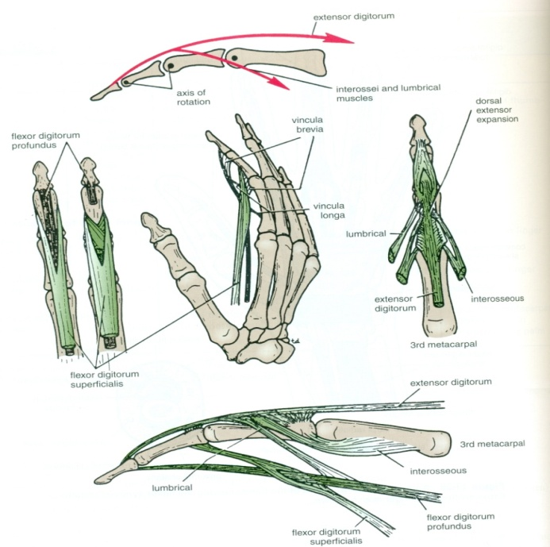
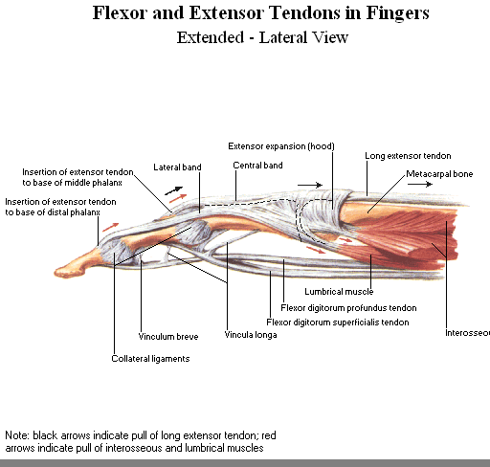
Insertion of Flexor Dig Profundus
Each tendon
  Inserted into the Base of the Distal Phalanx.

Slide 19
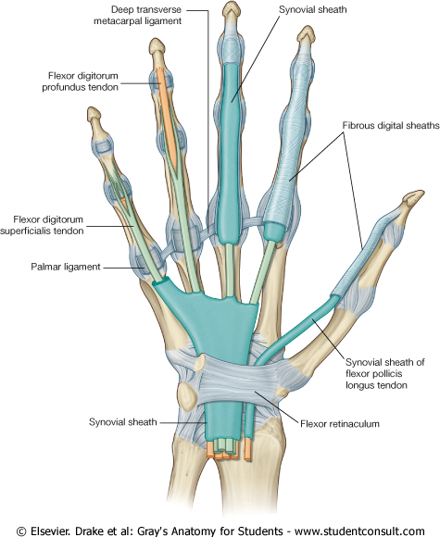
Fibrous Flexor Sheath
A Strong Fibrous Sheath which covers the anterior surface of the fingers and attached to the sides of the phalanges.
Its proximal end is opened, Its distal end is closed
The sheath with the anterior surfaces of the phalanges & the interphalangeal joints form an Osteofibrous blind Tunnel, for the long flexor tendons of the fingers

Slide 20
Synovial Flexor Sheaths
Common Synovial sheath
  (Ulnar Bursa)
  Invigilates all tendons of flexor digitorum superficialis & profundus
  The Medial part of the sheath extends distally (without interruption) on the tendons of the little finger.
  The Lateral part of the sheath stops on the middle of the palm.
  The distal ends of the long flexor tendons to(Index, Middle & Ring) fingers acquire digital synovial sheaths.
Flexor Pollicis Longus tendon has its own synovial sheath (Radial Bursa)
Ulnar Bursa

Slide 21
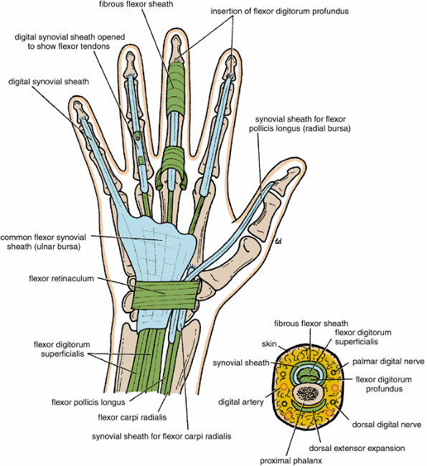
Function of synovial sheaths:
They protect and lubricate the flexor & extensor tendons

Slide 22
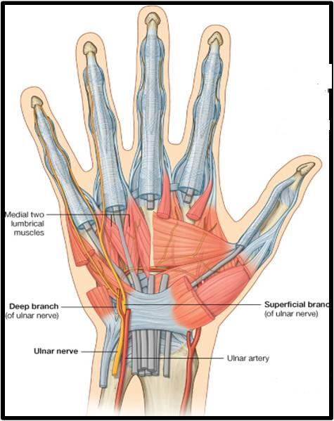
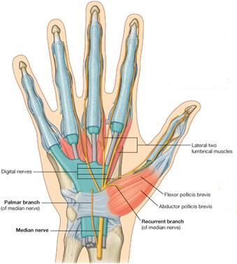
Lumbrical Muscles (4)
ORIGIN | INSERTION | NS
Tendons of Flex.dig. profundus | EXT. EXP | 1ST & 2ND (MEDIAN N). 3RD & 4TH ULNAR N (Deep branch)
Action
Flex the metacarpophalangeal joints & Extend interphalangeal joints except thumb

Slide 23
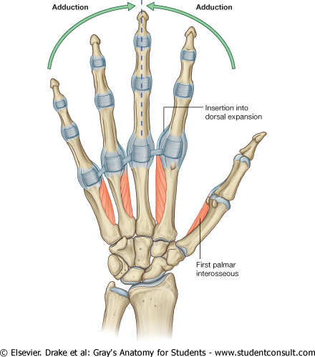
Palmar Interossei (3?4)
ORIG | INSERTION | NS | ACT
1stbase of 1st metacarpal.(?) Other three: From ant surface of shafts of 2nd , 4th & 5th metacarpals. | Proximal phalanges of thumb, index, ring, & little fingers and dorsal extensor expansion of each finger | Deep branch of Ulnar nerve | Adduct fingers toward center of the 3rd finger
3
2
4
2
1
3
4

Slide 24
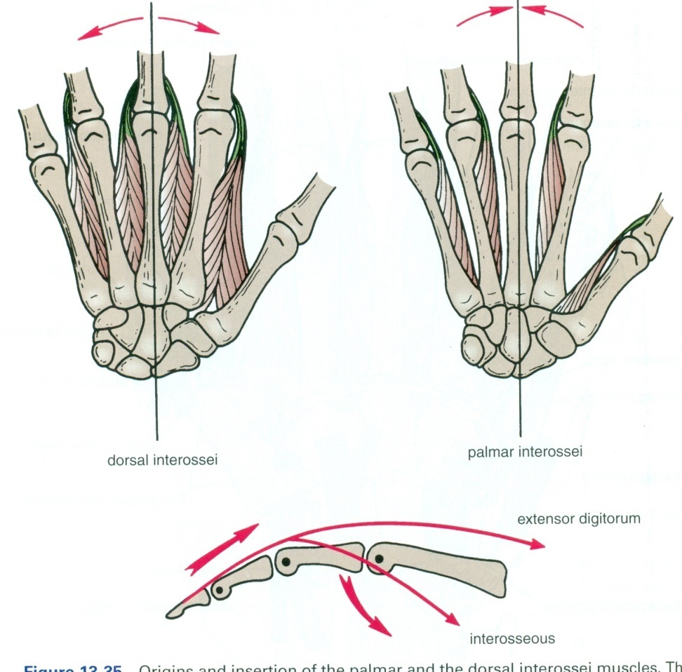
Dorsal Interossei (4)
AB
ORIGIN | INSERTION | ACTION
Contiguous sides of shafts of metacarpals | Proximal Phalanges of index, middle & ring finger & dorsal extensor expansion | Abduct fingers away from center of 3^{rd.} ^{Flex} metacarpo-phalangeal & extend inter phalangeal joints
AB
4
3
2
1

Slide 25
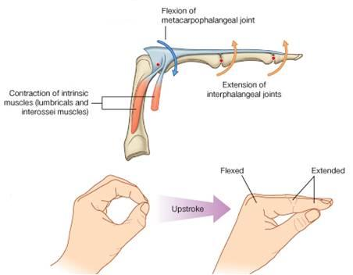
Action of Lumbricals &
Interossei

Slide 26
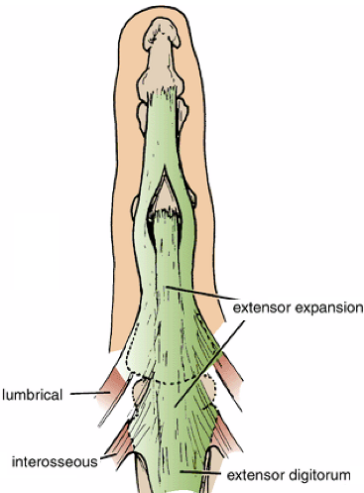
Extensor Expansion
Formed from the expansion of extensor digitorum tendons
At the PIJ, the expansion splits into 3 parts
  One Central inserted into the base of Middle phalanx.
  Two laterals inserted into the base of the Distal phalanx.
The Expansion Receives the insertions of:
  Corresponding Interosseous muscle (on each side).
  Lumbrical muscle (on the lateral side).

Slide 27


