Slide 1
Muscles of the forearm
Posterior compartment

Slide 2
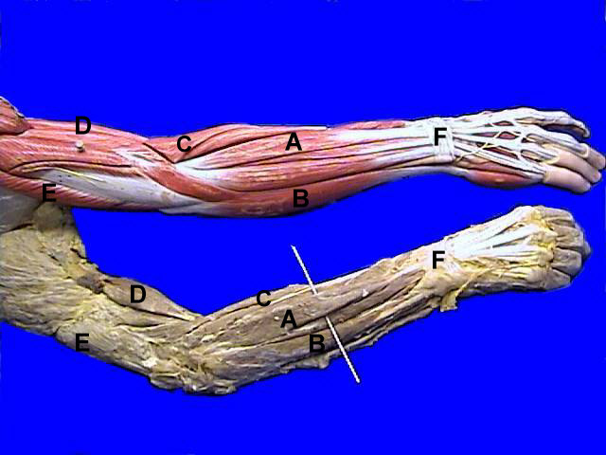
Post. Forearm
A:
Extensor Digitorum
B:
Extensor Carpi Ulnaris
C:
Brachio Radialis
D:
Biceps Brachii
E:
Triceps
F:
Extensor Retinaculum

Slide 3
Muscles of the posterior compartment
Arranged In two layers:
1- A superficial layer
2- A deep layer.

Slide 4
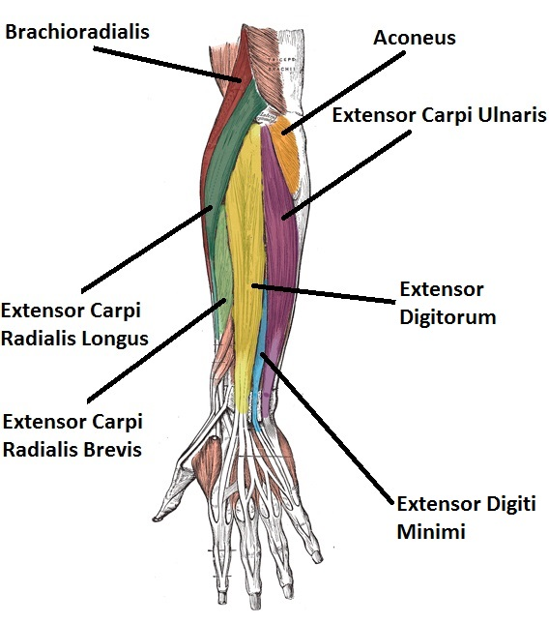
Superficial Group
Brachioradialis
Extensor carpi radialis longus
Extensor carpi radialis brevis
Extensor digitorum
Extensor digiti minimi
Extensor carpi ulnaris
Anconeus
Common origin from the supracondylar ridge and lateral epicondyle of the humerus
Except for the brachioradialis and anconeus, the rest extend as tendons into the hand.

Slide 5
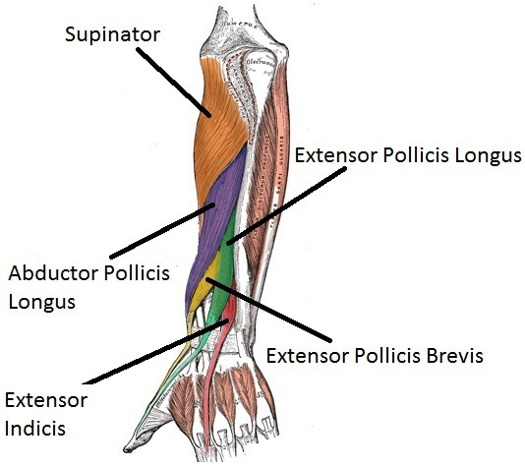
Deep Group
Supinator
Abductor pollicis longus
Extensor pollicis brevis
Extensor pollicis Longus
Extensor indicis
Except for the supinator muscle, all these deep layer muscles originate from the posterior surfaces of the radius, ulna, and interosseous membrane and pass into the thumb and fingers.

Slide 6
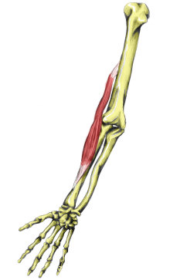
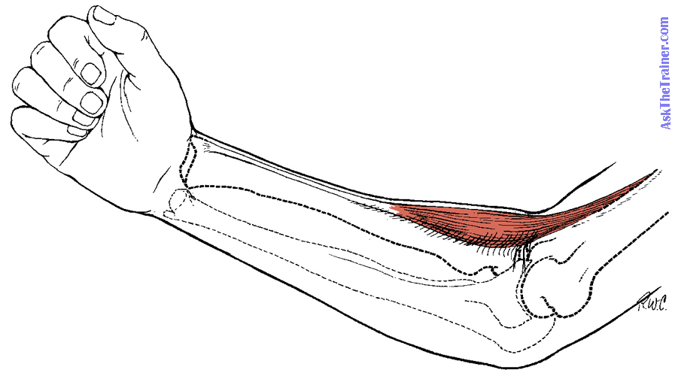
Brachioradialis
Superficial Group
Origin
Lower 2/3 of the lateral supracondylar ridge of the humerus
Insertion
Styloid process of the radius
Actions
Elbow flexion in midprone position
Pronation
Supination
Innervation
Radial nerve

Slide 7
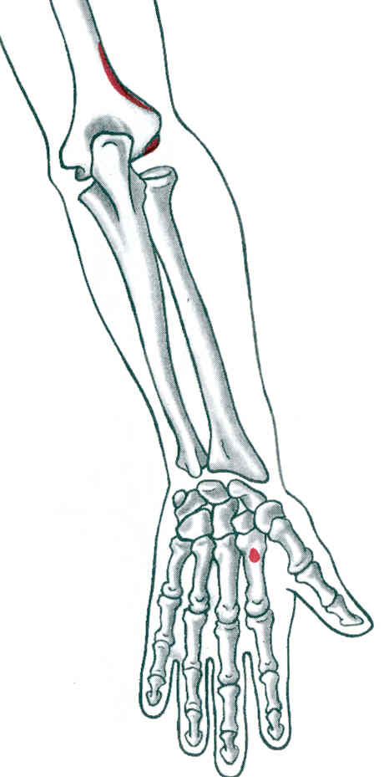
Extensor Carpi Radialis Longus
Origin:
  Lower 1/3 of lateral supracondylar ridge of humerus
  Lateral epicondyle of humerus
Insertion:
  Base of 2nd metacarpal (dorsal surface)

Slide 8
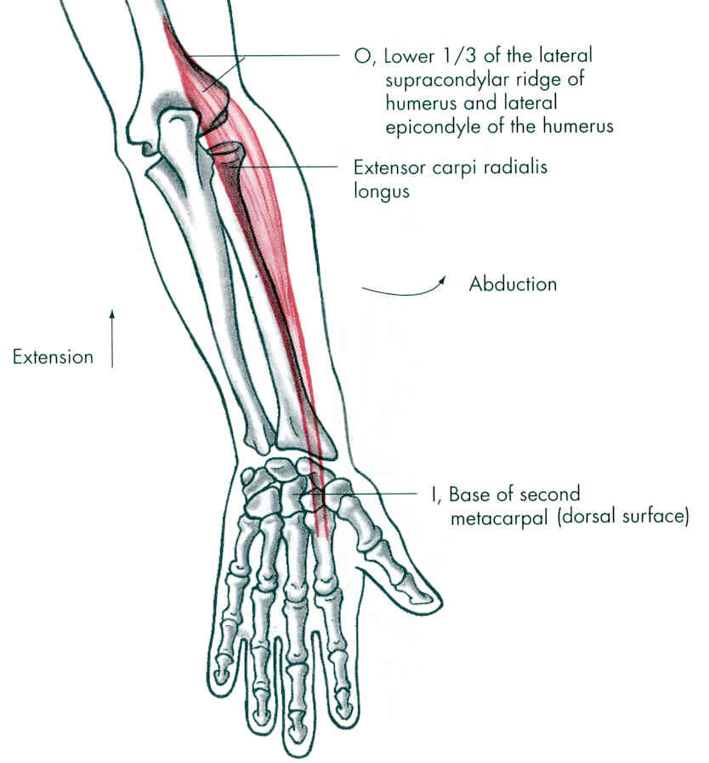
Extensor Carpi Radialis Longus
Action:
  Extension of wrist
  Abduction of wrist
  Weak extension of elbow
Innervation:
  Radial Nerve (C6,7)

Slide 9
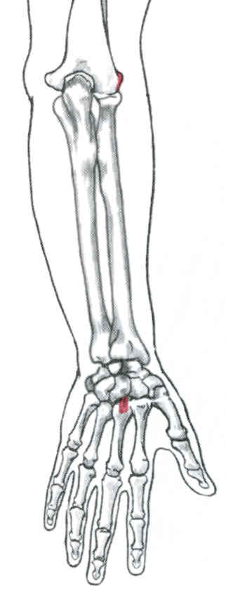
Extensor Carpi Radialis Brevis
Origin:
  Lateral epicondyle of humerus
Insertion:
  Base of 3rd metacarpal (dorsal surface)

Slide 10
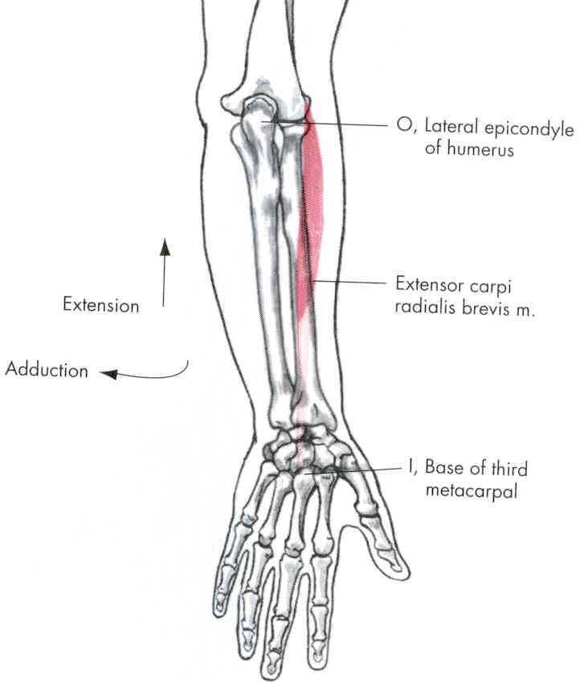
Extensor Carpi Radialis Brevis
Action:
  Extension of wrist
  Abduction of wrist
  Weak extension of elbow
Innervation:
  Radial nerve (C6,7)

Slide 11
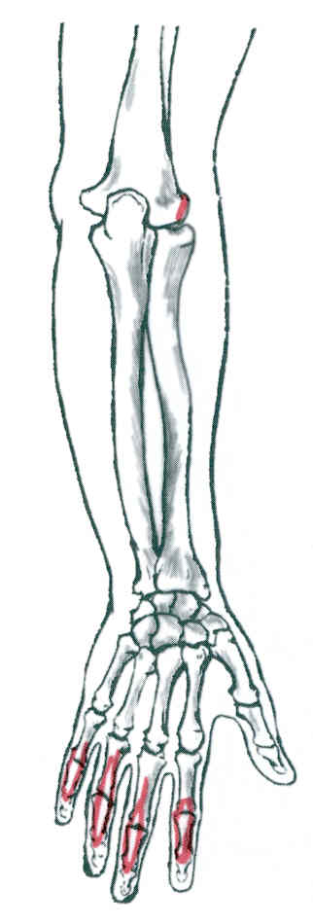
Extensor Digitorum
Origin:
  Lateral epicondyle of humerus
Insertion:
  4 tendons to bases of middle & distal phalanges of the 4 fingers

Slide 12
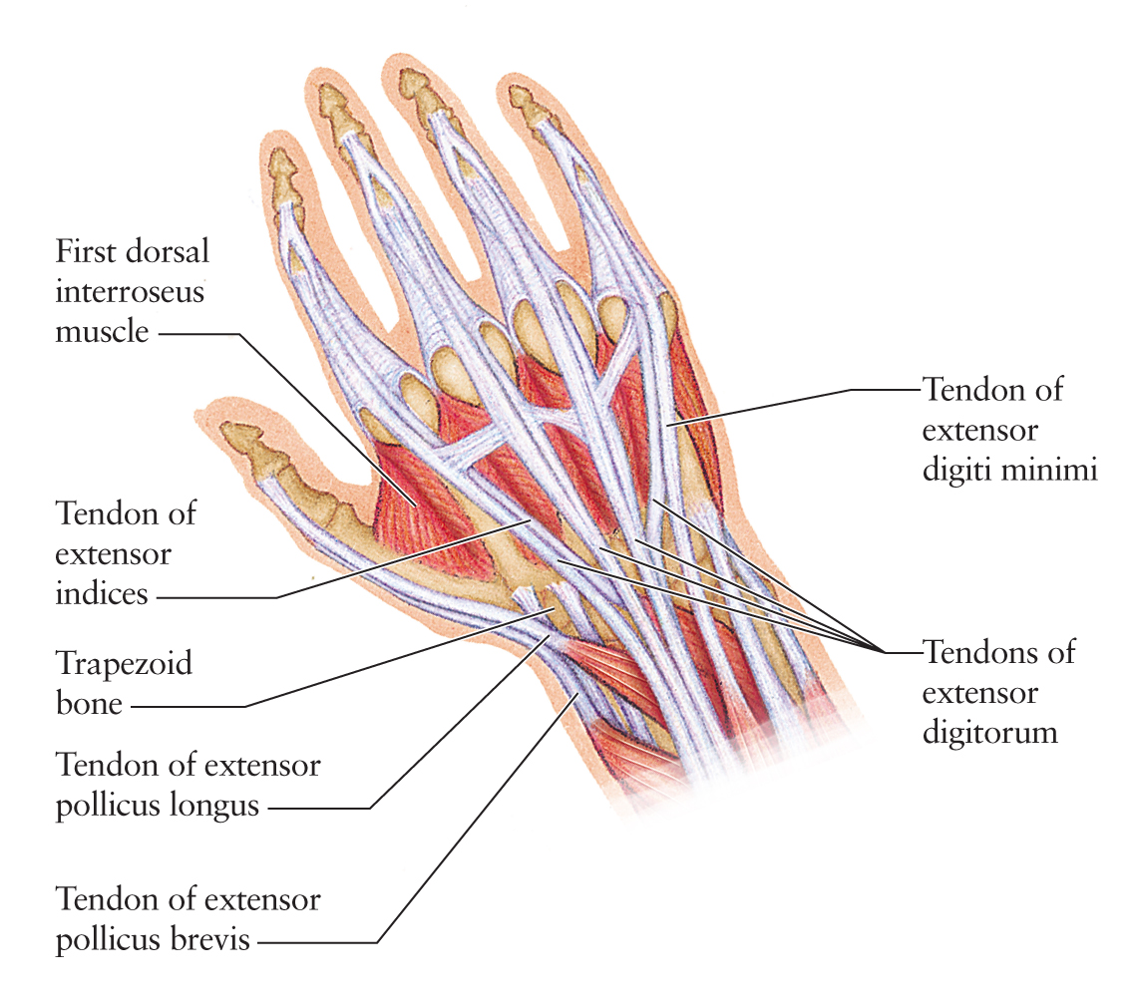

Slide 13
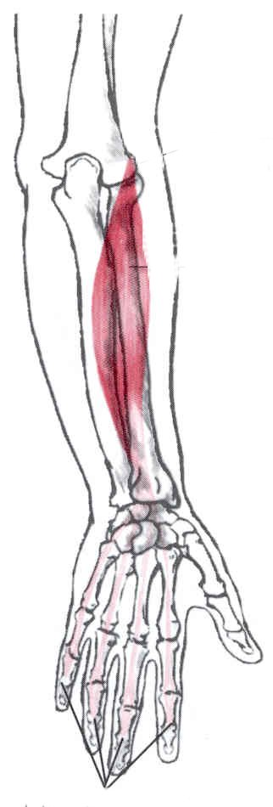
Extensor Digitorum
Action:
  Extension of 2nd, 3rd, 4th, 5th phalanges
  Extension of wrist
  Weak extension of wrist
Innervation:
  Radial nerve (C6,7,8)

Slide 14
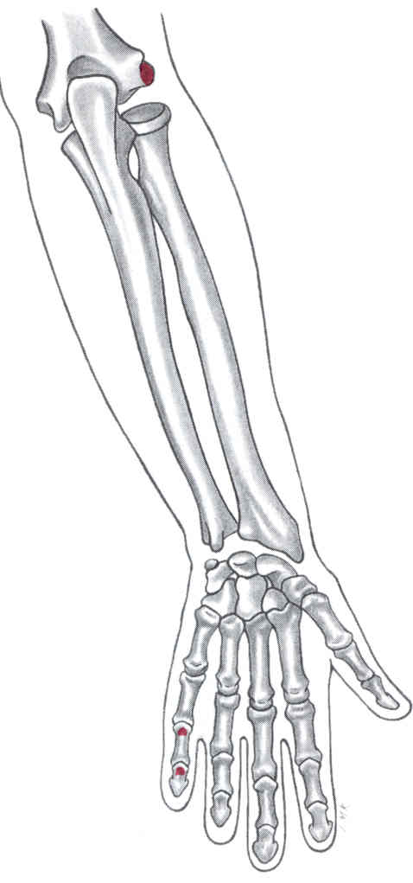
Extensor Digiti Minimi
Origin:
  Lateral epicondyle of humerus
Insertion:
  Base of middle & distal phalanxes of 5th phalange (dorsal surface)

Slide 15
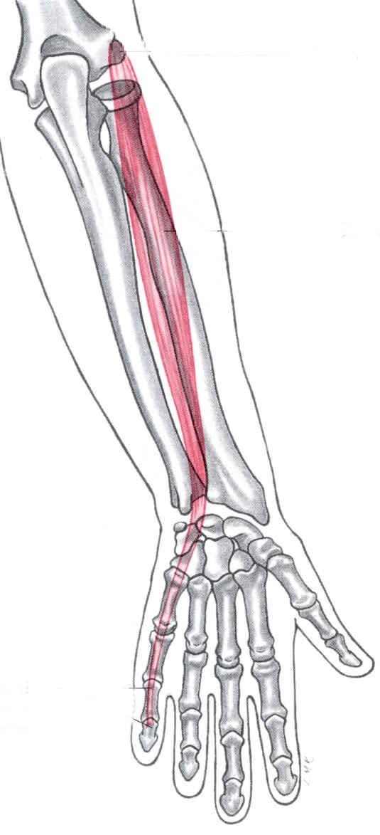
Extensor Digiti Minimi
Action:
  Extension of little finger
  Weak wrist extension
Innervation:
  Radial nerve (C6,7,8)

Slide 16
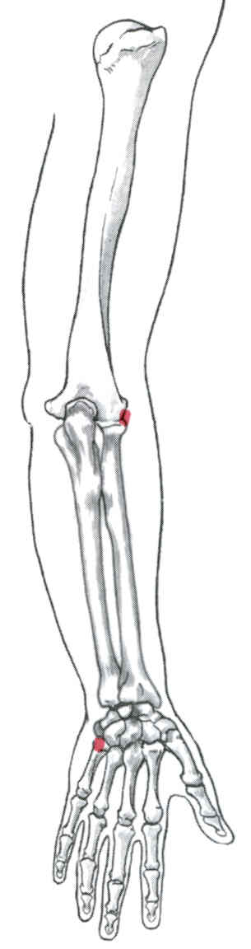
Extensor Carpi Ulnaris
Origin:
  Lateral epicondyle of humerus
Insertion:
  Base of 5th metacarpal (dorsal side)

Slide 17
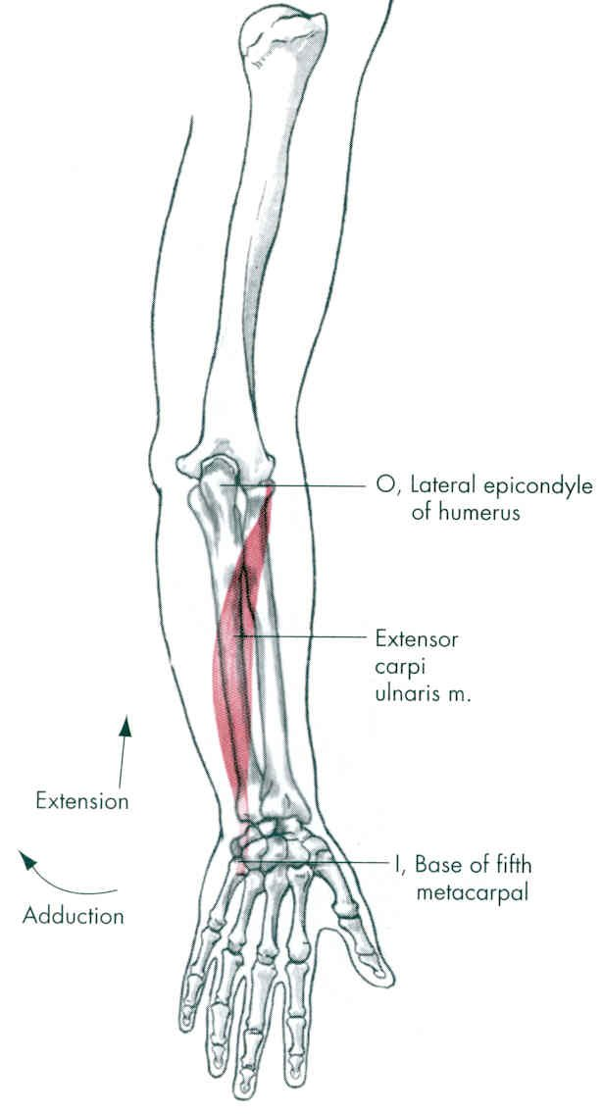
Extensor Carpi Ulnaris
Action:
  Extension of wrist
  Adduction of wrist
  Weak extension of elbow
Innervation:
  Radial nerve (C6,7,8)

Slide 18
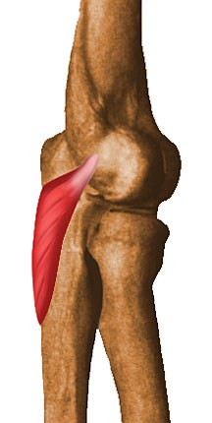
Anconeus
Origin:
origin from lateral epicondyle of humerus;
Insertion :
At posterolateral surface of olecranon process of ulna
• Action:
Extension of forearm at elbow
Nerve supply:
Radial nerve (C7, C8 and T1)

Slide 19
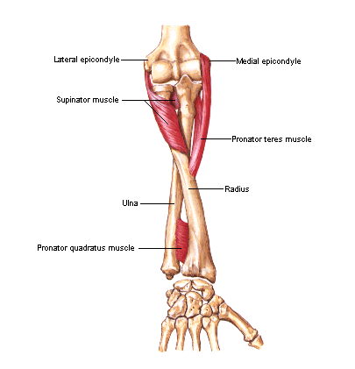
Deep Group
Supinator
Origin:
from lateral surface of olecranon,
lateral epicondyle &
elbow ligaments
Insertion:
posterior and lateral surface of proximal ¹/₃ of radius
• Actions: supination
Nerve Supply: Radial n.

Slide 20
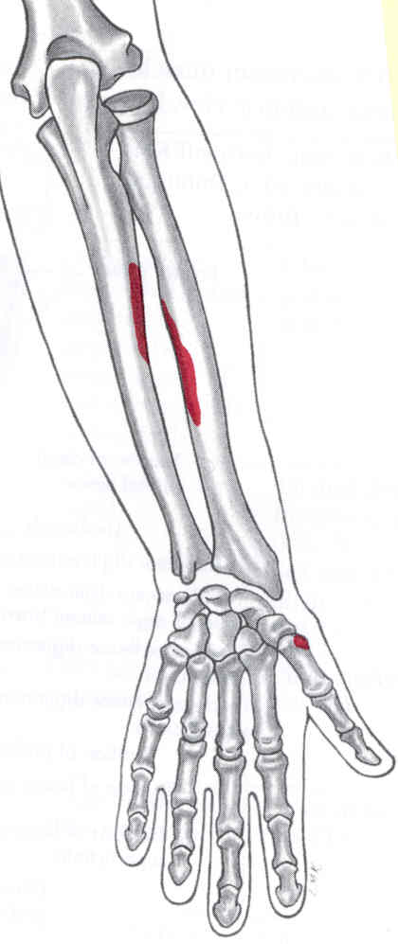
Abductor Pollicis Longus
Origin:
  Posterior aspect of radius
  Midshaft of ulna
Insertion:
  Base of 1st metacarpal (dorsal surface)

Slide 21
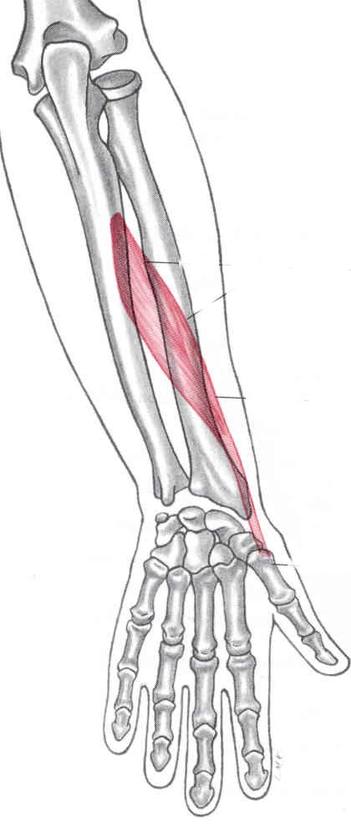
Abductor Pollicis Longus
Action:
  Abduction of thumb
  Abduction of wrist
Innervation:
  Radial nerve (C6, 7)

Slide 22
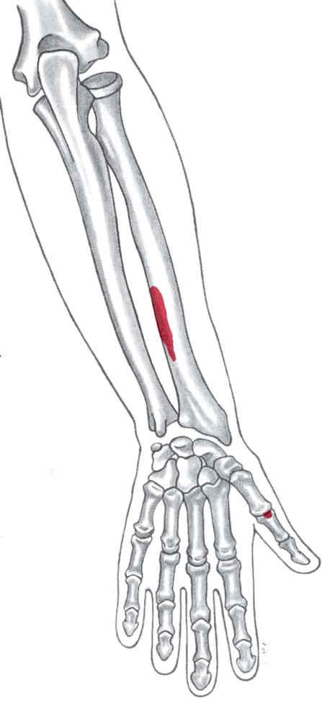
Extensor Pollicis Brevis
Origin:
  Posterior surface of lower middle radius
Insertion:
  Base of proximal phalanx of thumb (dorsal surface)

Slide 23
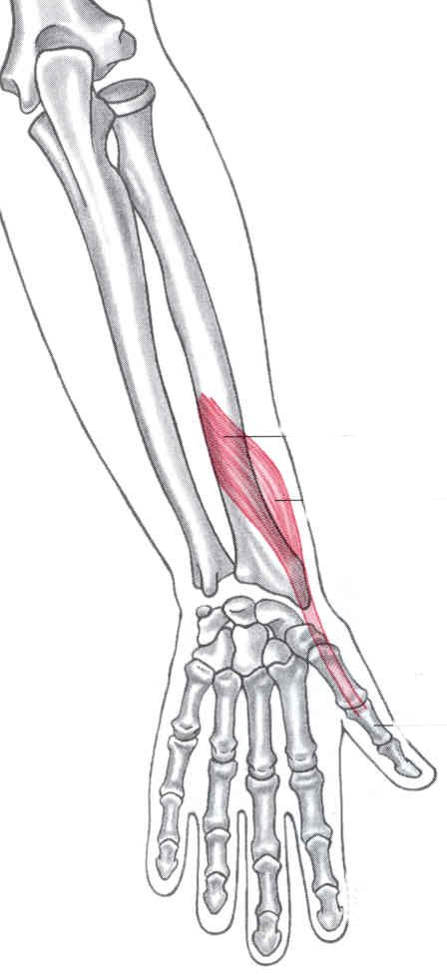
Extensor Pollicis Brevis
Action:
  Extension of thumb
  Weak extension of wrist
Innervation:
  Radial nerve (C6,7)

Slide 24
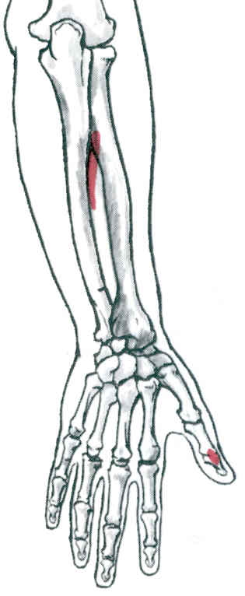
Extensor Pollicis Longus
Origin:
  Posterior lateral surface of lower middle ulna
Insertion:
  Base of distal phalanx of thumb (dorsal surface)

Slide 25
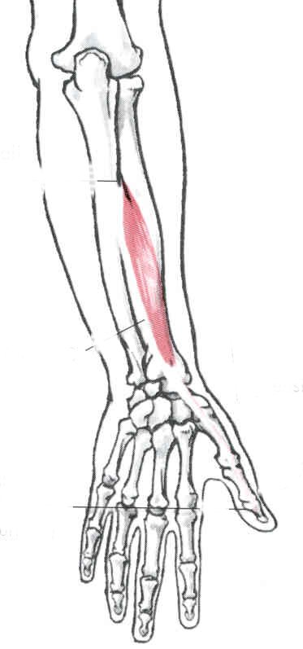
Extensor Pollicis Longus
Action:
  Extension of thumb
  Extension of wrist
Innervation:
  Radial nerve (C6,7,8)

Slide 26
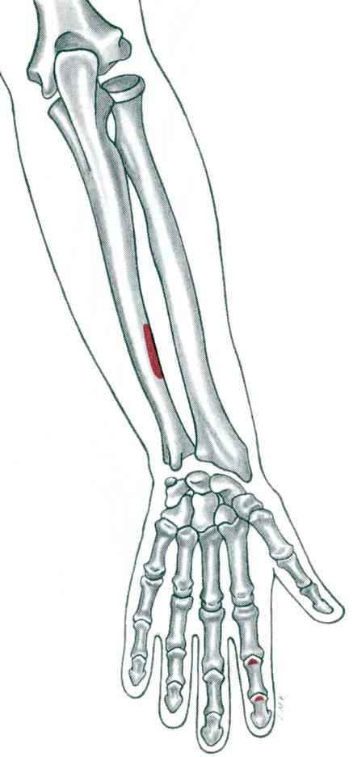
Extensor Indicis
Origin:
  Middle to distal 1/3 of posterior ulna
Insertion:
  Base of middle & distal phalanxes (dorsal surface)

Slide 27
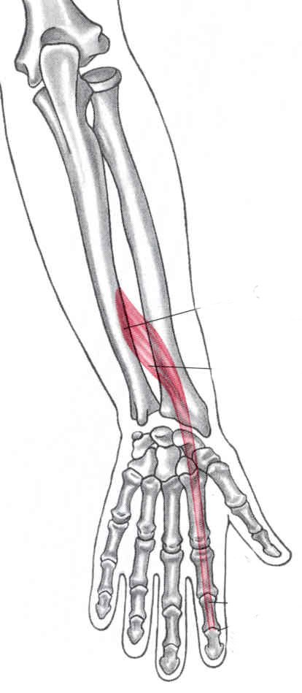
Extensor Indicis
Action:
  Extension of index finger
  Weak wrist extension
Innervation:
  Radial nerve (C6,7,8)

Slide 28
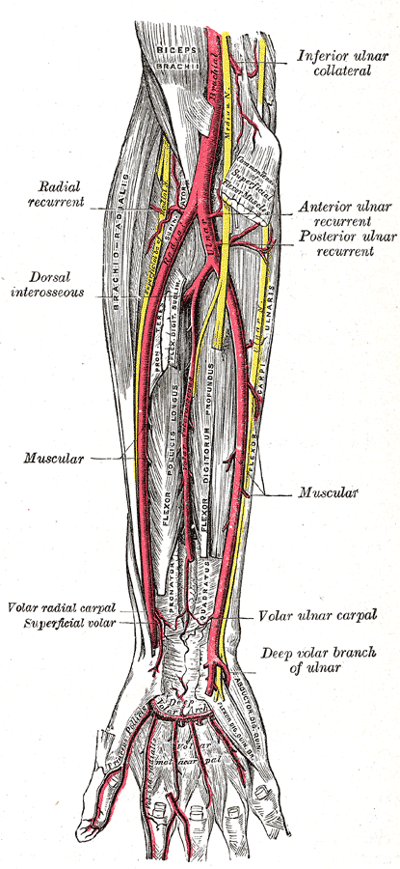
Blood supply of the posterior compartment
1-Radial artery
2-Posterior interosseous artery
origin:
common interosseous branch of the ulnar artery
recurrent interosseous artery
End by joining to dorsal carpal arch of the wrist
3-Anterior interosseous artery
origin:
common interosseous branch of the ulnar artery

Slide 29
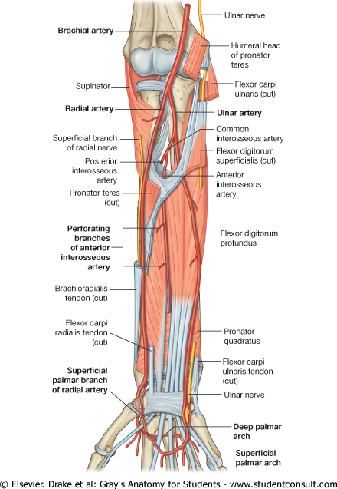
ARTERIES AND VEINS

Slide 30
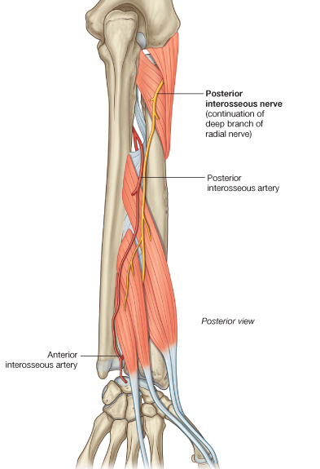
Posterior interosseous artery
POSTERIOR INTEROSSEOUS ARTERY
Branch of Common interosseous artery
Crosses over interosseous memb to reach post compartment.
Gives recurrent interosseous artery, which takes part in anastomosis around elbow joint .
Passes between supinator and abductor pollicis longus to supply superficial extensors.
Terminates by joining dorsal carpal arch of wrist after receiving terminal end of anterior interosseous artery.

Slide 31
ANTERIOR INTEROSSEOUS ARTERY
Branch of the common interosseous artery.
Situated in the anterior compartment of the forearm on the interosseous membrane.
Perforating branches, which pass through the interosseous membrane to supply deep muscles of the posterior compartment

Slide 32
VEINS
Deep veins of the posterior compartment generally accompany the arteries. They ultimately drain into brachial veins associated with the brachial artery in the cubital fossa.

Slide 33
POSTERIOR INTEROSSEOUS NERVE
Branch of radial nerve
Enters back between sup. &deep fibres of supinator
Runs on post surface of interrosseous memb up to wrist
Branches:
A: Muscular
B: Articular
C: Sensory

Slide 34
EXTENSOR COMPARTMENT :NERVE SUPPLY
  Anconeus
  Brachioradialis
  Extensor carpi radialis longus
  Extensor carpi radialis brevis
  Extensor digitorum
  Extensor digiti minimi
  Supinator
  Abductor pollicis longus Extensor pollicis longus
  Extensor pollicis brevis
  Extensor indicis
  Extensor carpi ulnaris
Aconeus
Brachioradialis
ECRL
Radial nerve
ECRB
ED
EDM
ECU
S
APL
EPB
EPL
EI
Posterior interosseous nerve

Slide 35
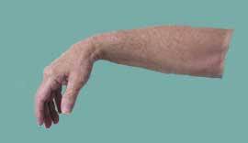
APPLIED ANATOMY
WRIST DROP: Injury to radial nerve above the origin of post interosseous nerve
Paralysis of extensor muscles of forearm
If deep branch of radial nerve is damaged
Ext carpi radialis longus and brevis are spared wrist drop is absent

Slide 36
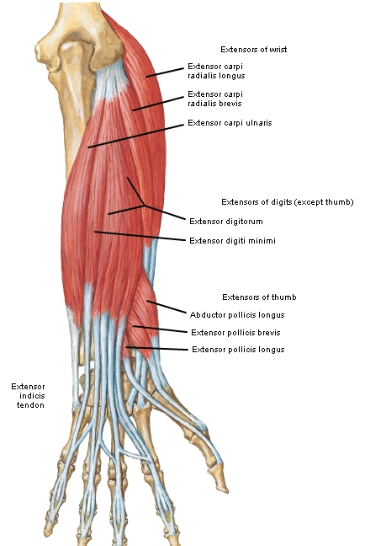

Muscles of the Forearm
Post View
Origin :Lateral epicondyle of humerus Insertion Lateral surface of olecranon and
superior part of posterior surface of ulna Action Assists triceps in extending forearm;
stabilizes elbow joint; abducts ulna during pronation Innervation Radial nerve (C7, C8 and T1)
Anconeus
Radial nerve innervates the BEST.
Brachioradialis
Extensors
Supinator
Triceps
Notes:
Origin :Lateral epicondyle of humerus Insertion Lateral surface of olecranon and
superior part of posterior surface of ulna Action Assists triceps in extending forearm;
stabilizes elbow joint; abducts ulna during pronation Innervation Radial nerve (C7, C8 and T1) Arterial
Supply Middle collateral branch of deep brachial artery
Recurrent interosseous artery

Slide 37
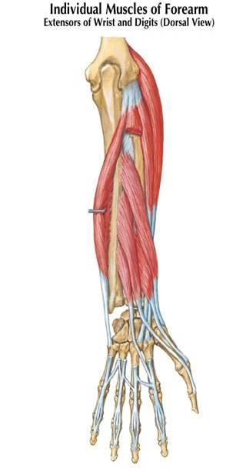
Deep posterior compartment.
- abductor pollicis longus
- extensor pollicis brevis
- extensor pollicis longus
- extensor indicis
- supinator
Functional organization:
extend hand at wrist
extend / abduct thumb
extend index finger
supinate
abductor pollucis longus
extensor pollicis brevis
extensor pollicis longus
extensor indicis

Slide 38
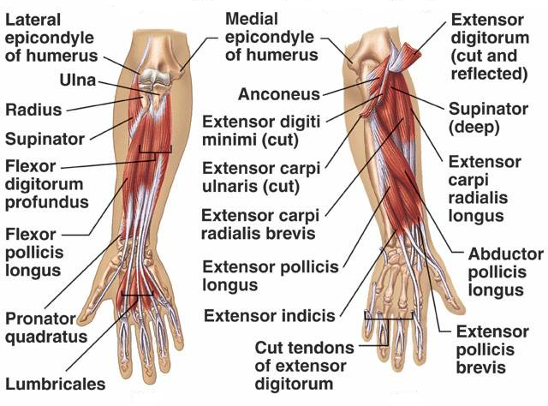
Deep Dissection Forearm
Ant
Post

Slide 39
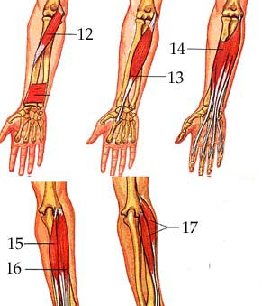
Quiz
12. Pronator Teres
13. Flexor carpi radialis:
14. Flexor Digitorum:
15. Extensor carpi ulnaris:
16. Extensor digitorum:
17. Extensor carpi radialis:

Slide 40
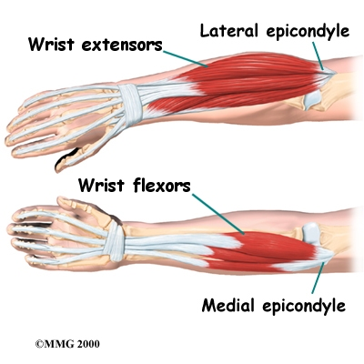
Common Extensor Origin
Common
Flexor
Origin

Slide 41


