Slide 1
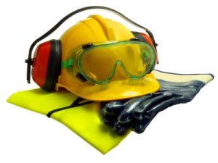
SAFETY and INJURY PREVENTION
PATH216
Mohamed M. B. Alnoor

Slide 2
CONTENT
Definition of injury
Causes of Accident
Epidemiologic Triangle
Impact of injury and accidents
Prevention of Injury

Slide 3
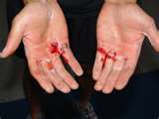
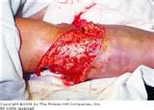
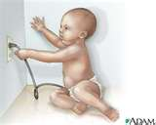
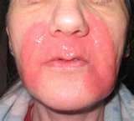
INJURY
Definition:
Injury: Physical damage due to transfer of energy
kinetic
thermal
electrical
chemical
radiant
Over a period of time: “exposure”
either acute or chronic

Slide 4
INJURY
Definition:
Injury, Not Accident!
Accident: An unexpected occurrence, happening by chance
Injury: a definable, understandable, predictable, preventable, correctable event, with specific risks for occurrence.
A result of poorly managed risk

Slide 5
INJURY
Definition:
“Disease of injury” concept
Epidemiologic Triangle
AGENT
A causal
relationship!
Environment
Host
“Prevention is the vaccine for the disease of injury.”

Slide 6
INJURY
Causes of Accident
Accidents are caused by:
Unsafe acts
Unsafe conditions
Most difficult to address
Changing behavior isn’t easy
Best prevented by developing a “safety culture”

Slide 7
INJURY
Causes of Accident
Unsafe Conditions
Easiest to correct (and very cost effective)
Easiest to prevent
Safety audits
Safety inspections
Maintenance schedules for equipment
Encouraging employee reporting
Good housekeeping

Slide 8
INJURY
Causes of Accident
Factors influencing Road Injuries,
The Haddon Matrix
ENVIRONMENT | VEHICLE | HUMAN
 |  |  | PRE EVENT
 |  |  | EVENT
 |  |  | POST EVENT

Slide 9
INJURY
Causes of Accident
Factors influencing Road Injuries,
The Haddon Matrix
ENVIRONMENT | VEHICLE | HUMAN
VISIBILITY PAVEMENT SIGNALS CONSTRUCTION | DEFECTS BREAKS TIRES AVOIDANCE SYSTEMS | AGE EXPERIENCE ALCOHOL DRUGS SPEED | PRE EVENT
GUARD RAILS MEDIANS BREAKAWAY POSTS | AIR BAGS AUTOMATIC BELTS CRASHWORTHINESS | BELT USE HELMET USE TOLERANCE | EVENT
EMS SYSTEM FIRST RESPONDER BYSTANDER CARE | POST-CRASH FUEL LEAKS FIRE | AGE PHYSICAL CONDITION | POST EVENT
Notes:
AVOIDANCE SYSTEMS: is a system of sensors that is placed within a car to warn its driver of any dangers that may lie ahead on the road.
TOLERANCE : a physical distance or space (tolerance), as in a truck (lorry), train or boat under a bridge as well as a train in a tunnel for safe passage.
Crashworthiness is the ability of a structure to protect its occupants during an impact.
EMS: emergency medical services may refer solely to the pre-hospital element of the care.
First responder: the first medically trained responder to arrive on scene of road injury (police, fire, EMS).

Slide 10
INJURY
Causes of Accident
Factors influencing Road Injuries,
The Haddon Matrix
ENVIRONMENT | VEHICLE | HUMAN
 |  | AGE EXPERIENCE ALCOHOL DRUGS SPEED | PRE EVENT
 |  |  | EVENT
 |  |  | POST EVENT

Slide 11
INJURY
Causes of Accident
Factors influencing Road Injuries,
The Haddon Matrix
ENVIRONMENT | VEHICLE | HUMAN
 | DEFECTS: BREAKS TIRES AVOIDANCE SYSTEMS | AGE EXPERIENCE ALCOHOL DRUGS SPEED | PRE EVENT
 |  |  | EVENT
 |  |  | POST EVENT

Slide 12
INJURY
Causes of Accident
Factors influencing Road Injuries,
The Haddon Matrix
ENVIRONMENT | VEHICLE | HUMAN
VISIBILITY PAVEMENT SIGNALS CONSTRUCTION | DEFECTS BREAKS TIRES AVOIDANCE SYSTEMS | AGE EXPERIENCE ALCOHOL DRUGS SPEED | PRE EVENT
 |  |  | EVENT
 |  |  | POST EVENT

Slide 13
INJURY
Causes of Accident
Factors influencing Road Injuries,
The Haddon Matrix
ENVIRONMENT | VEHICLE | HUMAN
VISIBILITY PAVEMENT SIGNALS CONSTRUCTION | DEFECTS BREAKS TIRES AVOIDANCE SYSTEMS | AGE EXPERIENCE ALCOHOL DRUGS SPEED | PRE EVENT
 |  | BELT USE HELMET USE TOLERANCE | EVENT
 |  |  | POST EVENT

Slide 14
INJURY
Causes of Accident
Factors influencing Road Injuries,
The Haddon Matrix
ENVIRONMENT | VEHICLE | HUMAN
VISIBILITY PAVEMENT SIGNALS CONSTRUCTION | DEFECTS BREAKS TIRES AVOIDANCE SYSTEMS | AGE EXPERIENCE ALCOHOL DRUGS SPEED | PRE EVENT
 | AIR BAGS AUTOMATIC BELTS CRASHWORTHINESS | BELT USE HELMET USE TOLERANCE | EVENT
 |  |  | POST EVENT

Slide 15
INJURY
Causes of Accident
Factors influencing Road Injuries,
The Haddon Matrix
ENVIRONMENT | VEHICLE | HUMAN
VISIBILITY PAVEMENT SIGNALS CONSTRUCTION | DEFECTS BREAKS TIRES AVOIDANCE SYSTEMS | AGE EXPERIENCE ALCOHOL DRUGS SPEED | PRE EVENT
GUARD RAILS MEDIANS BREAKAWAY POSTS | AIR BAGS AUTOMATIC BELTS CRASHWORTHINESS | BELT USE HELMET USE TOLERANCE | EVENT
 |  |  | POST EVENT

Slide 16
INJURY
Causes of Accident
Factors influencing Road Injuries,
The Haddon Matrix
ENVIRONMENT | VEHICLE | HUMAN
VISIBILITY PAVEMENT SIGNALS CONSTRUCTION | DEFECTS BREAKS TIRES AVOIDANCE SYSTEMS | AGE EXPERIENCE ALCOHOL DRUGS SPEED | PRE EVENT
GUARD RAILS MEDIANS BREAKAWAY POSTS | AIR BAGS AUTOMATIC BELTS CRASHWORTHINESS | BELT USE HELMET USE TOLERANCE | EVENT
 |  | AGE PHYSICAL CONDITION | POST EVENT

Slide 17
INJURY
Causes of Accident
Factors influencing Road Injuries,
The Haddon Matrix
ENVIRONMENT | VEHICLE | HUMAN
VISIBILITY PAVEMENT SIGNALS CONSTRUCTION | DEFECTS BREAKS TIRES AVOIDANCE SYSTEMS | AGE EXPERIENCE ALCOHOL DRUGS SPEED | PRE EVENT
GUARD RAILS MEDIANS BREAKAWAY POSTS | AIR BAGS AUTOMATIC BELTS CRASHWORTHINESS | BELT USE HELMET USE TOLERANCE | EVENT
 | POST-CRASH FUEL LEAKS FIRE | AGE PHYSICAL CONDITION | POST EVENT

Slide 18
INJURY
Causes of Accident
Factors influencing Road Injuries,
The Haddon Matrix
ENVIRONMENT | VEHICLE | HUMAN
VISIBILITY PAVEMENT SIGNALS CONSTRUCTION | DEFECTS BREAKS TIRES AVOIDANCE SYSTEMS | AGE EXPERIENCE ALCOHOL DRUGS SPEED | PRE EVENT
GUARD RAILS MEDIANS BREAKAWAY POSTS | AIR BAGS AUTOMATIC BELTS CRASHWORTHINESS | BELT USE HELMET USE TOLERANCE | EVENT
EMS SYSTEM FIRST RESPONDER BYSTANDER CARE | POST-CRASH FUEL LEAKS FIRE | AGE PHYSICAL CONDITION | POST EVENT

Slide 19
INJURY
Causes of Accident
Factors influencing Road Injuries,
The Haddon Matrix
ENVIRONMENT | VEHICLE | HUMAN
VISIBILITY PAVEMENT SIGNALS CONSTRUCTION | DEFECTS BREAKS TIRES AVOIDANCE SYSTEMS | AGE EXPERIENCE ALCOHOL DRUGS SPEED | PRE EVENT
GUARD RAILS MEDIANS BREAKAWAY POSTS | AIR BAGS AUTOMATIC BELTS CRASHWORTHINESS | BELT USE HELMET USE TOLERANCE | EVENT
EMS SYSTEM FIRST RESPONDER BYSTANDER CARE | POST-CRASH FUEL LEAKS FIRE | AGE PHYSICAL CONDITION | POST EVENT
Notes:
AVOIDANCE SYSTEMS: is a system of sensors that is placed within a car to warn its driver of any dangers that may lie ahead on the road.
TOLERANCE : a physical distance or space (tolerance), as in a truck (lorry), train or boat under a bridge as well as a train in a tunnel for safe passage.
Crashworthiness is the ability of a structure to protect its occupants during an impact.
EMS: emergency medical services may refer solely to the pre-hospital element of the care.

Slide 20
INJURY
Injury Prevention
Categories of injury prevention:
Primary prevention:
Secondary prevention:
Tertiary prevention:
PRE EVENT
Eliminate the event
EVENT
Diminish effect
POST EVENT
Improve outcomes

Slide 21
INJURY
Cost of Accidents
Direct Costs
Medical Costs(including worker’s compensation)
Indemnity Payments
Indirect Costs
Time Lost (by worker and supervisor)
Schedule delays
Training new employees
Cleanup time / equipment repairs
Legal fees

Slide 22
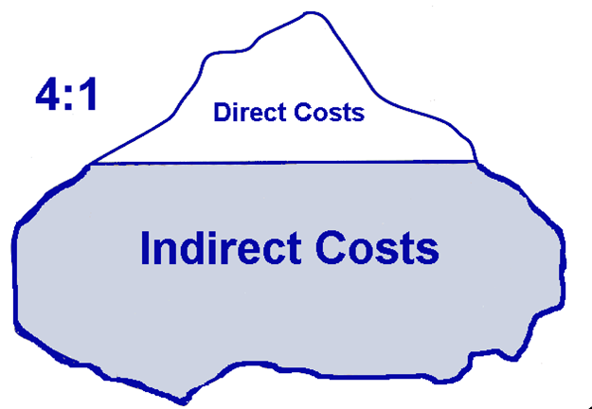
INJURY
Cost of Accidents
The Iceberg Effect
On average, the indirect costs of accidents exceed the direct costs by a 4:1 ratio

Slide 23
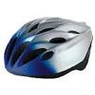
INJURY
Injury Prevention
Strategies of injury prevention:
Examples of effective injury prevention:
Highway speed limits
“Cycle” helmet laws
Child passenger restraint laws
Smoke detectors
Apartment window guards

Slide 24
INJURY
Injury Prevention
Safety Cultures
Establish accountability for safety
Define safety responsibilities

Slide 25
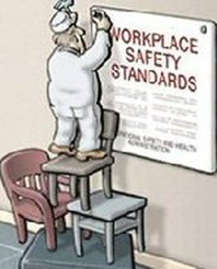
INJURY
Injury Prevention
Safety Cultures
Establish accountability
for safety
Employees should be
evaluated on their safety
Performance: Doing a job
correctly includes doing
it safely

Slide 26
INJURY
Injury Prevention
Safety Cultures
Define safety responsibilities
Employee responsibilities include
Maintaining good housekeeping
Recognizing and reporting safety hazards
Using personal protective equipment (PPE)

Slide 27
INJURY
Injury Prevention
Safety Cultures
Define safety responsibilities
Employer responsibilities include
Providing access to information
Providing personal protective equipment
Providing training

